Slide 1



Slide 3
Staying Strong
WHEN LIFE SEEMS EASY

Slide 4
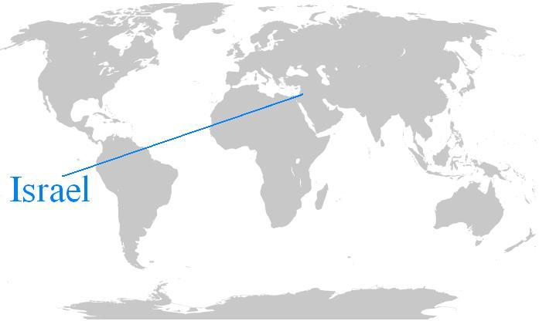

Slide 5
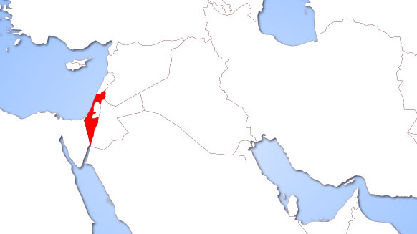
Israel

Slide 6
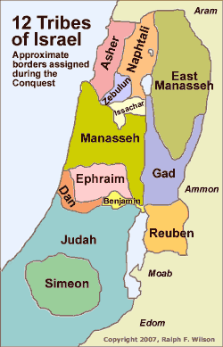
Israel

Slide 8
1
Do things that are Beneficial

Slide 9
Half the tribe of Manasseh
and the tribes of Reuben and Gad
had already received their grants of land
on the east side of the Jordan
Joshua 13:8
New Living Translation

Slide 10
Half the tribe of Manasseh
and the tribes of Reuben and Gad
had already received their grants of land
on the east side of the Jordan
Joshua 13:8
New Living Translation

Slide 11
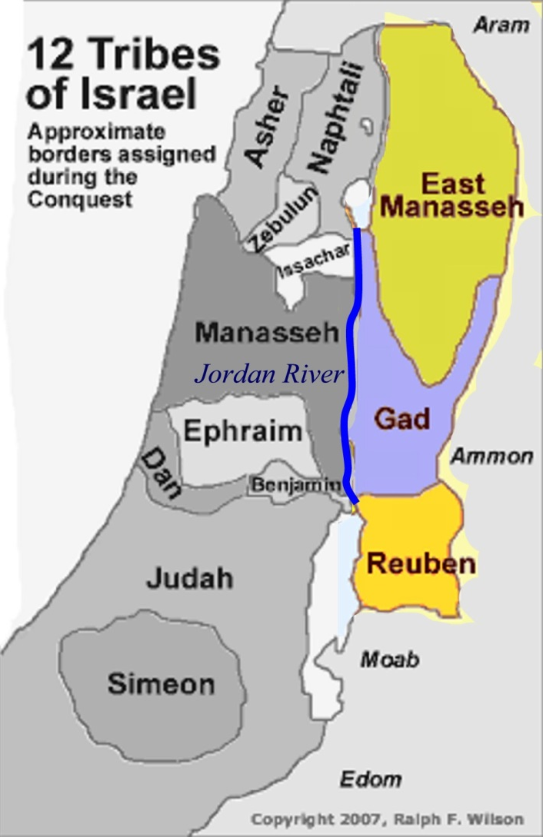
Half the tribe of Manasseh
and the tribes of Reuben and Gad
had already received their grants of land
on the east side of the Jordan
Joshua 13:8
New Living Translation

Slide 13
You say, “I am allowed to do anything”
—but not everything is good for you.
You say, “I am allowed to do anything”
—but not everything is beneficial
1 Corinthians 10:23
New Living Translation

Slide 15
“they do not belong to the world,
just as I do not belong to the world…
18 Just as you sent me into the world,
I am sending them into the world.”
John 17:14, 18
New living translation

Slide 16
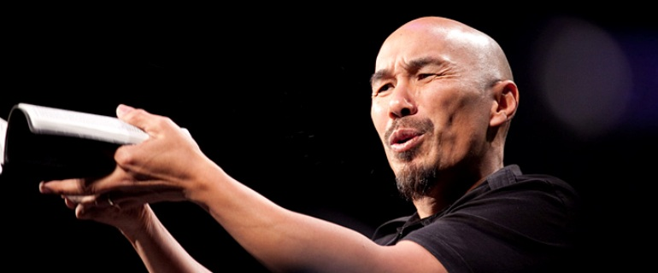
Francis Chan

Slide 17
1. Lukewarm people attend church fairly regularly.
2. Lukewarm people give money
3. Lukewarm people tend to choose
what is popular over what is right
4. Lukewarm people don’t really want to be saved from their sin; they want only to be saved from the penalty of their sin.
5. Lukewarm people are moved by stories of people who do radical things for Christ, yet they do not act.
6. Lukewarm people rarely share their faith
with their neighbors, coworkers, or friends.

Slide 18
7. Lukewarm people gauge their morality or “goodness”
by comparing themselves to the secular world.
8. Lukewarm people say they love Jesus, and He is, indeed,
a part of their lives, their money, and their thoughts,
but he isn’t allowed to control their lives.
9. Lukewarm people love God, but they do not love Him all their heart, soul, and strength.
10. Lukewarm people love others but do not seek to love others
as much as they love themselves.
11. Lukewarm people will serve God and others, but there are limits to how far they will go or how much time, money,
and energy they are willing to give.
12. Lukewarm people think about life on earth
much more often than eternity in heaven.

Slide 19
13. Lukewarm people are thankful for their luxuries and comforts, and rarely consider trying to give as much as possible to the poor.
14. Lukewarm people do whatever is necessary
to keep themselves from feeling too guilty.
15. Lukewarm people are continually concerned with playing it safe; they are slaves to the god of control.
16. Lukewarm people feel secure
17. Luke warm people do not live by faith;
their lives are structured so they never have to.
18. Lukewarm people probably drink and swear less than average, but besides that, they really aren’t very different
from your typical unbeliever.

Slide 21
Look Forward
2
TO CHRIST’S RETURN

Slide 22
Moses did not assign any allotment of land
to the tribe of Levi. Instead, as the Lord had promised them, their allotment came from the offerings burned on the altar to the Lord, the God of Israel.
Joshua 13:14
New living translation

Slide 23
“Our Lord, come!”
In Aramaic this expression is Maranatha
1 Corinthians 16:22
New living translation

Slide 24
Holy and godly lives you should live,
looking forward to the day of God
2 peter 3:11-12
New living translation

Slide 26
Never give up
3

Slide 27
Today I am eighty-five years old.
I am as strong now as I was when Moses
sent me on that journey, and I can still travel and fight as well as I could then.
So give me the hill country
that the Lord promised me.
Joshua 14:10-12
New living translation

Slide 28
That is why we never give up.
Though our bodies are dying,
our spirits are being renewed every day.
1 Corinthians 4:16
New living translation

Slide 30
Be an example
4
TO OTHERS

Slide 31
She said, “Give me another gift.
You have already given me land in the Negev; now please give me
springs of water, too.”
So Caleb gave her the
upper and lower springs.
Joshua 15:19
New Living Translation

Slide 32
Students are not greater than their teacher. But the student who is fully trained
will become like the teacher.
Luke 6:40
New Living Translation

Slide 33
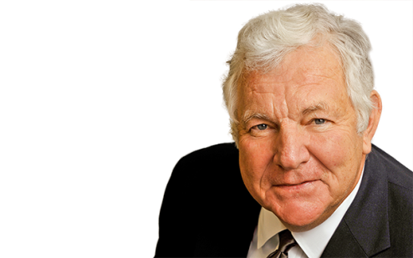
“We—all of us, but especially the young—need around us individuals who possess a certain nobility, a largeness of soul, and qualities of human experience worth imitating and striving for.”
William J. Bennett
former US Secretary of Education

Slide 35
5
Attempt Great Things
FOR GOD

Slide 36
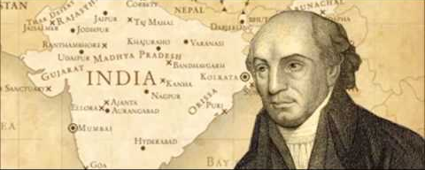
Expect great things from God;
attempt great things for God!
William Carey
missionary to india

Slide 38
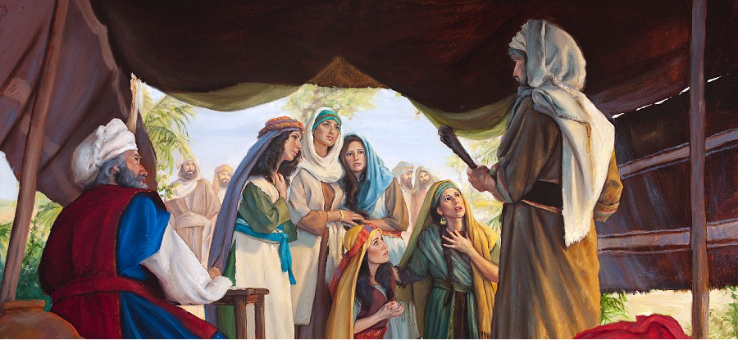

Slide 39
“The Lord commanded Moses
to give us a grant of land
along with the men of our tribe.”
So Joshua gave them a grant of land
along with their uncles,
as the Lord had commanded.
Joshua 17:4
New Living Translation

Slide 40
The claim of the daughters of Zelophehad is legitimate. You must give them a grant of land along with their father’s relatives. Assign them the property that would have been given to their father. “And give the following instructions to the people of Israel: If a man dies and has no son, then give his inheritance to his daughters.
Numbers 27:7-8
New Living Translation

Slide 42
6
Talk less
DO MORE

Slide 43
Israel

Slide 44
If there are so many of you,
and if the hill country of Ephraim is not large enough for you,
clear out land for yourselves…
Joshua 17:15
New Living Translation

Slide 45
But don’t just listen to God’s word.
You must do what it says.
Otherwise, you are only fooling yourselves.
James 1:22
New Living Translation

Slide 47
7
Find Refuge
I N J E S U S

Slide 48
Anyone who kills another person accidentally
and unintentionally can run to one of these cities; they will be places of refuge from relatives seeking revenge for the person who was killed.
Joshua 20:3
New Living Translation

Slide 49
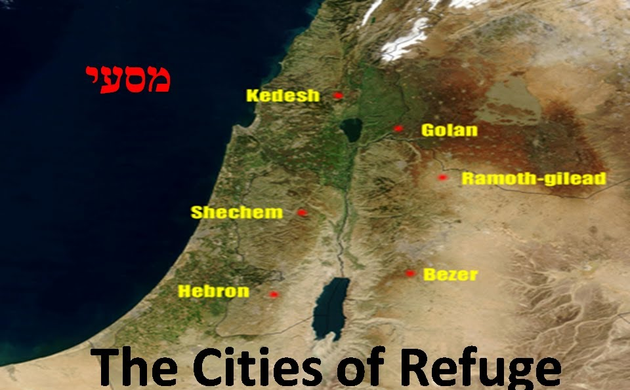

Slide 51
Do things that are Beneficial
Look Forward to Christ’s Return
Never Give Up
Be An Example to Others
Attempt Great Things for God
Talk Less, Do More
Find Refuge in Jesus

