Slide 2
Move on
JOSHUA 1

Slide 3
ISRAEL
40 YEARS
EGYPT

Slide 4
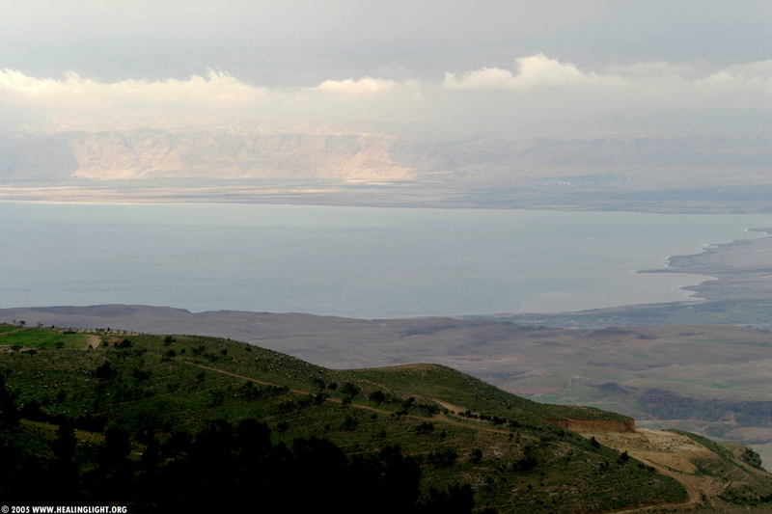
“Then Moses went up to Mount Nebo from the plains of Moab and climbed Pisgah Peak, which is across from Jericho. And the Lord showed him the whole land…” Deuteronomy 34:1
MT. NEBO

Slide 5
DON’T
1
GET DISCOURAGED AND QUIT

Slide 6
“after the death of Moses…”
JOSHUA 1:1 New Living Translation

Slide 7
“There has never been another prophet in Israel like Moses, whom the Lord knew face to face.”
DEUTERONOMY 34 :10
New Living Translation

Slide 8
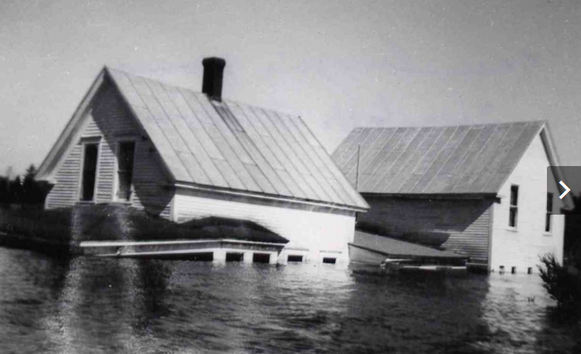
“Where there is no faith in the future, there is no power in the present.”
FLAGSTAFF, MAINE
1950
Halford Luccock “Unfinished Business”

Slide 9
DON’T
2
TAKE THE EASY WAY OUT

Slide 10
“Be strong and courageous,
for you are the one
who will lead these people.”
Joshua 1:6 new Living Translation

Slide 11
“the easy road is almost never the best road”
-Ray JOHNSTON

Slide 12
“When God wants you to go without, Satan will attempt to meet your needs.”
Ray JOHNSTON

Slide 13
DON’T
3
THINK YOU KNOW BETTER THAN GOD

Slide 14
“We can’t go up against them! They are stronger than we are!” So they spread this bad report about the land among the Israelites”
NUMBERS 13:31-32 New Living Translation

Slide 15
The ten men Moses had sent to explore the land—the ones who incited rebellion against the Lord with their bad report— were struck dead with a plague before the Lord. Of the twelve who had explored the land, only Joshua and Caleb remained alive.
NUMBERS 14:36-38 New Living Translation

Slide 16
“I never met a Christian who sat down and planned to live a mediocre life.”
-Howard Hendricks

Slide 17
DON’T
4
develop destructive
lifestyle patterns

Slide 18
Then the Lord said,
“I have seen how
stubborn and rebellious
these people are.
Exodus 32:9 new Living Translation

Slide 19
Move on
BETTER DAYS ARE AHEAD

