Slide 2
God blesses
those who mourn

Slide 3
MATTHEW 5:4 NLT
God blesses those who mourn, for they will be comforted.

Slide 5
1
There are
times to mourn

Slide 6
Ecclesiastes 3: 1 and 4 (New Living Translation) For everything there is a season, a time for every activity under heaven…
…a time to cry and a time to laugh. A time to grieve and a time to dance.

Slide 7
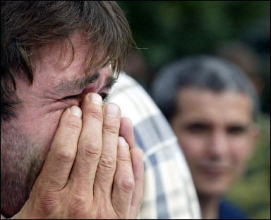

Slide 8
John 11:33-38 (New Living Translation) When Jesus saw her weeping and saw the other people wailing with her, a deep anger welled up within him, and he was deeply troubled. “Where have you put him?” he asked them. They told him, “Lord, come and see.” Then Jesus wept… 38 Jesus was still angry as he arrived at the tomb.

Slide 9
Isaiah 53:3-4 NLT a man of sorrows, acquainted with deepest grief.
We turned our backs on him and looked the other way.
He was despised, and we did not care.
Yet it was our weaknesses he carried;
it was our sorrows that weighed him down.

Slide 11
2
Grieving is
essential for our health

Slide 12
Psalm 32:3 (new century version) When I kept things to myself, I felt weak deep inside me. I moaned all day long.

Slide 13
Psalm 39:2 (English Standard Version) I was silent and held my peace to no avail. My distress only grew worse.

Slide 15
3
God is
always with us

Slide 16
Psalm 34:18 NIV The Lord is close to the brokenhearted, and he saves those whose spirits have been crushed.
Hebrews 13:5
I will never leave you and I will never abandon you.

Slide 18
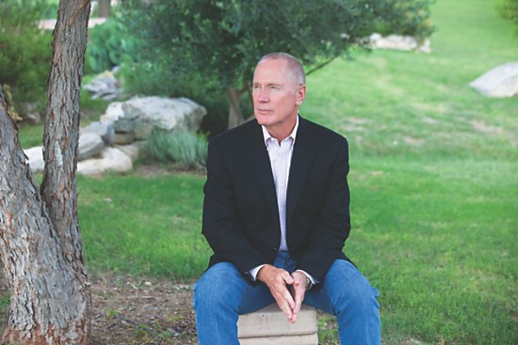
Max Lucado pastor and author

Slide 20
4
God uses grief
to help us grow

Slide 21
God uses pain to get our attention
Proverbs 20:30 (TEV) Sometimes it takes a painful experience to make us change our ways.

Slide 22
He brings good out of bad
Genesis 50:20 NLT
You intended to harm me, but God intended it all for good. He brought me to this position so I could save the lives of many people.

Slide 24
5
God uses our pain
to comfort others

Slide 25
2 Corinthians 1:4 NLT He comforts us in all our troubles so that we can comfort others. When they are troubled, we will be able to give them the same comfort God has given us.

Slide 27
6
God prepares us
for eternity

Slide 28
2 Corinthians 4:17 ESV For this light momentary affliction is preparing for us an eternal weight of glory beyond all comparison,

Slide 29
Revelation 21:3-4 NLT God’s home is now among his people! He will live with them, and they will be his people. God himself will be with them. He will wipe every tear from their eyes, and there will be no more death or sorrow or crying or pain. All these things are gone forever.

Slide 31
G R I E V E

Slide 32
G rieving is good R epression is unhealthy I nseparable Love of God E ndurance is developed V alue for others E ternity is better

