Slide 2
OUT
O F T H E
COMFORT
ZONE

Slide 3
EXPECT
THE UNEXPECTED

Slide 5
EXPECT GOD TO TURN THE UNEXPECTED
1
INTO GAIN

Slide 6
A great wave of persecution began that day, sweeping over the church in Jerusalem; and all the believers except the apostles were scattered through the regions of Judea and Samaria. ...
…but the believers who were scattered preached the Good News about Jesus wherever they went. Philip, for example, went to the city of Samaria and told the people there about the Messiah.…
…So there was great joy in that city.
Acts 8: 1,4-5,8
new living translation

Slide 7
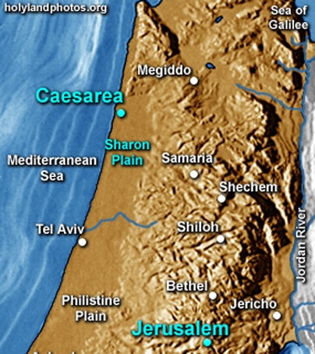

Slide 9
EXPECT GOD TO KNOW THE UNEXPECTED
2
HEART

Slide 10
“You can have no part in this, for your heart is not right with God.”
Acts 8:21 new living translation

Slide 11
“Then he said to them, “You like to appear righteous in public, but God knows your hearts. What this world honors is detestable in the sight of God.”
Luke 16:15 new living translation

Slide 12
“On judgment day many will say to me, ‘Lord! Lord! We prophesied in your name and cast out demons in your name and performed many miracles in your name.’ But I will reply, ‘I never knew you. Get away from me, you who break God’s laws.’”
Matthew 7:22-23 new living translation

Slide 13
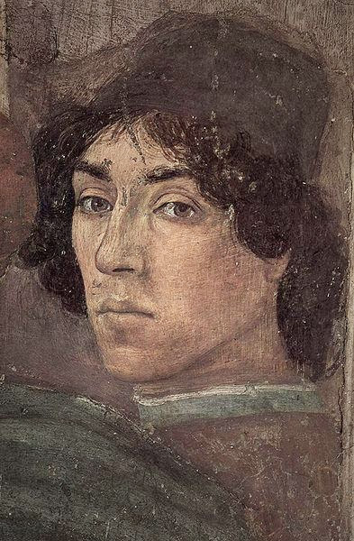

Slide 15
3
EXPECT THAT GOD HAS SCHEDULED UNEXPECTED
APPOINTMENTS

Slide 16
As for Philip, an angel of the Lord said to him, “Go south down the desert road that runs from Jerusalem to Gaza.”
Acts 8:26 new living translation

Slide 17
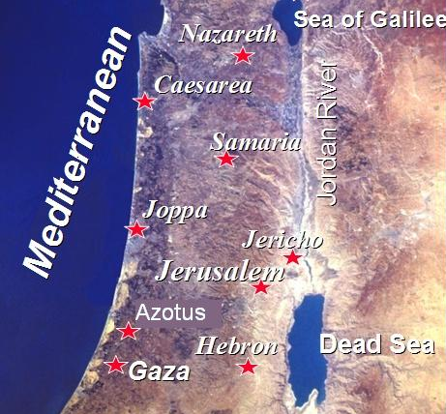

Slide 19
4
EXPECT GOD TO REACH OUT TO
UNEXPECTED PEOPLE

Slide 20
“So he started out, and he met the treasurer of Ethiopia, a eunuch of great authority under the Kandake, the queen of Ethiopia. The eunuch had gone to Jerusalem to worship, and he was now returning. Seated in his carriage, he was reading aloud from the book of the prophet Isaiah.”
Acts 8:27-28 new living translation

Slide 21
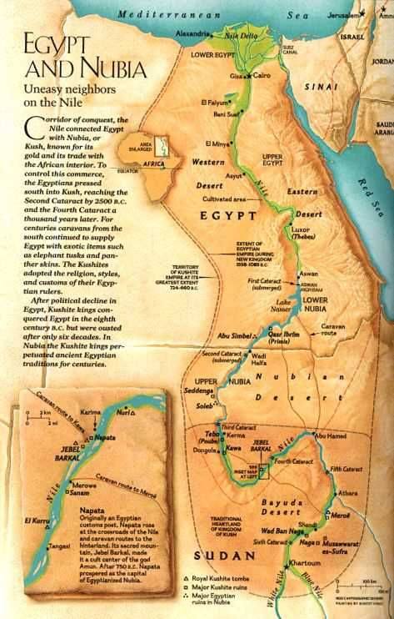
NUBIA

Slide 22
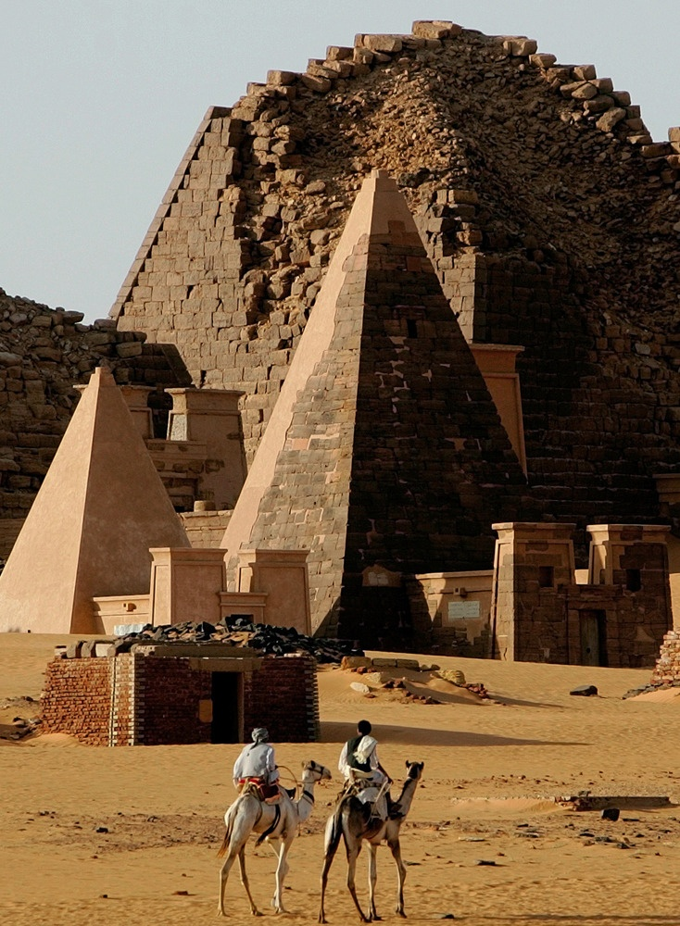
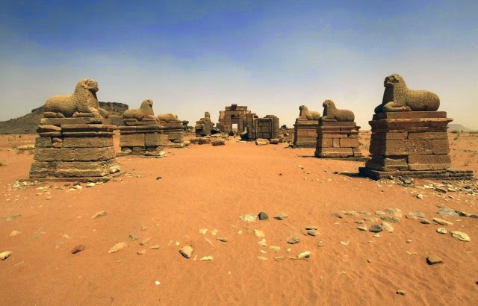

Slide 23
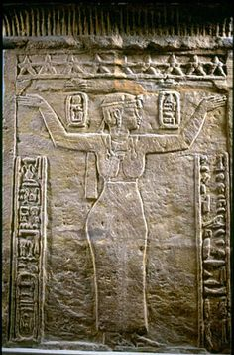
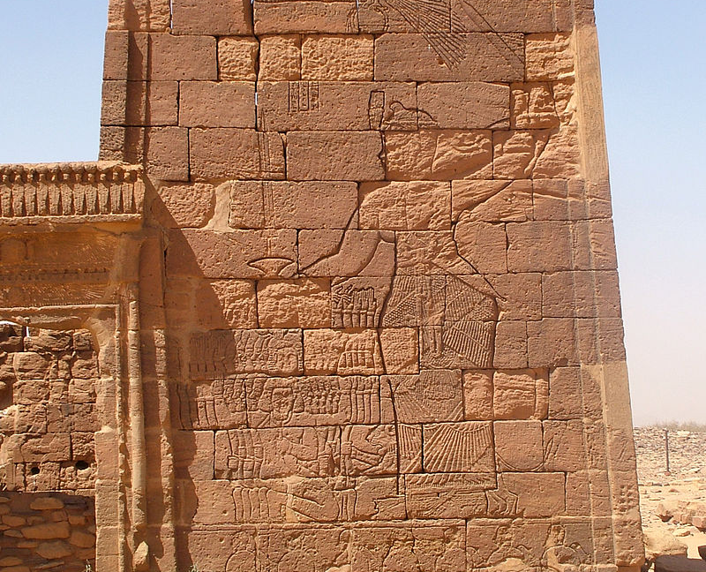

Slide 24
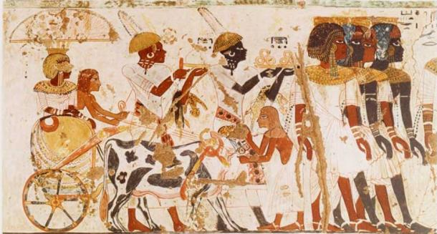

Slide 25
“So he started out, and he met the treasurer of Ethiopia, a eunuch of great authority under the Kandake, the queen of Ethiopia. The eunuch had gone to Jerusalem to worship, and he was now returning. Seated in his carriage, he was reading aloud from the book of the prophet Isaiah.”
Acts 8:27-28 new living translation

Slide 27
“He was led like a sheep to the slaughter.
And as a lamb is silent before the shearers,
he did not open his mouth.
33 He was humiliated and received no justice.
Who can speak of his descendants?
For his life was taken from the earth.” (Isaiah 53)
The eunuch asked Philip, “Tell me, was the prophet talking about himself or someone else?” So beginning with this same Scripture, Philip told him the Good News about Jesus.
Acts 8:32-35 new living translation

Slide 28
This is what the Lord says:
“Be just and fair to all. Do what is right and good,
for I am coming soon to rescue you and to display my righteousness among you.
Blessed are all those who are careful to do this.
Blessed are those who honor my Sabbath days of rest
and keep themselves from doing wrong.
Isaiah 56:1-2 new living translation

Slide 29
“Don’t let foreigners who commit themselves to the Lord say,
‘The Lord will never let me be part of his people.’
And don’t let the eunuchs say,
‘I’m a dried-up tree with no children and no future.’
For this is what the Lord says:
I will bless those eunuchs
who keep my Sabbath days holy
and who choose to do what pleases me
and commit their lives to me.”
Isaiah 56: 3-4 new living translation

Slide 31
When you feel like an “outsider,” REMEMEBER GOD WELCOMES YOU IN
If you think you’re an “insider,” REMEMEBER TO GO NEAR THE “OUTSIDER.”

Slide 33
EXPECT
THE UNEXPECTED

