Slide 3
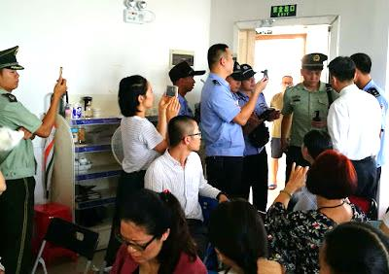
Pastor Huang Xiaoning Bible Reformed Church
with his family.

Slide 4
Fort Leonard Wood Missouri
1,839 soldiers professions of faith in Jesus.

Slide 5
Living in the goodness of God
How to be Led by God

Slide 7
The Lord is my shepherd;
I have all that I need.
He lets me rest in green meadows;
he leads me beside peaceful streams.
He renews my strength.
He guides me along right paths,
bringing honor to his name.
Psalm 23:1-3

Slide 8
Psalm 23

Slide 10
Stop copying the behaviors and values of the world
“give your bodies to God because of all he has done for you. Let them be a living and holy sacrifice—the kind he will find acceptable. This is truly the way to worship him. Don’t copy the behavior and customs of this world…” romans 12:1-2

Slide 11
Psalm 23

Slide 12
Stop letting friends set the agenda of your life!
“Don’t be fooled by those who say such things, for
“bad company corrupts good character.” 1 Corinthians 15:33

Slide 13
Psalm 23

Slide 14
Stop Looking for Other sources of Advice
“Never look to psychics or séances or fortunetelling or the stars, or people who claim to contact the dead. People who do these things are doing evil and God hates it with a passion.” Deuteronomy 18:10-12

Slide 15
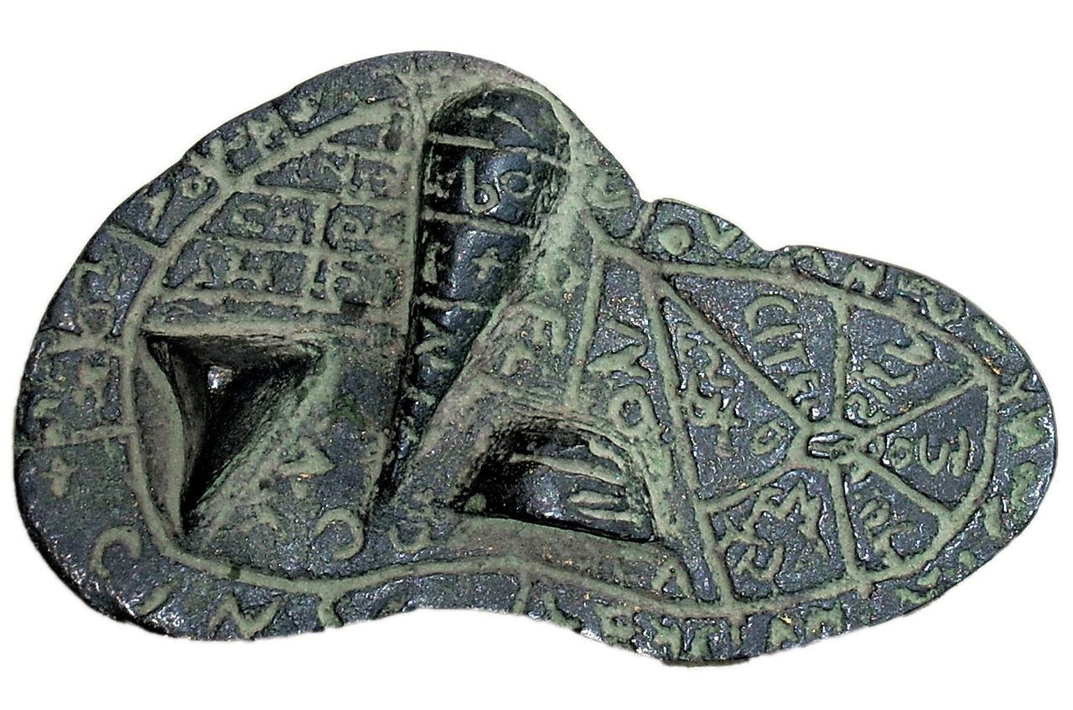

Slide 16
Psalm 23

Slide 17
“The king of Babylon now stands at the fork, uncertain whether to attack Jerusalem or Rabbah. He calls his magicians to look for omens. They cast lots by shaking arrows from the quiver. They inspect the livers of animal sacrifices.”
Ezekiel 21:21

Slide 18
Psalm 23

Slide 19
Stop depending only on Circumstances
“Even Satan disguises himself as an angel of light.”
2 Corinthians 11:14

Slide 20
Psalm 23

Slide 21
Stop following your feelings
Next to them we felt like grasshoppers, and that’s what they thought, too!”
Numbers 13:33

Slide 22
Psalm 23

Slide 23
Letting God Lead

Slide 24
1
Start wanting to be led

Slide 25
Let God transform you into a new person by changing the way you think.
Romans 12:2
As the deer longs for streams of water,
so I long for you, O God.
Psalm 42:1

Slide 27
2
Start following God’s Directions

Slide 28
Choose today whom you will serve. Would you prefer the gods your ancestors served beyond the Euphrates? Or will it be the gods of the Amorites in whose land you now live? But as for me and my family,
we will serve the LORD.”
Joshua 24:15

Slide 30
3
Start Reading the Bible

Slide 31
Don’t copy the behavior and customs of this world,
but let God transform you into a new person by changing the way you think. Then you will learn to know God’s will for you,
which is good and pleasing and perfect.
Romans 12:2

Slide 33
4
Start Asking the Holy Spirit to be Our Guide

Slide 34
“…the Holy Spirit—he will teach you everything and will remind you of everything I have told you.”
john 14:26

Slide 36
5
Start waiting on God’s Timing

Slide 37
Each morning I bring my requests to you and wait expectantly.
Psalm 5:3

Slide 38
Psalm 23

Slide 39
1. Does it Agree with the Bible?
2. Does it Make Me More Like Christ?
3. Does my Church Family Confirm it?
4. Do You Sense God’s Peace about it?

Slide 40
Psalm 23

Slide 41
God may call you to do what is beyond your natural ability so that you would have to rely on Him to get it done.

Slide 42
Psalm 23

