Slide 2
MATTHEW 24: 36-40
“Teacher, which is the most important commandment in the law of Moses?” Jesus replied, “‘You must love the Lord your God with all your heart, all your soul, and all your mind.’ This is the first and greatest commandment. A second is equally important: ‘Love your neighbor as yourself.’ The entire law and all the demands of the prophets are based on these two commandments.”

Slide 3
THE MOST IMPORTANT WORD
in the Bible

Slide 5
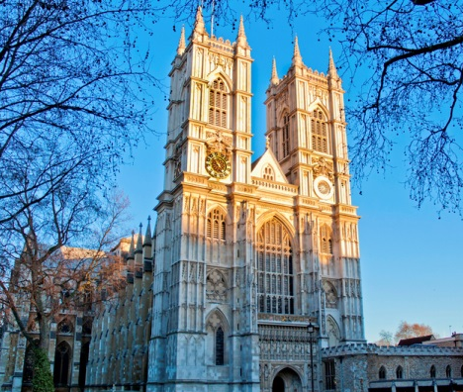
The Westminster Shorter Catechism -1647
Quest. 1. What is the chief end of man?
Answer. Man's chief end is to glorify God, and to enjoy him for ever.

Slide 7
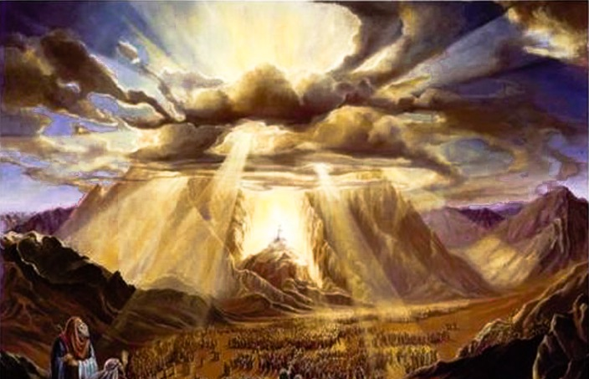
EXODUS 24:16-17
And the glory of the Lord settled down on Mount Sinai, and the cloud covered it for six days. On the seventh day the Lord called to Moses from inside the cloud. To the Israelites at the foot of the mountain, the glory of the Lord appeared at the summit like a consuming fire.

Slide 8
EXODUS 33:18
¹⁸ Moses responded, “Then show me your glorious presence.”

Slide 9
EXODUS 33:18-23
¹⁸ Moses responded, “Then show me your glorious presence.”
¹⁹ The Lord replied, “I will make all my goodness pass before you, and I will call out my name, Yahweh, before you. For I will show mercy to anyone I choose, and I will show compassion to anyone I choose. ²⁰ But you may not look directly at my face, for no one may see me and live.”²¹ The Lord continued, “Look, stand near me on this rock. ²² As my glorious presence passes by, I will hide you in the crevice of the rock and cover you with my hand until I have passed by. ²³ Then I will remove my hand and let you see me from behind. But my face will not be seen.”

Slide 11
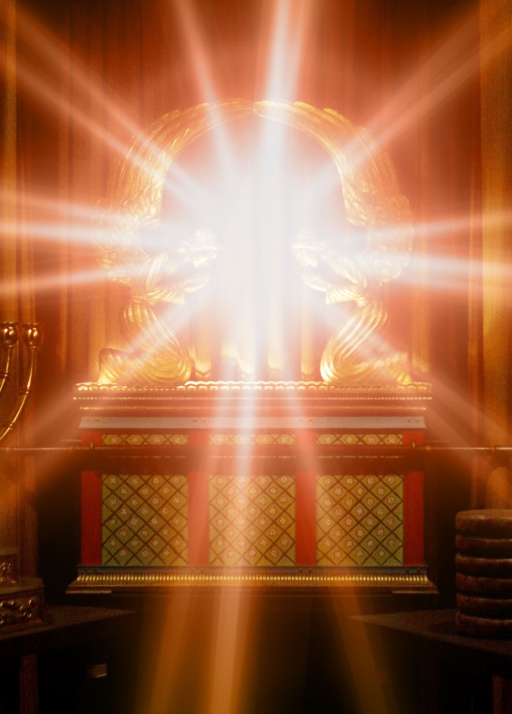
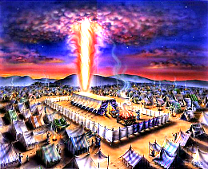
EXODUS 40:34-35
³⁴ Then the cloud covered the Tabernacle, and the glory of the Lord filled the Tabernacle. ³⁵ Moses could no longer enter the Tabernacle because the cloud had settled down over it, and the glory of the Lord filled the Tabernacle.

Slide 13
GLORY
…the manifestation of God's essence
…to glorify something, is to make something famous or to give honor

Slide 14
PSALM 19:1
“The heavens proclaim the glory of God.”

Slide 15
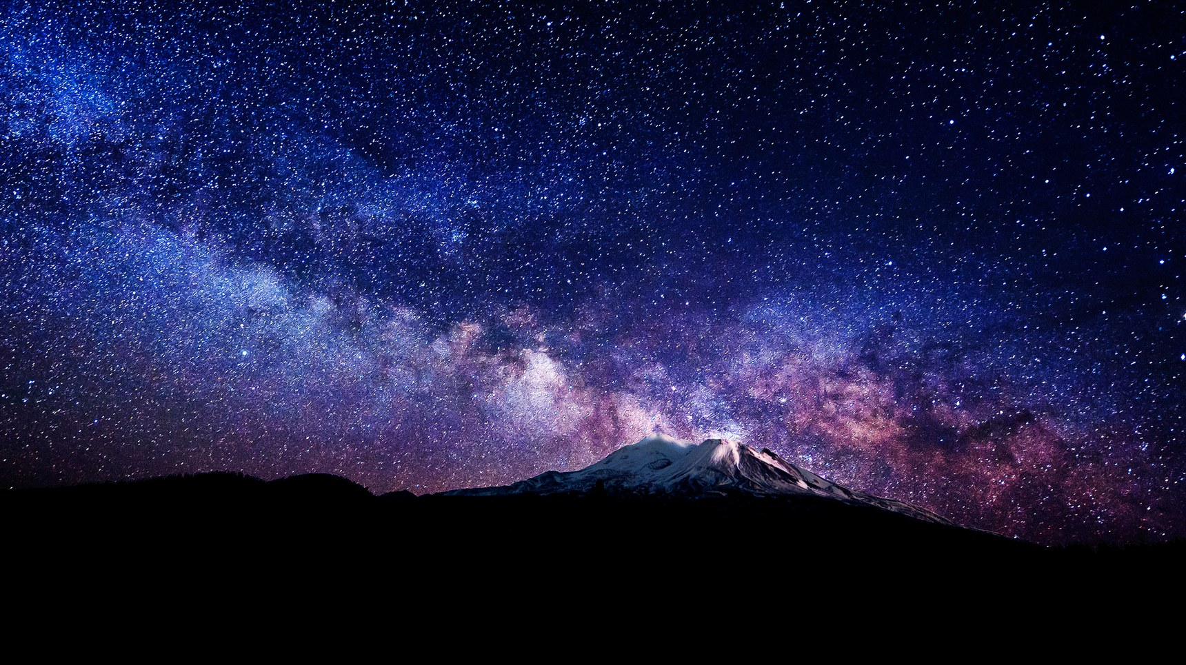

Slide 16
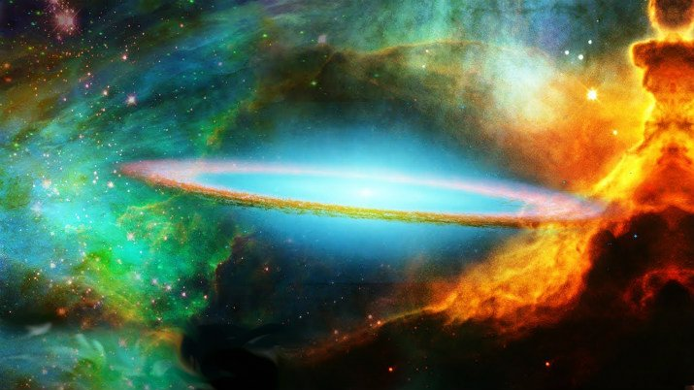

Slide 19
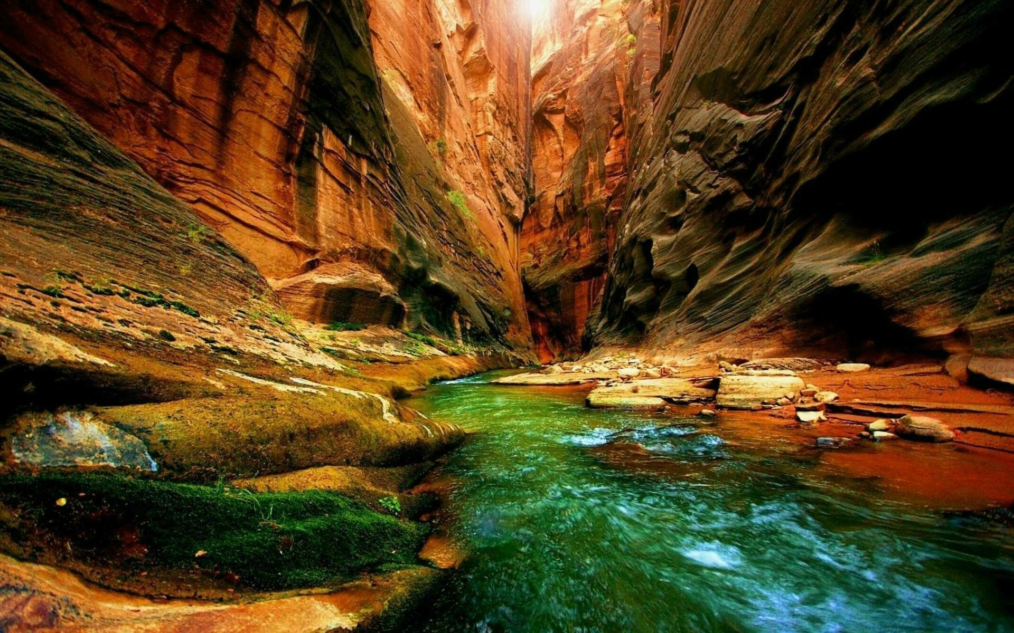

Slide 20
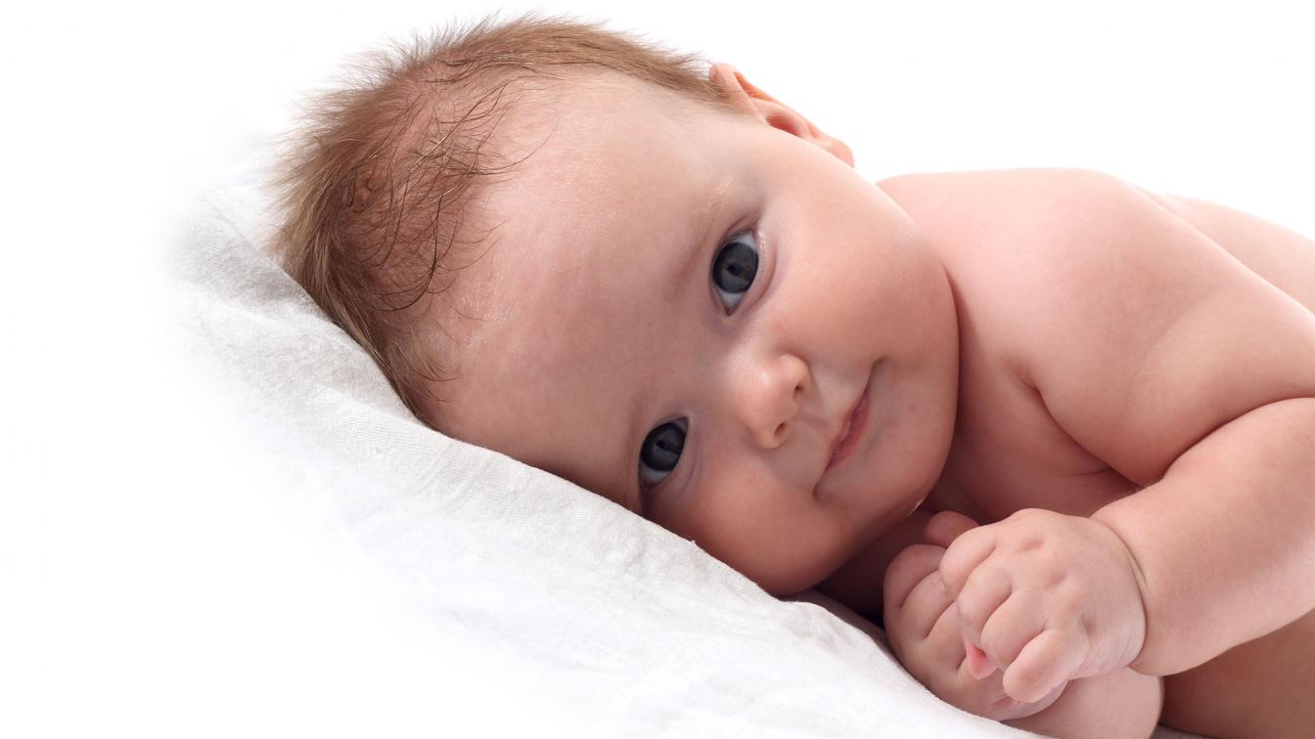

Slide 22
JOHN 1:14
So the Word became human and made his home among us. He was full of unfailing love and faithfulness. And we have seen his glory, the glory of the Father’s one and only Son.

Slide 23
HEBREWS 1:3
The Son radiates God’s own glory and expresses the very character of God, and he sustains everything by the mighty power of his command.

Slide 24
MATTHEW 17:2
As the men watched, Jesus’ appearance was transformed so that his face shone like the sun, and his clothes became as white as light.

Slide 25
REVELATION 21:23
And the city has no need of sun or moon, for the glory of God illuminates the city, and the Lamb is its light.

Slide 26
EXODUS 14:4
And once again I will harden Pharaoh’s heart, and he will chase after you. I have planned this in order to display my glory through Pharaoh and his whole army. After this the Egyptians will know that I am the Lord!

Slide 27
COLOSSIANS 1:26-27
This message was kept secret for centuries and generations past, but now it has been revealed to God’s people. For God wanted them to know that the riches and glory of Christ are for you Gentiles, too. And this is the secret: Christ lives in you.
This gives you assurance of sharing his glory.

Slide 28
2 CORINTHIANS 3:18
So all of us who have had that veil removed can see and reflect the glory of the Lord. And the Lord—who is the Spirit—makes us more and more like him as we are changed into his glorious image.

Slide 30
1
CONTEMPLATE
God’s Glory

Slide 31
PSALM 46:10
"Be Still and know that I am God"

Slide 33
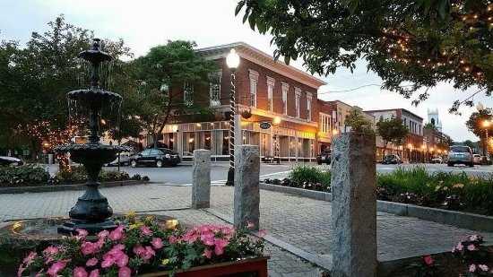

Slide 35
2
DEVELOP A HEALTHY FEAR
of God

Slide 36
REVELATION 14:7
“Fear God,” he shouted. “Give glory to him. For the time has come when he will sit as judge. Worship him who made the heavens, the earth, the sea, and all the springs of water.”
Let the whole world fear the Lord, and let everyone stand in awe of him.
The fear of the Lord is the beginning of knowledge.
PSALM 33:8
PROVERBS 9:10

Slide 38
3
SERVE GOD WITH
Boldness

Slide 39
2 CORINTHIANS 3:11-12
In fact, that first glory was not glorious at all compared with the overwhelming glory of the new way. So if the old way, which has been replaced, was glorious, how much more glorious is the new, which remains forever!
Since this new way gives us such confidence, we can be very bold.

Slide 40
1CORINTHIANS 10:31
Whatever you do, do it all for the glory of God.

Slide 41
God doesn’t exist for us,
we exist for him and to bring him glory!

