Slide 1
People
OF THE
NATIVITY

Slide 3
LESSONs
From the bad Girls of
Christmas past

Slide 4
Lesson one
God is never limited
By our
sinfulness

Slide 5
…our Lord came from the tribe of Judah
Hebrews 7:14
new living translation

Slide 6
So he stopped and propositioned her. “Let me have sex with you,” he said, not realizing that she was his own daughter-in-law.
Genesis 38:16
new living translation

Slide 7
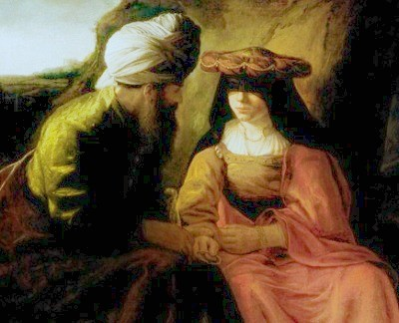
Genesis 38
Tamar

Slide 9
Lesson TWO
Our past
Does not determine
Our future

Slide 10
It was by faith that Rahab the prostitute was not destroyed with the people in her city who refused to obey God. For she had given a friendly welcome to the spies.
Hebrews 11:31
new living translation

Slide 11
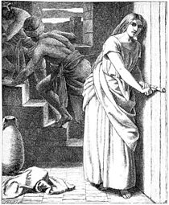
Rahab

Slide 13
Lesson THREE
The impossible
is
POSSible

Slide 14
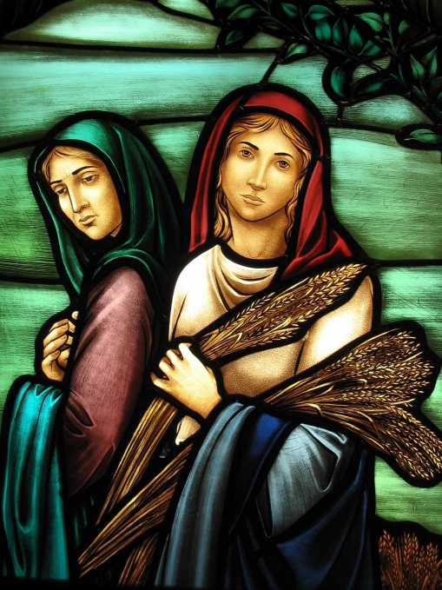
Ruth

Slide 15
“What is impossible for people
is possible with God.”
Luke 18:27
new living translation

Slide 17
Lesson four
Our failures
Are not
Final

Slide 18
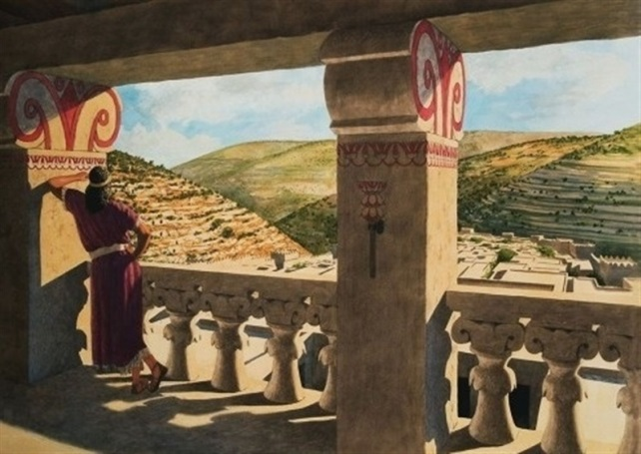
Bathsheba

Slide 19
Late one afternoon, after his midday rest, David got out of bed and was walking on the roof of the palace. As he looked out over the city, he noticed a woman of unusual beauty taking a bath. He sent someone to find out who she was, and he was told, “She is Bathsheba, the daughter of Eliam and the wife of Uriah the Hittite.” Then David sent messengers to get her; and when she came to the palace, he slept with her.
2 Samuel 11:2-4
new living translation

Slide 21
People
OF THE
NATIVITY

