Slide 2
DRIFTS
TO AVOID

Slide 4
https://www.youtube.com/watch?v=dAlDicosNH8

Slide 5
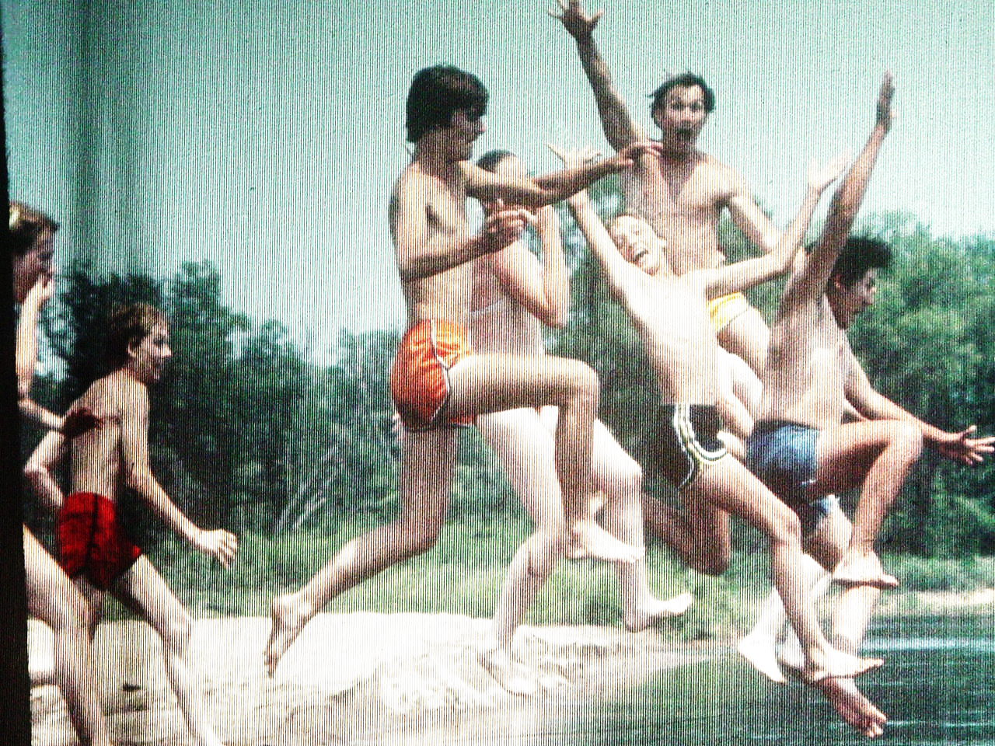

Slide 7
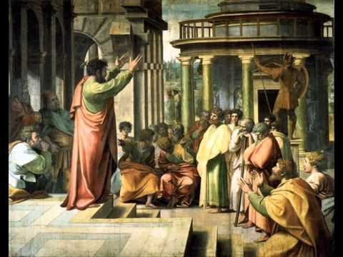

Slide 8
AVOID THE DRIFT FROM
ACCEPTING FAKE NEWS
ABOUT JESUS
1

Slide 9
While Paul and Barnabas were at Antioch of Syria, some men from Judea arrived and began to teach the believers: “Unless you are circumcised as required by the law of Moses, you cannot be saved.”
Acts 15:1 new living translation

Slide 10
I am shocked that you are turning away so soon from God, who called you to himself through the loving mercy of Christ. You are following a different way that pretends to be the Good News but is not the Good News at all. You are being fooled by those who deliberately twist the truth concerning Christ.
Galatians 1:6-7 new living translation

Slide 11
• The gospel works inside out not outside in “ cleansed their hearts through faith.” v.9
• The gospel is undeserved “we are all saved the same way, by the undeserved grace of the Lord Jesus.” v 11

Slide 13
AVOID THE DRIFT FROM
PASSION FOR OUTSIDERS
TO PACIFYING INSIDERS
2

Slide 14
GALATIA
Antioch
Iconium
Lystra
Derbe
Everyone listened quietly as Barnabas and Paul told about the miraculous signs and wonders God had done through them among the Gentiles.
Acts 15:12 new living translation

Slide 15
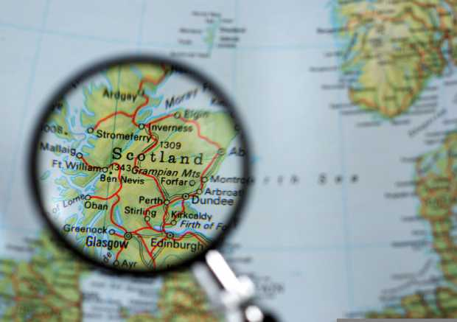
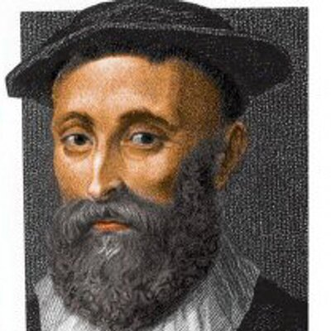
Give me Scotland, or I die! John Knox 1550

Slide 16
Cut the video use only minutes 2:15-3:33 building of the church in 52 days.
https://www.youtube.com/watch?v=U4e2cpdHDSA

Slide 18
AVOID THE DRIFT
TOWARD RULES AND
AWAY FROM GRACE
3

Slide 19
“And so my judgment is that we should not make it difficult for the Gentiles who are turning to God.”
Acts 15:19 new living translation

Slide 21
AVOID THE DRIFT
TOWARD ABUSING GRACE
RATHER THAN ADVANCING GRACE
4

Slide 22
Instead, we should write and tell them to abstain from eating food offered to idols, from sexual immorality, from eating the meat of strangled animals, and from consuming blood.
Acts 15:20 new living translation

Slide 23
“For you are a slave to whatever controls you.”
2 Peter 2:2 new living translation

Slide 25
We should be simplifiers not complicators of God’s grace.

