Slide 1


Slide 2
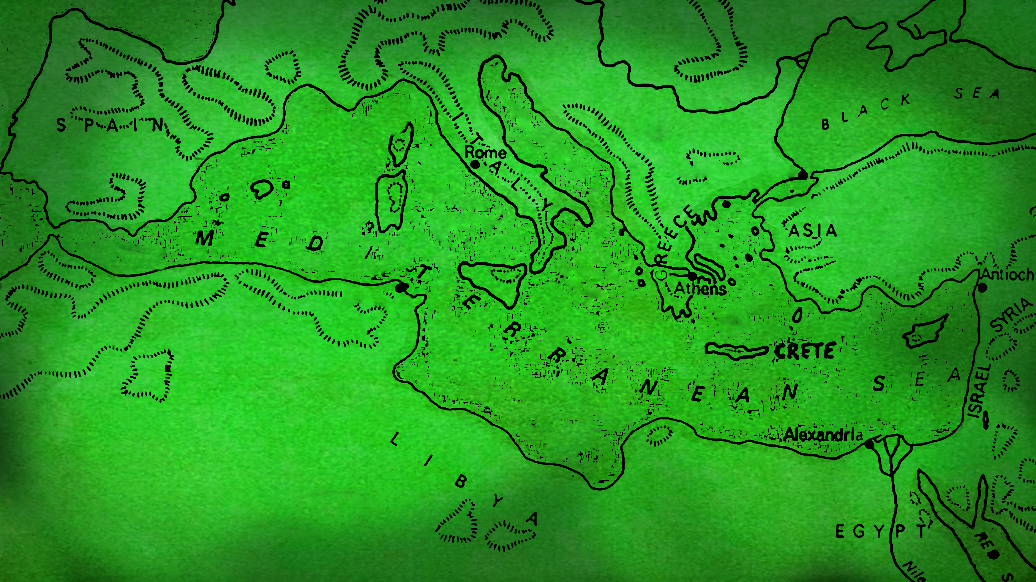
MISTAKES

Slide 3
1
WE ALL MAKE
MISTAKES

Slide 4
"watch out"
Acts 20:31
new living translation

Slide 6
2
DON’T GET
DISTRACTED

Slide 7
After greeting them, Paul gave a detailed account of the things God had accomplished among the Gentiles through his ministry.
Acts 21:19
“Go, for Saul is my chosen instrument to take my message to the Gentiles and to kings, as well as to the people of Israel. And I will show him how much he must suffer for my name’s sake.”
Acts 9:15-16
new living translation

Slide 9
DO WHAT’S BEST
INSTEAD OF WHAT IS GOOD ENOUGH
3

Slide 10
“He was hurrying to get to Jerusalem, if possible, in time for the Festival of Pentecost.”
Acts 20:16
“And now I am bound by the Spirit
to go to Jerusalem.”
Acts 20:22

Slide 11
My heart is filled with bitter sorrow and unending grief for my people, my Jewish brothers and sisters.
I would be willing to be forever cursed—cut off from Christ!—if that would save them.
Romans 9:2-3
new living translation

Slide 12
But now I have finished my work in these regions, and after all these long years of waiting, I am eager to visit you. I am planning to go to Spain, and when I do, I will stop off in Rome. And after I have enjoyed your fellowship for a little while, you can provide for my journey. But before I come, I must go to Jerusalem to take a gift to the believers there. For you see, the believers in Macedonia and Achaia have eagerly taken up an offering for the poor among the believers in Jerusalem. They were glad to do this because they feel they owe a real debt to them. Since the Gentiles received the spiritual blessings of the Good News from the believers in Jerusalem, they feel the least they can do in return is to help them financially. As soon as I have delivered this money and completed this good deed of theirs,
I will come to see you on my way to Spain.
Romans 15:23-28
new living translation

Slide 13
Now the Lord said to Samuel,
“You have mourned long enough for Saul. I have rejected him as king of Israel, so fill your flask with olive oil and go to Bethlehem. Find a man named Jesse who lives there,
for I have selected one of his sons to be my king.”
1 Samuel 16:1
new living translation

Slide 15
4
OBSERVE WHAT GOD SAYS
PLAINLY AND CLEARLY

Slide 16
We went ashore, found the local believers, and stayed with them a week. These believers prophesied through the Holy Spirit that Paul should not go on to Jerusalem.
Acts 21:4
new living translation

Slide 17
So stop telling lies….
Don’t let the sun go down while you are still angry…
…quit stealing.
Don’t use foul or abusive language.
Get rid of all bitterness, rage, anger, harsh words, and slander.
be kind to each other, tenderhearted, forgiving one another…
live a life filled with love…
Let there be no sexual immorality, impurity, or greed among you.
Obscene stories, foolish talk, and coarse jokes—these are not for you.
Don’t live like fools, but like those who are wise.
Make the most of every opportunity in these evil days.
Don’t be drunk with wine
each man must love his wife
The wife must respect her husband.
Ephesians 4 and 5
new living translation

Slide 19
5
LISTEN TO YOUR GODLY
INFLUENCERS

Slide 20
When we heard this,
we and the local believers all begged Paul
not to go on to Jerusalem.
there is safety in having many advisers.
Acts 21:12
new living translation
Proverbs 11:14
new living translation

Slide 22
6
PRAISE GOD FOR HIS
SALVAGING GRACE

Slide 23
When it was clear that we couldn’t persuade him, we gave up and said, “The Lord’s will be done.”
Acts 21:14
new living translation

Slide 25

Where you look, you will go.
What you behold, you will become.
-Christine Cain
speaker, author, co-founder of A21

