Slide 2
E N C O U N T E R
AT PENIEL

Slide 3
WRESTLEMANIA 1
GOD vs JACOB

Slide 4
APPEARANCES CAN BE DECEPTIVE
16 Make sure that no one is immoral or godless like Esau, who traded his birthright as the firstborn son for a single meal. 17 You know that afterward, when he wanted his father’s blessing, he was rejected. It was too late for repentance, even though he begged with bitter tears. HEBREWS 12:16-17 new living translation
1

Slide 5
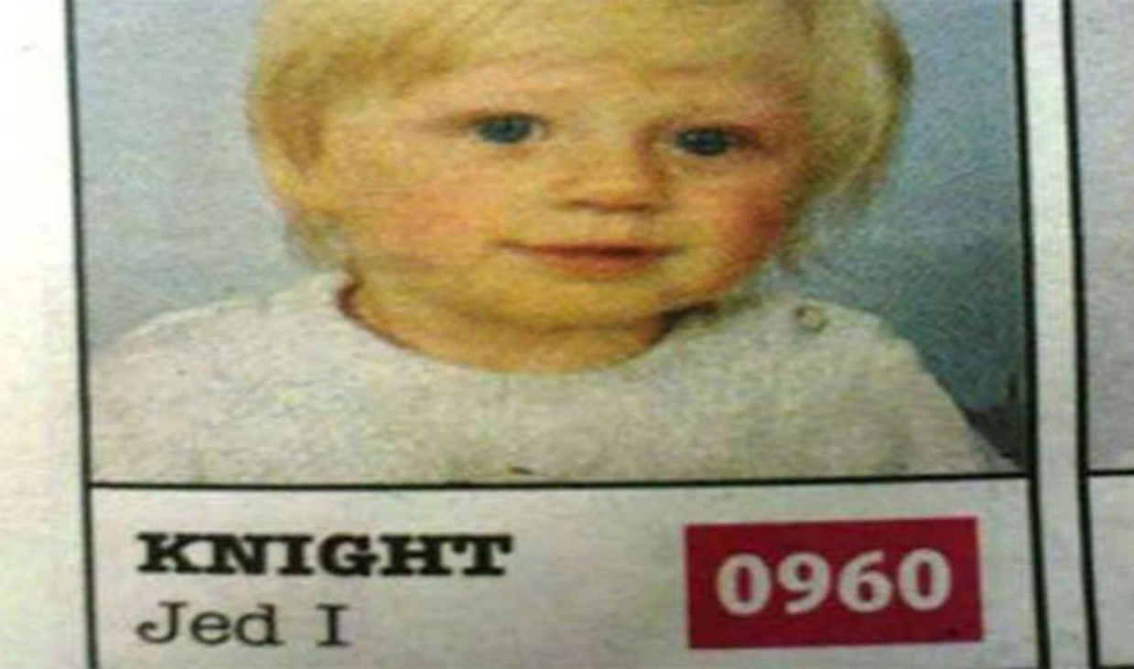

Slide 6
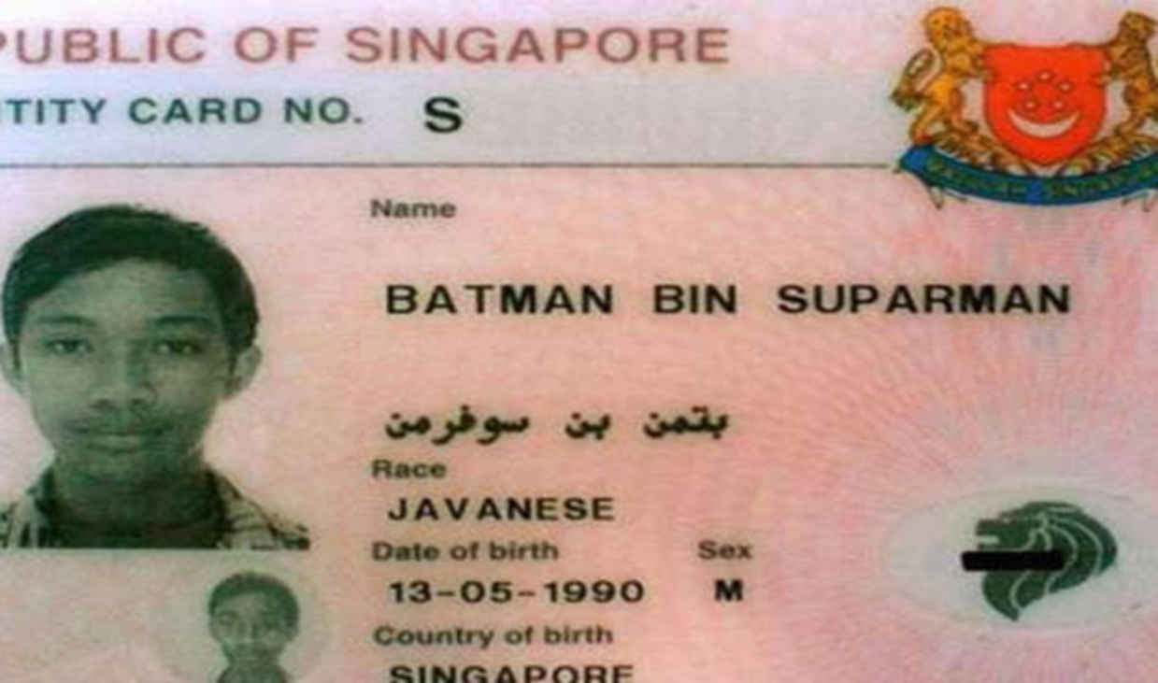

Slide 7
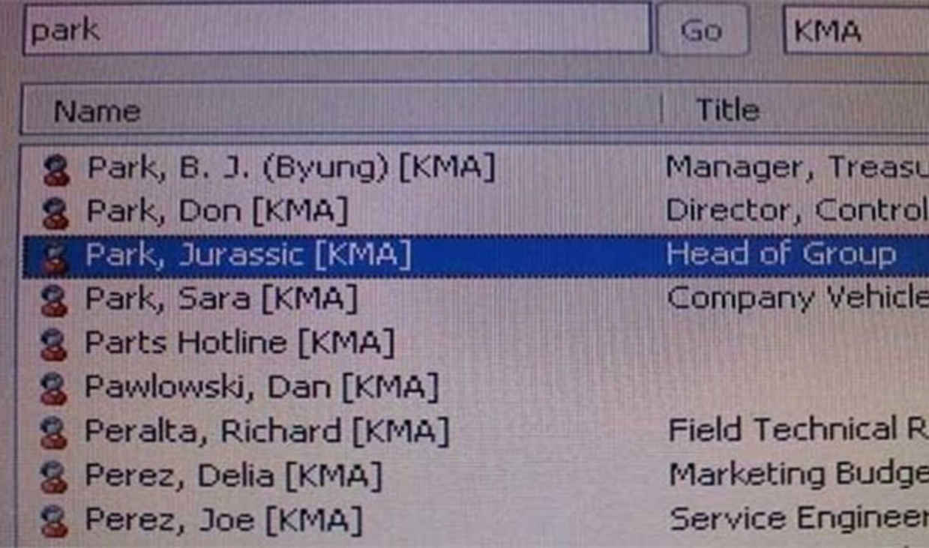

Slide 8
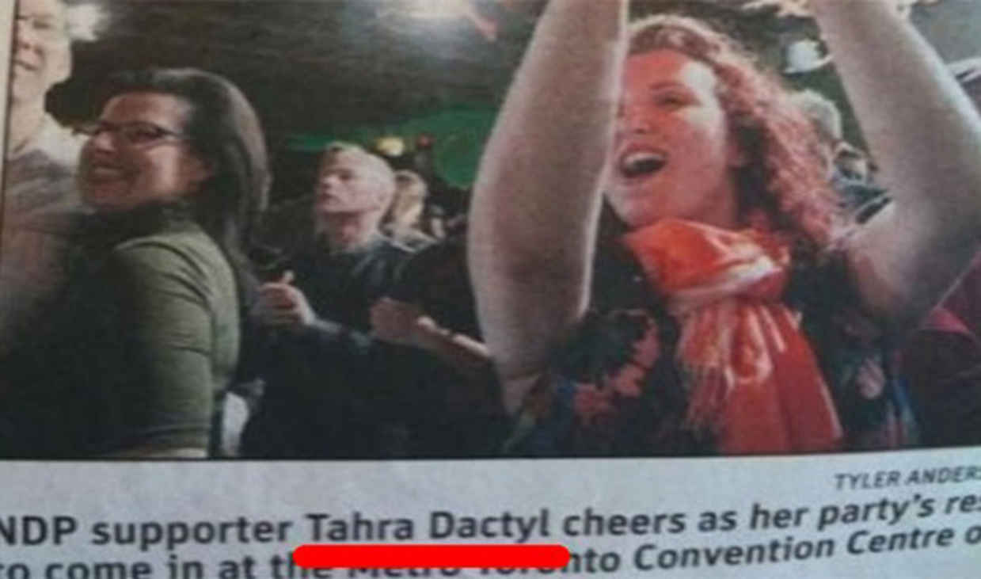

Slide 9
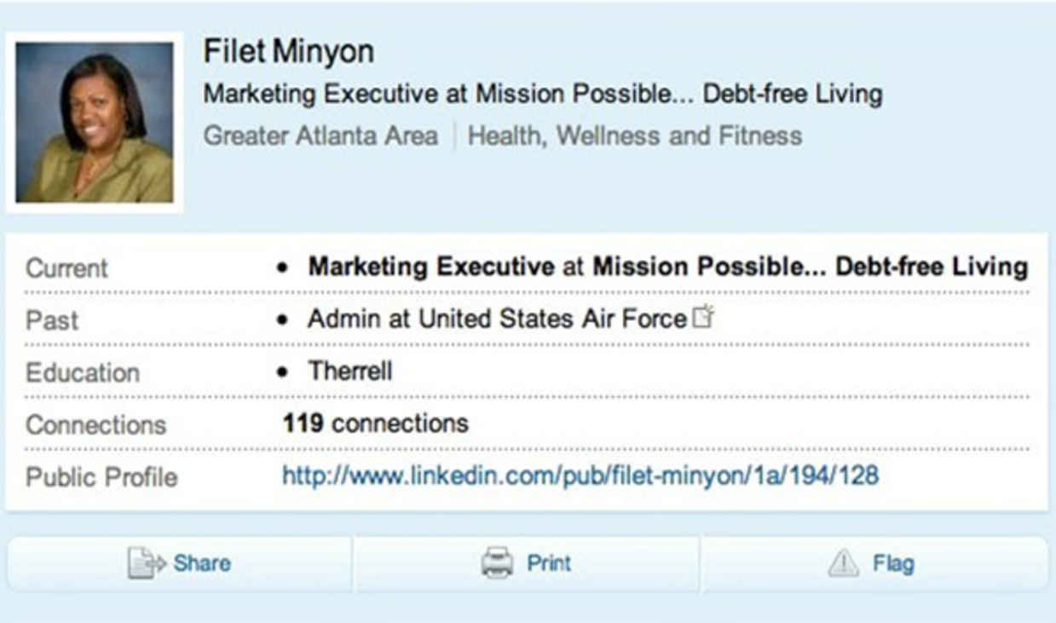

Slide 10
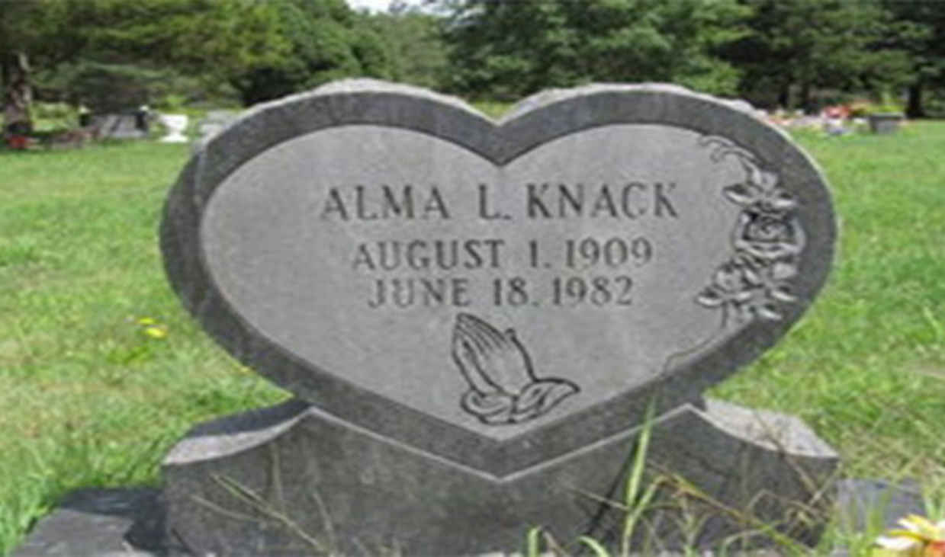

Slide 11
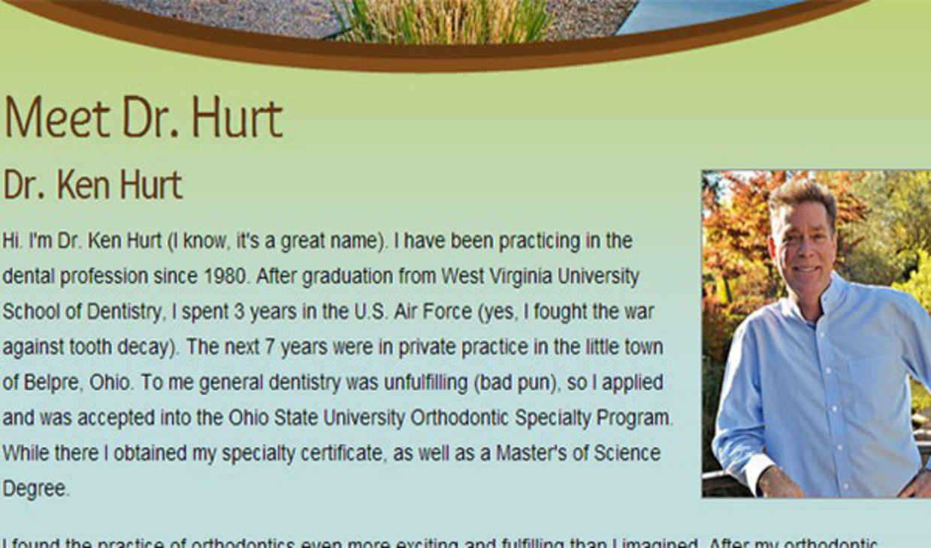

Slide 13
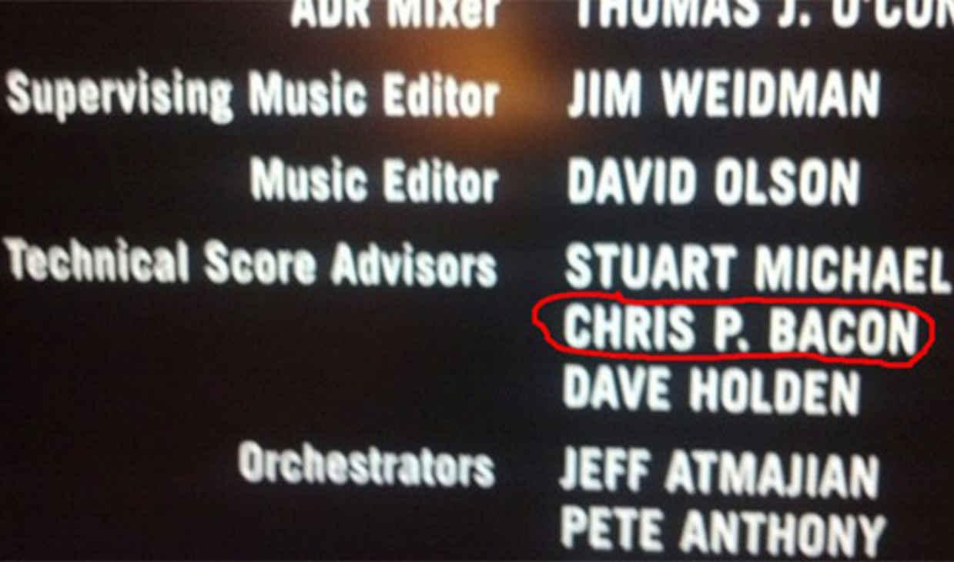

Slide 14
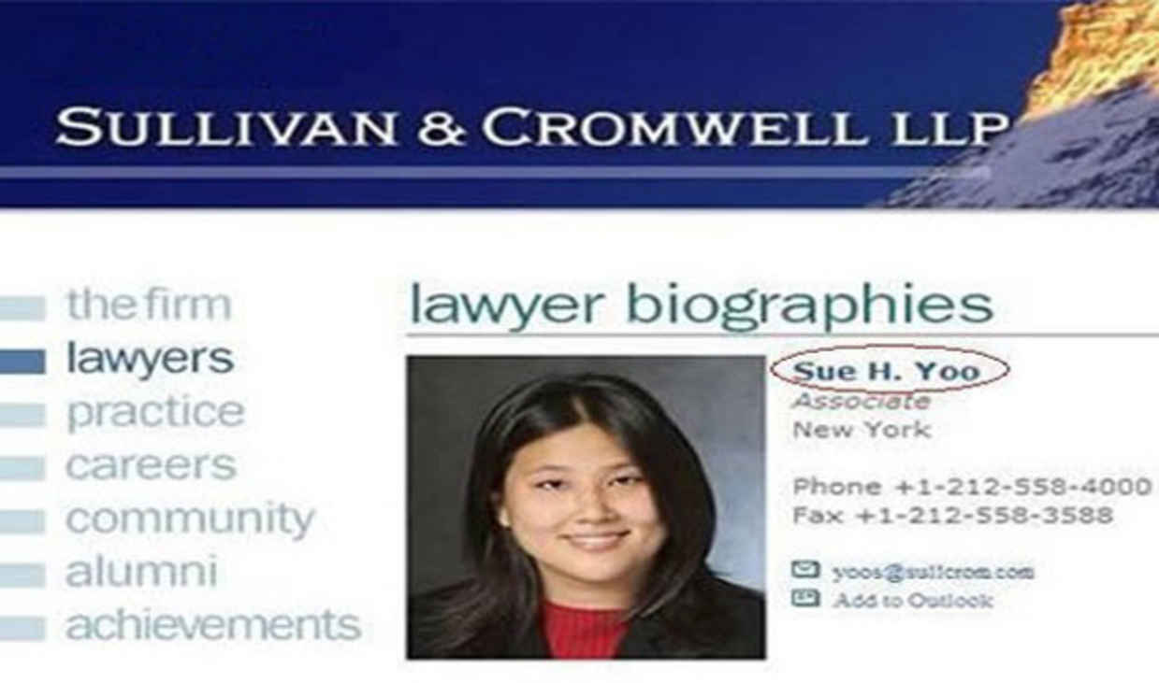

Slide 15
E N C O U N T E R
AT PENIEL

Slide 16
APPEARANCES CAN BE DECEPTIVE
16 Make sure that no one is immoral or godless like Esau, who traded his birthright as the firstborn son for a single meal. 17 You know that afterward, when he wanted his father’s blessing, he was rejected. It was too late for repentance, even though he begged with bitter tears. HEBREWS 12:16-17 new living translation
1

Slide 17
GOD DOESN’T NEED YOU
I know every bird on the mountains, and all the animals of the field are mine. If I were hungry, I would not tell you, for all the world is mine and everything in it. PSALM 50:11-12 new living translation
2

Slide 18
GOD WANTS US TO TRUST HIM
3 Then the Lord said to Jacob, “Return to the land of your father and grandfather and to your relatives there, and I will be with you.” GENESIS 31:3 new living translation
3

Slide 20
GOD’S GRACE IS SUFFICIENT FOR YOU
7 Don’t be misled—you cannot mock the justice of God. You will always harvest what you plant. 8 Those who live only to satisfy their own sinful nature will harvest decay and death from that sinful nature. But those who live to please the Spirit will harvest everlasting life from the Spirit. GALATIANS 6:7-8 new living translation
4

Slide 21
PROVERBS 18:19 NEW LIVING TRANSLATION
A brother offended is harder to win than a strong city,
And contentions are like the bars of a castle.

Slide 22
HEBREWS 4:16 NEW INTERNATIONAL VERSION
16 Let us therefore come boldly to the throne of grace, that we may obtain mercy and find grace to help in time of need.

Slide 24
PSALM 18:25-26 NEW LIVING TRANSLATION
To the faithful you show yourself faithful; to those with integrity you show integrity. To the pure you show yourself pure, but to the crooked you show yourself shrewd.

Slide 25
WE NEED TO BE ALONE WITH GOD
5
30 Jacob named the place Peniel (which means “face of God”), for he said, “I have seen God face to face, yet my life has been spared.” GENESIS 32:30 new living translation

Slide 26
C.K. MACKINTOSH
“To be alone with God is the only true way of arriving at a just knowledge of ourselves and our ways. no matter what we may think about ourselves, or what others may think of us, the great question is what does God think of us?”

Slide 27
PROPER WRESTLING WITH GOD
COLOSSIANS 4:12
ROMANS 15:30
GENESIS 18
DEUTERONOMY 9:25-26
1 KINGS 18:42-44
PSALM 39:12

Slide 28
GOD WANTS TO MAKE US WHOLE
5
When Jesus saw him and knew he had been ill for a long time, he asked him, "Would you like to get well?" JOHN 5:6 new living translation

Slide 29
OSWALD CHAMBERS
“Sin enough and soon you will be unconscious of sin.”

Slide 30
2 CORINTHIANS 12:9 NEW LIVING TRANSLATION
But he said to me, "My grace is sufficient for you, for my power is made perfect in weakness." Therefore I will boast all the more gladly about my weaknesses, so that Christ's power may rest on me.

