Slide 2
Book of the TWELVE

Slide 3
OBADIAH
Do Something Good

Slide 4
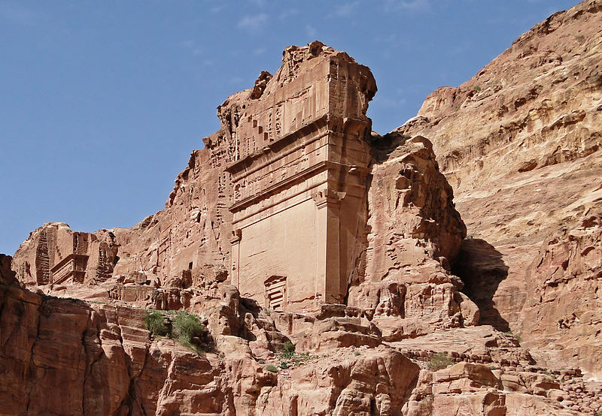

Slide 5
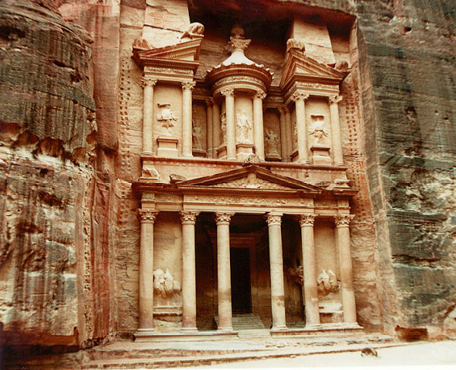

Slide 6
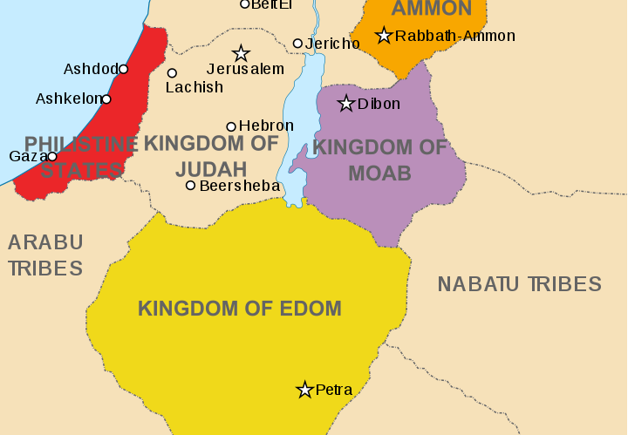
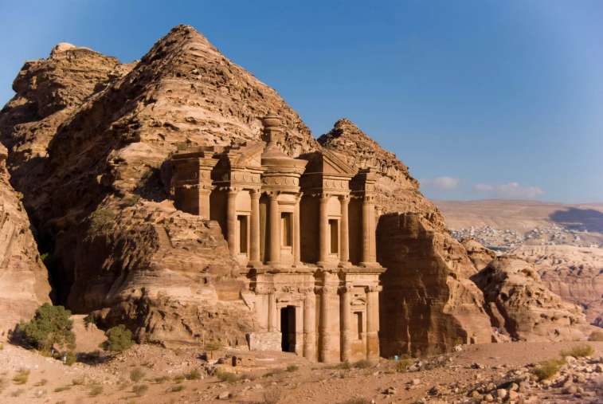

Slide 8
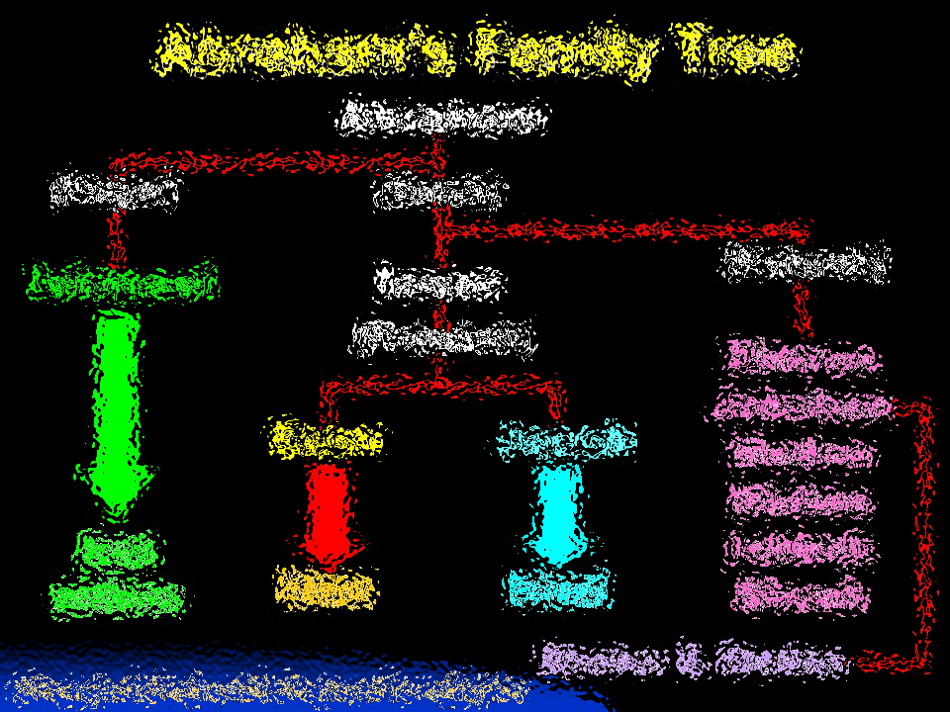

Slide 10
“Do not detest the Edomites or the Egyptians, because the Edomites are your relatives and you lived as foreigners among the Egyptians.“
Deuteronomy 23:7

Slide 11
“Do not detest the Edomites or the Egyptians, because the Edomites are your relatives and you lived as foreigners among the Egyptians.“
Deuteronomy 23:7
But those who won’t care for their relatives, especially those in their own household, have denied the true faith. Such people are worse than unbelievers. 1 Timothy 5:8

Slide 13
Whatever you do
1
ALWAYS LISTEN TO GOD

Slide 14
We have heard a message from the Lord
that an ambassador was sent to the nations to say, “Get ready, everyone! Let’s assemble our armies and attack Edom!”
Obadiah 1:1

Slide 15
The Lord says to Edom,
“I will cut you down to size among the nations; you will be greatly despised.”
Obadiah 1:2

Slide 17
Don’t listen to your
PRIDE
2

Slide 18
You have been deceived by your own pride because you live in a rock fortress and make your home high in the mountains. ‘Who can ever reach us way up here?’ you ask boastfully.
Obadiah 1:3

Slide 20
3
Know that consequences
ALWAYS CATCH UP

Slide 21
“Because of the violence you did to your close relatives in Israel, you will be filled with shame and destroyed forever. When they were invaded, you stood aloof, refusing to help them.”
Obadiah 1:10-11

Slide 23
Take no joy in the demise of
YOUR ENEMIES
4

Slide 24
but you acted like one of Israel’s enemies.
You should not have gloated…
You should not have rejoiced…
…. spoken arrogantly
…. plundered the land of Israel
…. gloated over their destruction
…. seized their wealth
…. killing those who tried to escape.
…. captured the survivors and handed them over in their terrible time of trouble.
Obadiah 1:11-14

Slide 26
Accept God’s Way of
ESCAPE
5

Slide 27
“But Jerusalem will become a refuge for those who escape; it will be a holy place. And the people of Israel will come back to reclaim their inheritance.
Obadiah 1:17

Slide 29
https://www.youtube.com/watch?v=lHEnevlwlWM

Slide 31
Often… not doing Something is worst than wrongdoing

