Slide 1


Slide 2
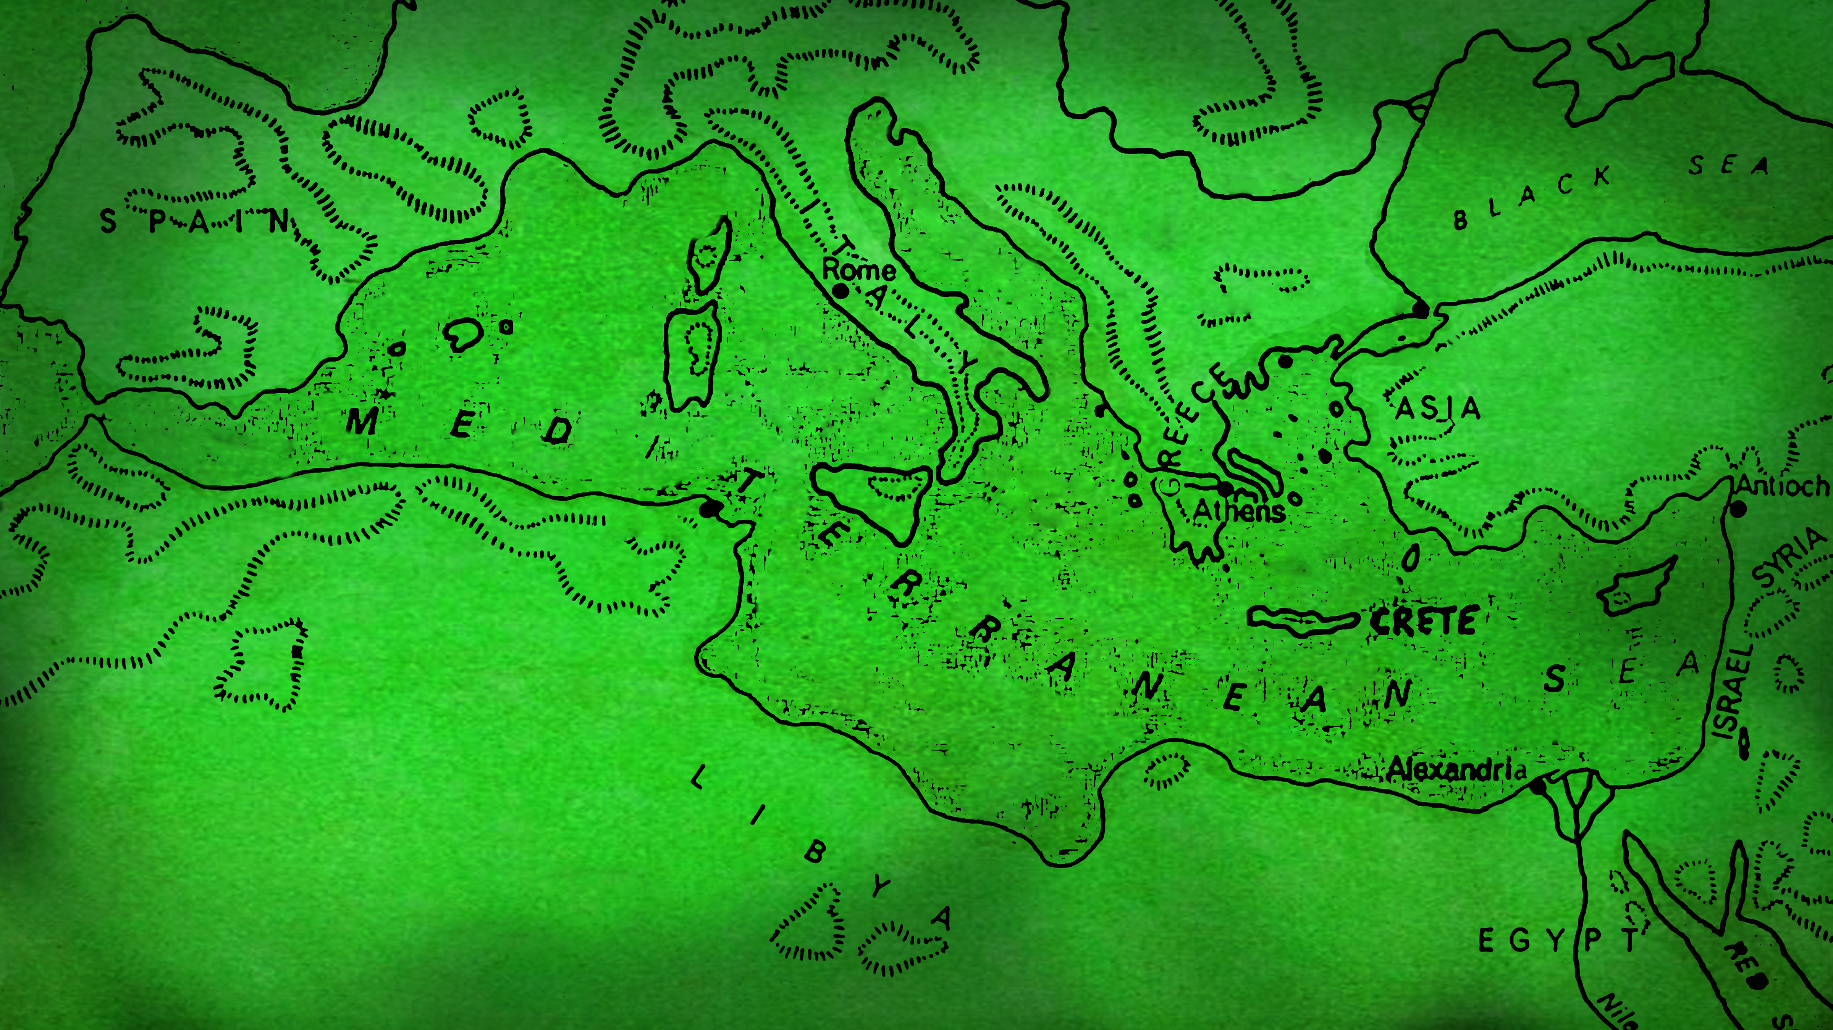
KEEEP GOING

Slide 3
https://www.youtube.com/watch?v=yKaff8kZXG8

Slide 4
1
BE AUTHENTIC AND
HONEST

Slide 5
Many who became believers confessed their sinful practices.
A number of them who had been practicing sorcery brought their incantation books and burned them at a public bonfire.
The value of the books was several million dollars.
Acts 19:18-19
new living translation

Slide 7
2
BE WILLING TO
CHANGE PLANS

Slide 8
He was preparing to sail back to Syria when he discovered a plot by some Jews against his life, so he decided to return through Macedonia.
Acts 20:3
new living translation

Slide 10
3
BE WILLING TO LAY DOWN
PERSONAL PREFERENCES

Slide 11
"he keep talking until midnight…"
Acts 20:7
"Paul went by land to Assos…"
Acts 20:13
“And now I know that none of you to whom I have preached the Kingdom will ever see me again.”
Acts 20:25

Slide 13
4
GUARD YOURSELVES AGAINST
DISTROTED TRUTH

Slide 14
I know that false teachers, like vicious wolves, will come in among you after I leave, not sparing the flock.
Even some men from your own group will rise up and distort the truth in order to draw a following.
Watch out!
Acts 20:29-31
new living translation

Slide 16
5
WATCH OUT FOR THE DANGERS
WITHIN US

Slide 17
Carelessness: “remember" v. 31

Slide 18
Carelessness: “remember" v. 31
Shallowness: "build you up" v. 32

Slide 19
Carelessness: “remember" v. 31
Shallowness: "build you up" v. 32
Covetousness: "never coveted" v. 33

Slide 20
Carelessness: “remember" v. 31
Shallowness: "build you up" v. 32
Covetousness: "never coveted" v. 33
Laziness: “worked to supply my own needs“ v. 34

Slide 21
Carelessness: “remember" v. 31
Shallowness: "build you up" v. 32
Covetousness: "never coveted" v. 33
Laziness: “worked to supply my own needs“ v. 34
Selfishness: “…more blessed to give than to receive.” v. 35

Slide 23
Therefore, since we are surrounded by such a huge crowd of witnesses to the life of faith, let us strip off every weight that slows us down, especially the sin that so easily trips us up. And let us run with endurance the race God has set before us. We do this by keeping our eyes on Jesus, the champion who initiates and perfects our faith.
Hebrews 12:1-2
new living translation

Slide 25

Where you look, you will go.
What you behold, you will become.
-Christine Cain
speaker, author, co-founder of A21

