Slide 2
Book of the TWELVE

Slide 3
NAHUM
The Fall of Nineveh

Slide 4
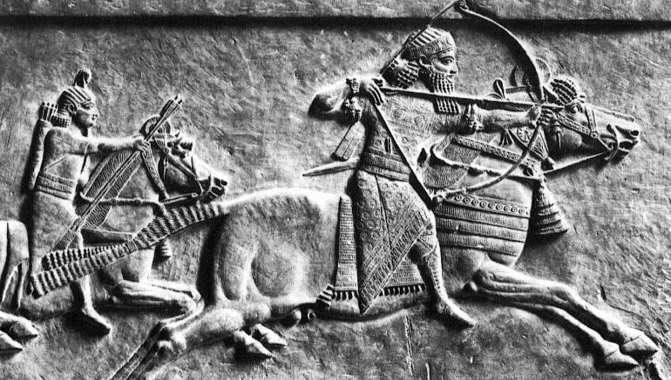

Slide 5
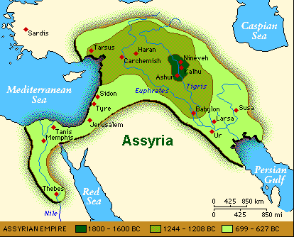
Nineveh

Slide 6
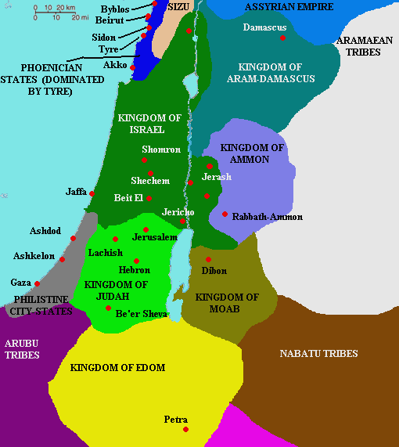
ASSYRIAN EMPIRE

Slide 8
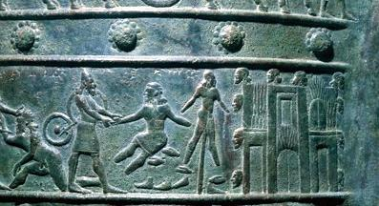
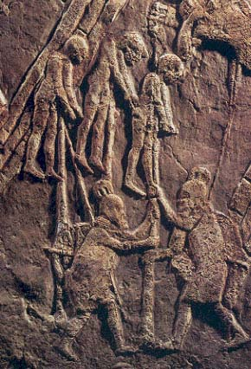

Slide 10
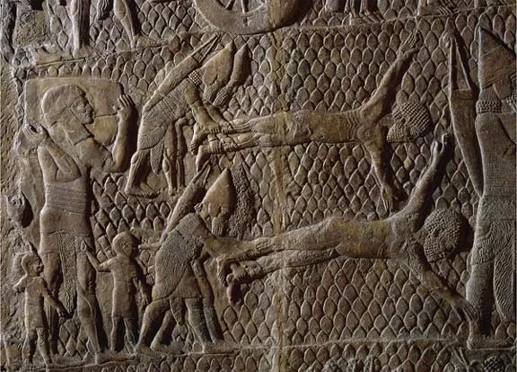

Slide 12
REMEMBER WHO GOD IS
in the midst of suffering
1

Slide 13
-GOD IS A JEALOUS GOD
The Lord is a jealous God, filled with vengeance and rage. He takes revenge on all who oppose him and continues to rage against his enemies! NAHUM 1:2

Slide 14
-GOD HAS GREAT POWER
The Lord is slow to get angry, but his power is great, and he never lets the guilty go unpunished. He displays his power in the whirlwind and the storm. Nahum 1:3

Slide 15
-GOD IS GOOD
The Lord is good, a strong refuge when trouble comes. He is close to those who trust in him.
Nahum 1:7

Slide 16
-GOD WILL JUDGE THE WICKED
And this is what the Lord says concerning the Assyrians in Nineveh: “You will have no more children to carry on your name. I will destroy all the idols in the temples of your gods. I am preparing a grave for you because you are despicable!” Nahum 1:14

Slide 17
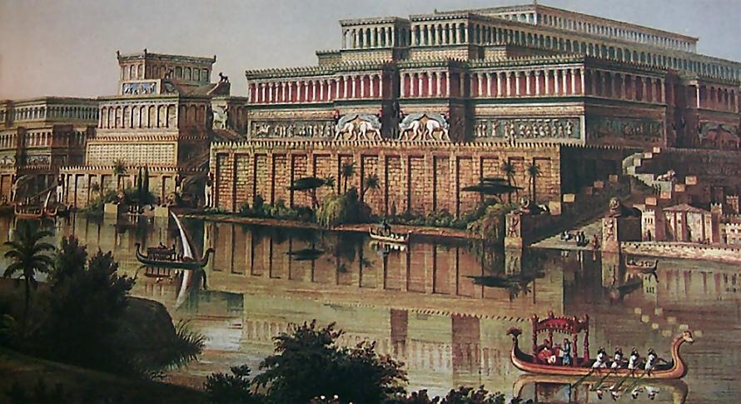

Slide 18
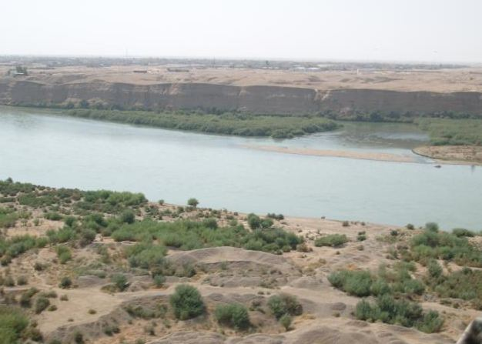
Nineveh’s ruins discovered 1847

Slide 19
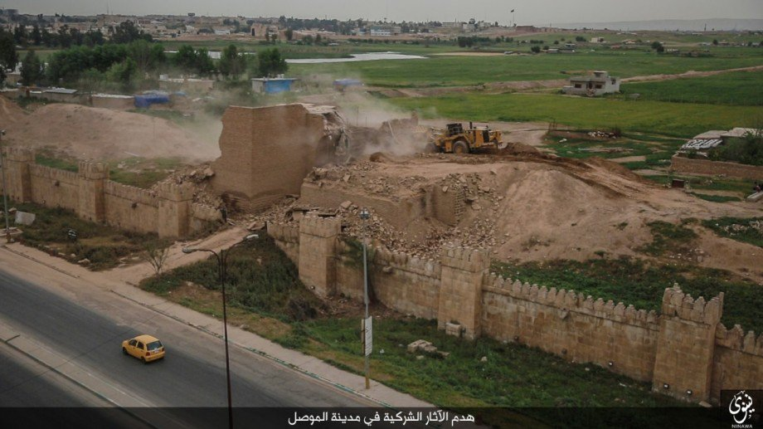

Slide 20
-GOD WILL BLESS THOSE WHO STAY FAITHFUL
Even though the destroyer has destroyed Judah, the Lord will restore its honor. Israel’s vine has been stripped of branches, but he will restore its splendor.
Nahum 2:2

Slide 22
FOCUS ON JESUS
in the midst of suffering
2

Slide 23
And let us run with endurance the race God has set before us. We do this by keeping our eyes on Jesus, the champion who initiates and perfects our faith. Because of the joy awaiting him, he endured the cross, disregarding its shame. Now he is seated in the place of honor beside God’s throne. Think of all the hostility he endured from sinful people; then you won’t become weary and give up. After all, you have not yet given your lives in your struggle against sin.
Hebrews 12:1-4

Slide 24
PSALM 73 A song of Aseph

Slide 25
-LIFE SOMETIMES DOESN’T SEEM FAIR
Truly God is good to Israel, to those whose hearts are pure. But as for me, I almost lost my footing. My feet were slipping, and I was almost gone.
PSALM 73:1-2

Slide 26
-DON’T FOCUS ON OTHERS
For I envied the proud when I saw them prosper despite their wickedness.
PSALM 73:3

Slide 27
-KEEP FOCUSING ON JESUS
Then I went into your sanctuary, O God…
PSALM 73:17

Slide 28
-KEEP FOCUSING ON JESUS
He’ll give us an eternal perspective

Slide 29
-KEEP FOCUSING ON JESUS
He’ll give us an eternal perspective “I finally understood the destiny of the wicked…” v.17
He’ll Show us who we really are “bitter…foolish…ignorant….like a senseless animal…” v.21-22

Slide 30
-KEEP FOCUSING ON JESUS
He’ll give us an eternal perspective “I finally understood the destiny of the wicked…” v.17
He’ll Show us who we really are v.21-23
“bitter…foolish…ignorant….like a senseless animal… …Yet I still belong to you.”

Slide 31
-KEEP FOCUSING ON JESUS
He’ll give us an eternal perspective “I finally understood the destiny of the wicked…” v.17
He’ll Show us who we really are v.21-23
“bitter…foolish…ignorant….like a senseless animal… …Yet I still belong to you.”
He’ll show us who he really is v.23-26 “hold…guide...leading…strength…mine forever.”

Slide 32
Those who desert him will perish,
for you destroy those who abandon you. But as for me, how good it is to be near God! I have made the Sovereign Lord my shelter, and I will tell everyone about the wonderful things you do.
Psalm 73:27-28

Slide 34
Something to think about
Do I measure God’s blessings by the prosperity of life or my closeness to him.

