Slide 2
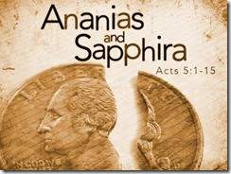
SIDETRACKED

Slide 3
Jerusalem

Slide 4
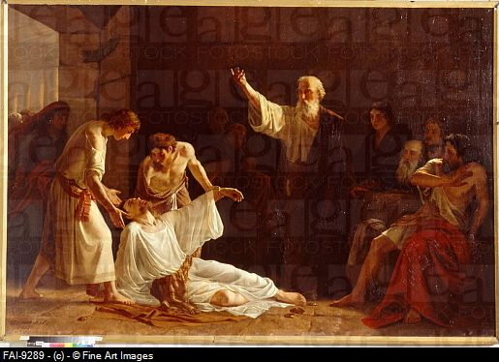

Slide 6
All the believers were united in heart and mind. And they felt that what they owned was not their own, so they shared everything they had. The apostles testified powerfully to the resurrection of the Lord Jesus, and God’s great blessing was upon them all. There were no needy people among them, because those who owned land or houses would sell them and bring the money to the apostles to give to those in need.
Acts 4: 32-35 new living translation

Slide 7
For instance, there was Joseph,
the one the apostles nicknamed Barnabas
(which means “Son of Encouragement”).
He was from the tribe of Levi and came from the
island of Cyprus. He sold a field he owned
and brought the money to the apostles.
Acts 4: 36-37 new living translation

Slide 8
1
EXCEL IN GENEROSITY

Slide 9
I want you to excel also in this gracious act of giving.
2 Corinthians 8:7 new living translation

Slide 10
Generously…Cheerfully
But the one who plants generously will get a generous crop. You must each decide in your heart how much to give. And don’t give reluctantly or in response to pressure. “For God loves a person who gives cheerfully.” And God will generously provide all you need. Then you will always have everything you need and plenty left over to share with others.
2 Corinthians 9:6-8 new living translation

Slide 11
Eagerly…Proportionally
Give in proportion to what you have.
Whatever you give is acceptable if you give it eagerly.
2 Corinthians 8:11-12 new living translation

Slide 12
tithe
You ignore the more important aspects of the law—justice, mercy, and faith. You should tithe, yes,
but do not neglect the more important things.
Matthew 23:23 new living translation

Slide 14
2
BE ALERT FOR SLIPPING HAZARDS

Slide 15
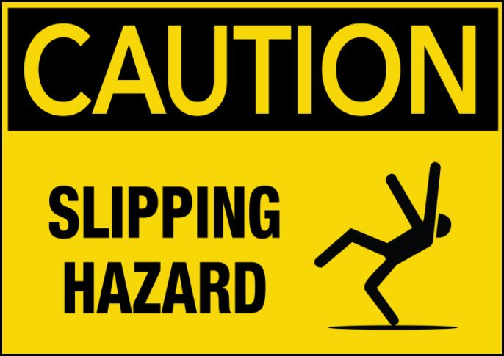

Slide 16
https://www.youtube.com/watch?v=Fbb3631ew_4

Slide 17
But there was a certain man named Ananias who, with his wife, Sapphira, sold some property. He brought part of the money to the apostles, claiming it was the full amount. With his wife’s consent, he kept the rest.
Acts 5:1-2 new living translation

Slide 19
So you must live as God’s obedient children. Don’t slip back into your old ways of living to satisfy your own desires. You didn’t know any better then.
1Peter 1:14 new living translation

Slide 20
Stay alert! Watch out for your great enemy,
the devil. He prowls around like a roaring lion,
looking for someone to devour.
1 Peter 5:8 new living translation

Slide 21
I know that false teachers, like vicious wolves,
will come in among you after I leave,
not sparing the flock. Even some men from your own group
will rise up and distort the truth in order to draw a following. Watch out!
Acts 20:19-31 new living translation

Slide 23
3
HUMBLY CONFESS YOUR SINS

Slide 24
About three hours later his wife came in, not knowing what had happened. Peter asked her, “Was this the price you and your husband received for your land?”

Slide 25
About three hours later his wife came in, not knowing what had happened. Peter asked her, “Was this the price you and your husband received for your land?”
“Yes,” she replied, “that was the price.”
Acts 5:7-8 new living translation

Slide 26
Do not be deceived: God is not mocked,
for whatever one sows, that will he also reap.
Galatians 6:7 English Standard Version
Be sure your sin will find you out.
Deuteronomy 32:23 new living translation

Slide 27
But if we confess our sins to him,
he is faithful and just to forgive us our sins
and to cleanse us from all wickedness.
1 John 1:9 new living translation

Slide 29
4
DON’T GIVE UP WHEN GOD DISCIPLINES YOU

Slide 30
As soon as Ananias heard these words, he fell to the floor and died….
…The young men who buried your husband are just outside the door, and they will carry you out, too.”
Instantly, she fell to the floor and died.
Acts 5:5, 9-10 new living translation

Slide 31
For if you eat the bread or drink the cup without honoring the body of Christ, you are eating and drinking God’s judgment upon yourself. That is why many of you are weak and sick and some have even died.
1 Corinthians 11:29-30 new living translation

Slide 32
“My child, don’t make light of the Lord’s discipline, and don’t give up when he corrects you…”
Hebrews 12:5 new living translation

Slide 34
5
FEAR THE LORD

Slide 35
Great fear gripped the entire church and everyone else who heard what had happened.
Acts 4:11
new living translation

Slide 36
The fear of the Lord is the beginning of knowledge
Proverbs 1:7 Fear of the Lord is the foundation of wisdom. Proverbs 9:10
Fear of the Lord lengthens one’s life Proverbs 10:27 Fear of the LORD teaches wisdom Prov. 15:33
By the fear of the LORD one keeps away from evil Proverbs 16:6
The fear of the LORD leads to life, so that one may sleep satisfied Proverbs 19:23

Slide 38
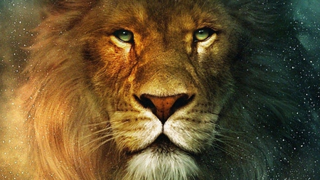
“Aslan is a lion- the Lion, the great Lion." "Ooh" said Susan. "I'd thought he was a man. Is he-quite safe? I shall feel rather nervous about meeting a lion"..."Safe?" said Mr. Beaver ..."Who said anything about safe?
'Course he isn't safe. But he's good. He's the King, I tell you.” -CS Lewis from “The Lion, the Witch and the Wardrobe.”

