Slide 2
PREPARED to win
THE BATTLES OF LIFE

Slide 4
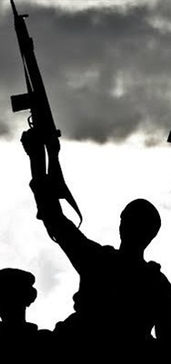

Slide 5
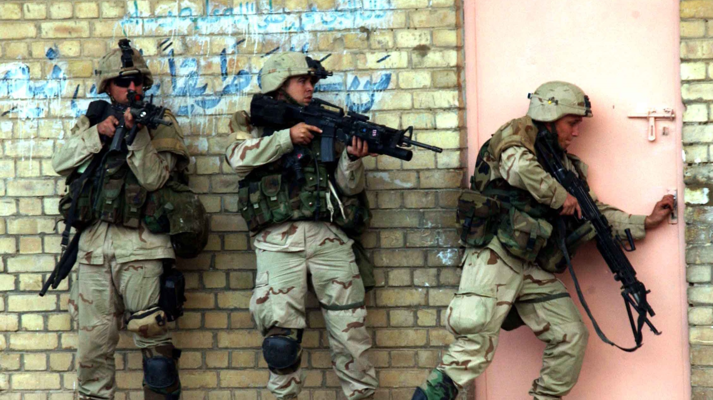

Slide 6
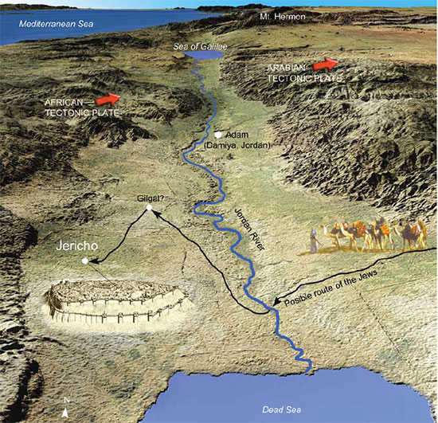

Slide 7
“after the death of Moses…”
JOSHUA 1:1 New Living Translation

Slide 8
BE SAVED
1
BY THE BLOOD OF THE LAMB

Slide 9
But the blood on your doorposts will serve as a sign, marking the houses where you are staying. When I see the blood, I will pass over you.
Exodus 12:13
New Living Translation

Slide 10
With his own blood, not the blood of goats and calves he entered the Most Holy Place once for all time and secured our redemption forever.
Hebrews 9:12
New Living Translation

Slide 11
“Today I have given you the choice between life and death, between blessings and curses. Now I call on heaven and earth to witness the choice you make. Oh, that you would choose life, so that you and your descendants might live!
Deuteronomy 30:19
New Living Translation

Slide 12
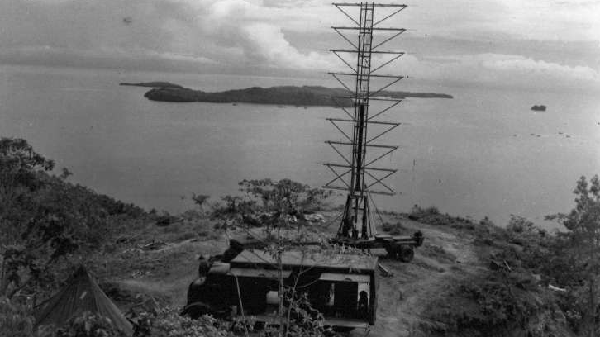
“Don’t worry about it”
1st Lieutenant Tyler 1941 Pearl Harbor

Slide 14
SERVE
2
OTHERS

Slide 15
“…the Lord spoke to Joshua son of Nun, Moses’ assistant.”
Joshua 1:1 new Living Translation

Slide 17
“The path of success always goes down the road of servanthood.”
-Jay Pankratz

Slide 21
BE CONFIDENT
3
IN GOD’S PROMISES

Slide 22
“No one will be able to stand against you as long as you live. For I will be with you as I was with Moses. I will not fail you or abandon you.”
JOSHUA 1:5 New Living Translation

Slide 24
BE COURAGEOUS
4
IN GOD’S PROMISES

Slide 25
“Be strong and courageous, for you are the one who will lead these people
JOSHUA 1:6 New Living Translation

Slide 27
Courage is not the absence of fear but moving on in spite of our fears

Slide 28
Eric-Liddell

Slide 30
BE CAREFUL
5
TO OBEY ALL OF GOD’S WORD

Slide 31
“Be strong and very courageous. Be careful to obey all the instructions Moses gave you. Do not deviate from them, turning either to the right or to the left.”
JOSHUA 1:7 New Living Translation

Slide 33
BE COMMITTED
6
TO GO FORWARD WITH GOD

Slide 34
“Go through the camp and tell the people to get their provisions ready. In three days you will cross the Jordan River and take possession of the land the Lord your God is giving you.”
JOSHUA 1:11 New Living Translation

Slide 35
PREPARED to win
THE BATTLES OF LIFE

