Slide 3
The Good Samaritan
What’s the Point?

Slide 4
Luke 10:25-29
One day an expert in religious law stood up to test Jesus by asking him this question: “Teacher, what should I do to inherit eternal life?” Jesus replied, “What does the law of Moses say? How do you read it?” The man answered, “‘You must love the Lord your God with all your heart, all your soul, all your strength, and all your mind.’ And, ‘Love your neighbor as yourself.’” “Right!” Jesus told him. “Do this and you will live!” The man wanted to justify his actions, so he asked Jesus, “And who is my neighbor?”

Slide 6
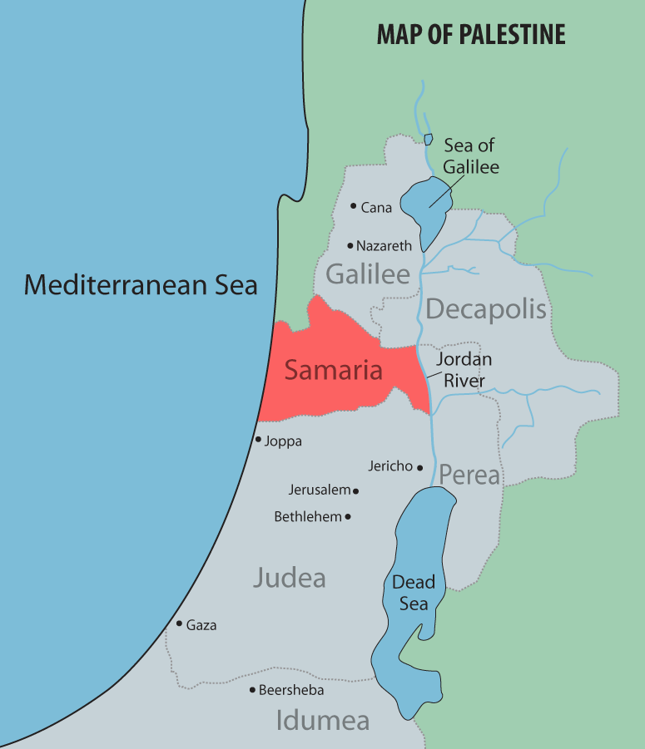

Slide 10
1
BE Aware
“Then a despised Samaritan came along, and when he saw the man…”
Luke 10:33

Slide 12
2
Show compassion
“…he felt compassion for him.”
Luke 10:33

Slide 14
3
Be there
“Going over to him…” Luke 10:34

Slide 16
4
Do what You can
“…the Samaritan soothed his wounds with olive oil and wine and bandaged them. Then he put the man on his own donkey and took him to an inn, where he took care of him.”
Luke 10: 34

Slide 17
Matthew 7:12 “The Golden Rule”
“Do to others whatever you would like them to do to you. This is the essence of all that is taught in the law and the prophets.”

Slide 18
PRAY
The earnest prayer of a righteous person has great power and produces wonderful results.
James 5:16

Slide 20
5
Stay Connected
”The next day he handed the innkeeper two silver coins, telling him, ‘Take care of this man. If his bill runs higher than this, I’ll pay you the next time I’m here.’”
Luke 10:35

