Slide 3
WE Will
remember

Slide 5
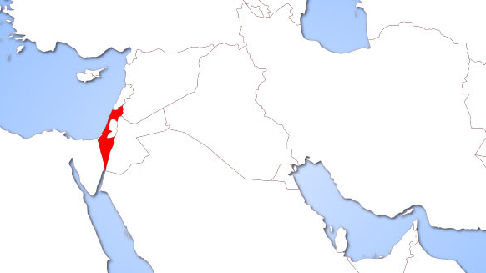
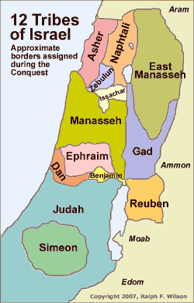
Israel

Slide 6
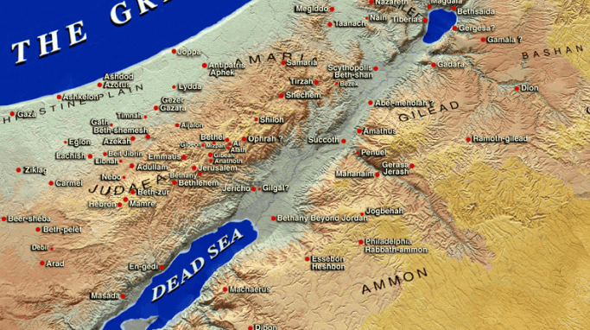
Geliloth

Slide 7
1
Remember
GOD’S COMMANDS

Slide 8
" You have done as Moses, the servant of the Lord, commanded you, and you have obeyed every order I have given you.”
Joshua 22:2
New Living Translation

Slide 9
" But be very careful to obey all the commands and the instructions that Moses gave to you. Love the Lord your God, walk in all his ways, obey his commands, hold firmly to him, and serve him with all your heart and all your soul.”
Joshua 22:2
New Living Translation

Slide 10
" But be very careful to obey all the commands and the instructions that Moses gave to you. Love the Lord your God, walk in all his ways, obey his commands, hold firmly to him, and serve him with all your heart and all your soul.”
Joshua 22:2
New Living Translation

Slide 11
" But be very careful to obey all the commands and the instructions that Moses gave to you. Love the Lord your God, walk in all his ways, obey his commands, hold firmly to him, and serve him with all your heart and all your soul.”
Joshua 22:2
New Living Translation

Slide 12
" But be very careful to obey all the commands and the instructions that Moses gave to you. Love the Lord your God, walk in all his ways, obey his commands, hold firmly to him, and serve him with all your heart and all your soul.”
Joshua 22:2
New Living Translation

Slide 13
" But be very careful to obey all the commands and the instructions that Moses gave to you. Love the Lord your God, walk in all his ways, obey his commands, hold firmly to him, and serve him with all your heart and all your soul.”
Joshua 22:2
New Living Translation

Slide 14
" But be very careful to obey all the commands and the instructions that Moses gave to you. Love the Lord your God, walk in all his ways, obey his commands, hold firmly to him, and serve him with all your heart and all your soul.”
Joshua 22:2
New Living Translation

Slide 16
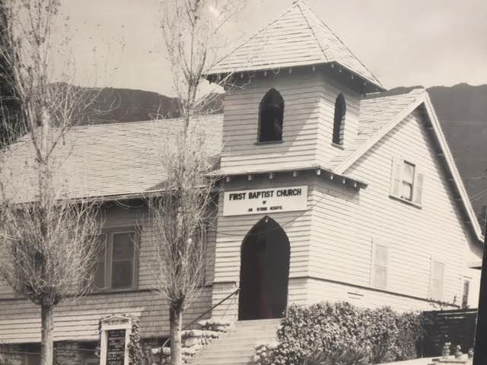
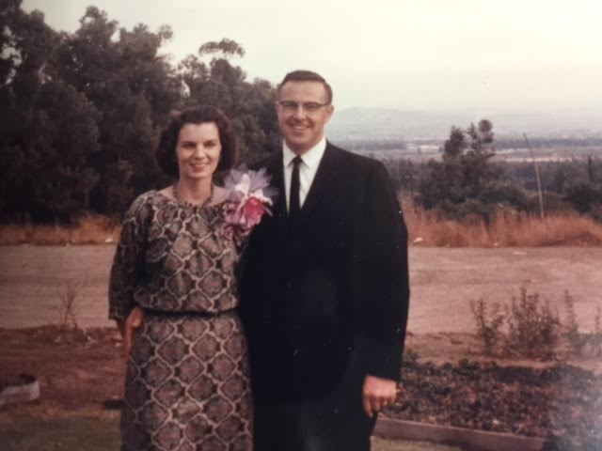
Ken Mayes 1960 - 1964
1916-1966

Slide 17
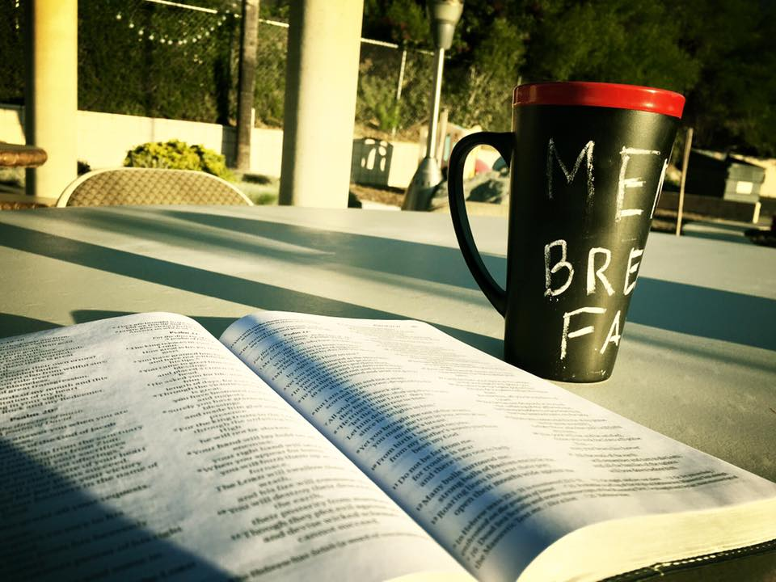

Slide 18
Remember
2
TO COMMUNICATE CLEARLY AND PEACEFULLY

Slide 19
" But while they were still in Canaan, and when they came to a place called Geliloth near the Jordan River, the men of Reuben, Gad, and the half-tribe of Manasseh stopped to build a large and imposing altar."
Joshua 22:10
New Living Translation

Slide 20
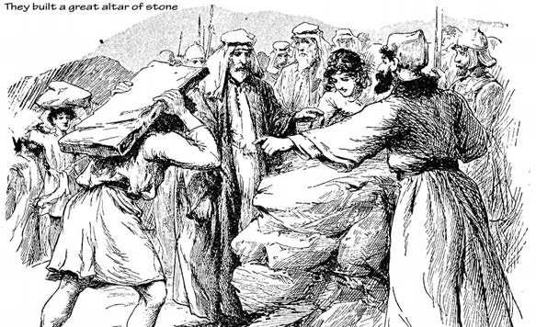
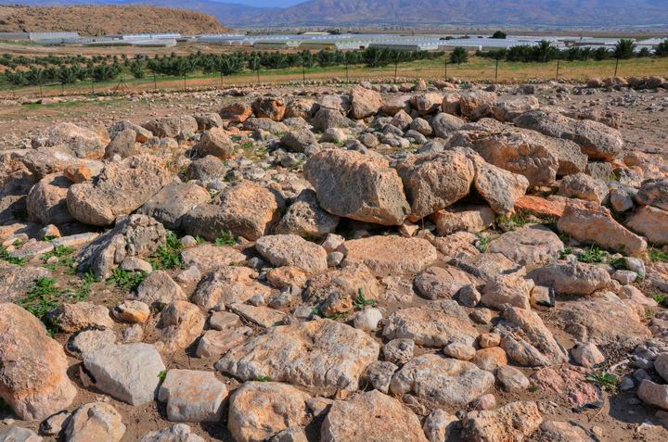

Slide 22
“The whole community of the Lord demands to know why you are betraying the God of Israel. How could you turn away from the Lord and build an altar for yourselves in rebellion against him?”
Joshua 22:16 New living translation

Slide 24
"The Mighty One, God, the Lord! The Mighty One, God, the Lord!
He knows the truth, and may Israel know it, too! We have not built the altar in treacherous rebellion against the Lord. If we have done so, do not spare our lives this day.
Joshua 22:22 New living translation

Slide 26
“Love each other. Just as I have loved you, you should love each other. Your love for one another will prove to the world that you are my disciples.”
John 13:34-35 New living translation

Slide 27
“Do all that you can to live in peace with everyone.”
Romans 12:19 New living translation

Slide 29
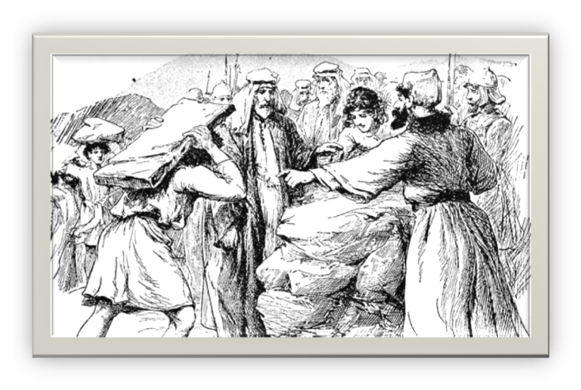
1. Get all the facts

Slide 30
1. Get all the facts
2 Don’t judge only by circumstances

Slide 31
1. Get all the facts
2 Don’t judge only by circumstances
3. Discuss it firmly and gently

Slide 33
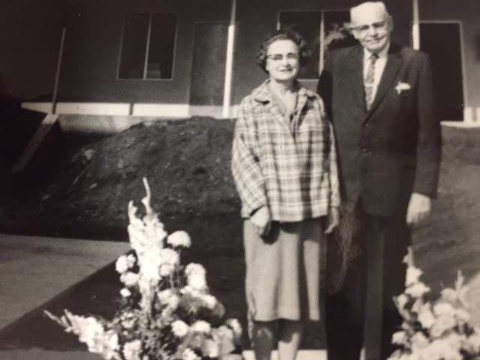
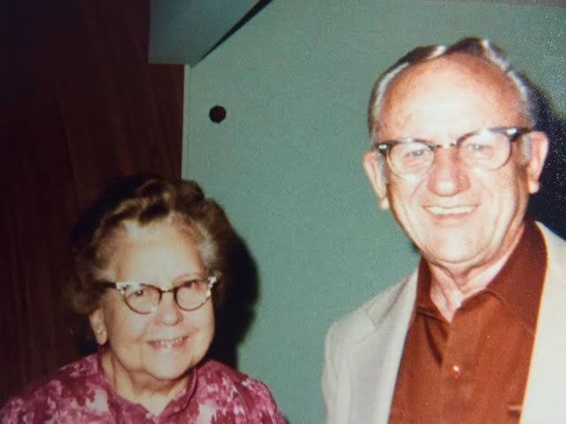
Harold Doty 1965 -1966
Al Engle 1970 -1973

Slide 34
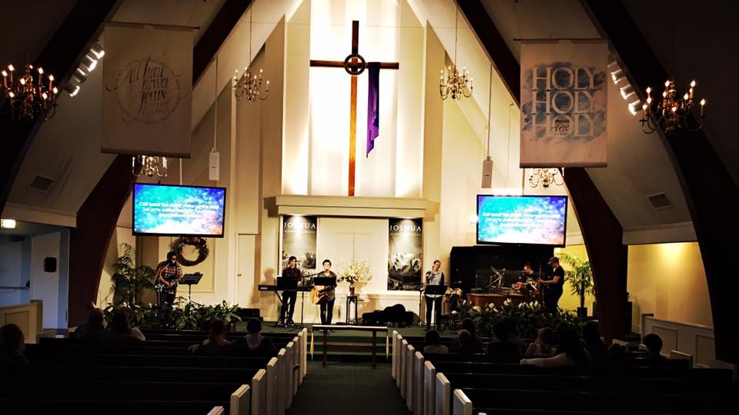
Harold Doty (interim) 1965 -1966 Ed Eliason 1966 – 1970 Irven White (interim) 1970
Al Engle 1970 -1973 Chuck Molnar (interim) 1973- 1974 Gene Paden (interim) 1974 -1975 E.F. Austen (interim) 1975 -1976 Don Buchanan 1976 -1982 Milt Gould (interim) 1982 Bob Coburn (interim) 1983
Rich Freeman 1983 -1987 Harold Adams (interim) 1988 Jay Miller (interim) 1988 Charles Talley (interim) 1989 Ron Boldman 1989 – 2004 Wayne Robbins (interim) 2004 -2005 Chuck McCament 2005 – 2013 Jon Uyboco (interim) 2013-2014 Jim Smith 2014 -

Slide 36
Remember
3
YOUR SPIRITUAL MARKERS

Slide 37
The truth is, we have built this altar because we fear that in the future your descendants will say to ours, ‘What right do you have to worship the Lord, the God of Israel? The Lord has placed the Jordan River as a barrier between our people and you people of Reuben and Gad.
Joshua 15:19
New Living Translation

Slide 38
You have no claim to the Lord.’ So your descendants may prevent our descendants from worshiping the Lord. “So we decided to build the altar, not for burnt offerings or sacrifices, but as a memorial.
Joshua 22:24-27
New Living Translation

Slide 39
It will remind our descendants and your descendants…your descendants will not be able to say to ours, ‘You have no claim to the Lord… it is a reminder of the relationship both of us have with the Lord.’
Joshua 22:27-28 New living translation

Slide 41
A spiritual marker identifies a time of decision when you clearly know that God guided you.
Can you remember the moment you became
a child of God? Were there specific times when He called you to His ways of living? Can you point to times when He clearly guided you in a decision?

Slide 42
Were there times when He spoke powerfully to you about a commitment you should make? Keep track of these important moments! Regularly rehearse them and notice the steady progression in the way God has led you. This will help you understand God’s activity in your life and give you a sense of direction as you face future decisions.
Henry Blackaby

Slide 43
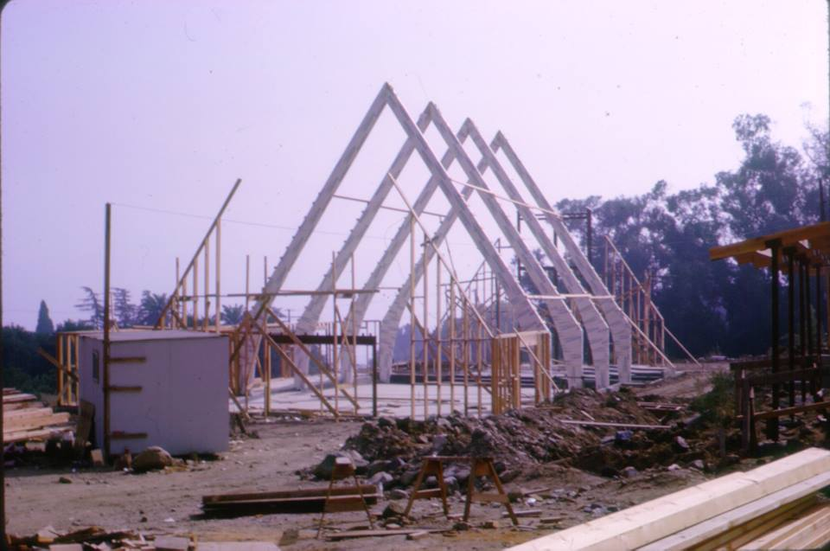
1966

Slide 44
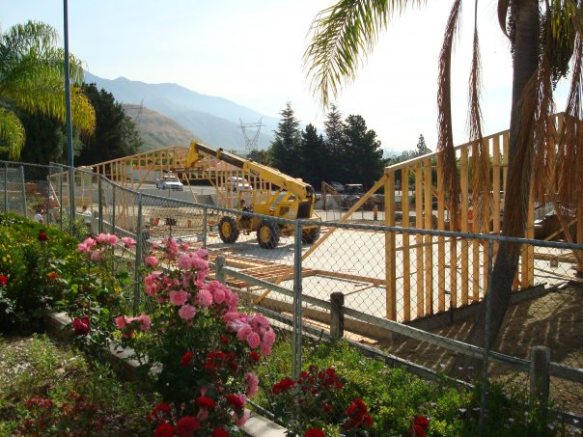
2009
2009

Slide 46
God is Always Working
How is He working in your life?

