Slide 1
HAPPY
EASTER

Slide 2
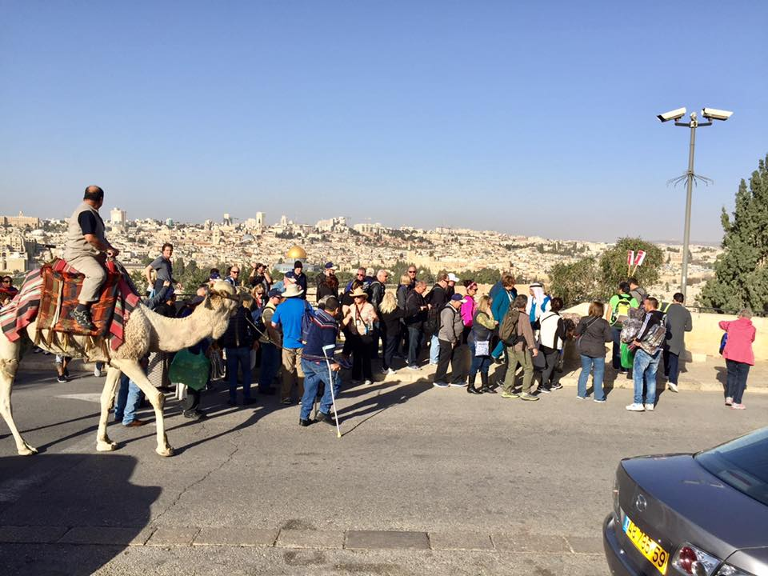

Slide 3
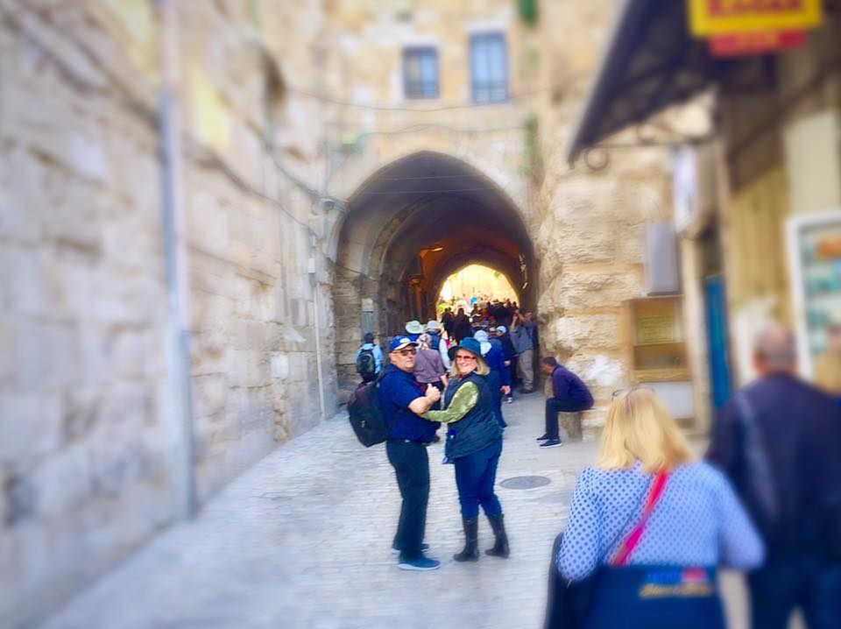

Slide 4
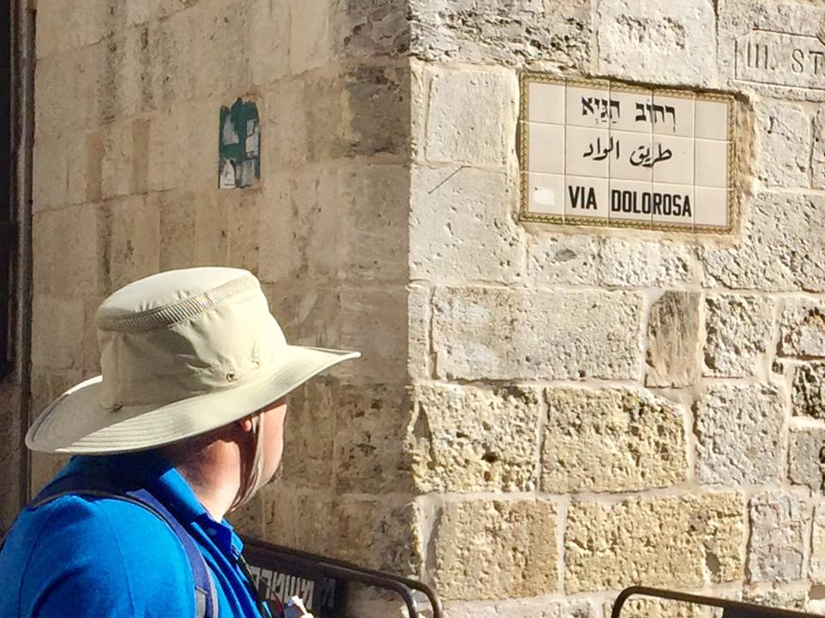

Slide 6
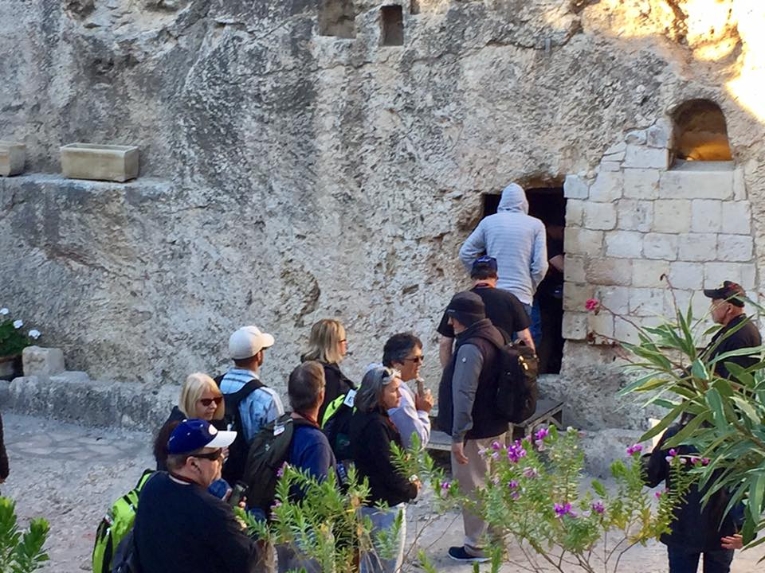

Slide 8
Easter A New Day of
Mercy

Slide 9
Early on Sunday morning, as the new day was dawning, Mary Magdalene and the other Mary went out to visit the tomb.
Matthew 28:1 New Living Translation

Slide 10
Because of God’s tender mercy,
the morning light from heaven is about to break upon us…
Luke 1:78 New Living Translation

Slide 12
MERCY IS
undeserved forgiveness
& unearned kindness

Slide 14
1
ACCEPT GOD’s MERCY BECAUSE
we’ve messed up

Slide 15
Because of God’s tender mercy,
the morning light from heaven is about to break upon us.
Luke 1:78 New Living Translation

Slide 16
Jesus returned to the Mount of Olives, ² but early the next morning he was back again at the Temple. A crowd soon gathered, and he sat down and taught them. ³ As he was speaking, the teachers of religious law and the Pharisees brought a woman who had been caught in the act of adultery. They put her in front of the crowd.
John 2: 1-3 New Living Translation

Slide 17
⁴ “Teacher,” they said to Jesus, “this woman was caught in the act of adultery. ⁵ The law of Moses says to stone her. What do you say?”⁶ They were trying to trap him into saying something they could use against him, but Jesus stooped down and wrote in the dust with his finger. ⁷ They kept demanding an answer, so he stood up again and said, “All right, but let the one who has never sinned throw the first stone!”⁸ Then he stooped down again and wrote in the dust.
John 2: 4-8 New Living Translation

Slide 18
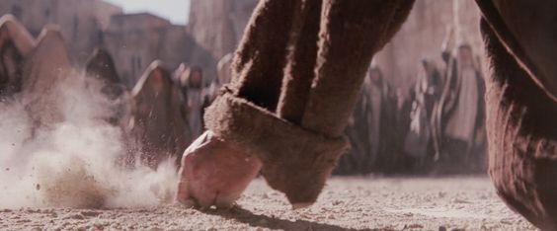

Slide 19
When the accusers heard this, they slipped away one by one, beginning with the oldest, until only Jesus was left in the middle of the crowd with the woman. ¹⁰ Then Jesus stood up again and said to the woman, “Where are your accusers? Didn’t even one of them condemn you?”
¹¹ “No, Lord,” she said.
And Jesus said, “Neither do I. Go and sin no more.”
John 2: 9-11 New Living Translation

Slide 20
What Happens When You accept it

Slide 21
What Happens When You accept it
GOD’S MERCY forgives and frees us from our past.

Slide 22
“I was sent to announce freedom to all held captive and forgiveness to all who’ve been imprisoned.” Isaiah 61:1 (Jesus)
“I have come to save the world and not to judge it.” John 12:47
“O Lord, you are so good and kind, so ready to forgive, so full of mercy for all who ask your aid.” Psalm 86:5

Slide 23
“Jesus understands every weakness of ours, because he was tempted in every way that we are. But he did not sin. So whenever we are in need, we should come bravely before the throne of our merciful God. There we will receive mercy and find the grace to help us in our time of need.”
Hebrews 4:15-16

Slide 25
2
ACCEPT GOD’s MERCY BECAUSE
we don’t have what we need

Slide 26
“What is impossible with men is possible with God.”
Luke 18:27
By his divine power, God has given us everything we need for living a godly life. 2 Peter 1:3

Slide 27
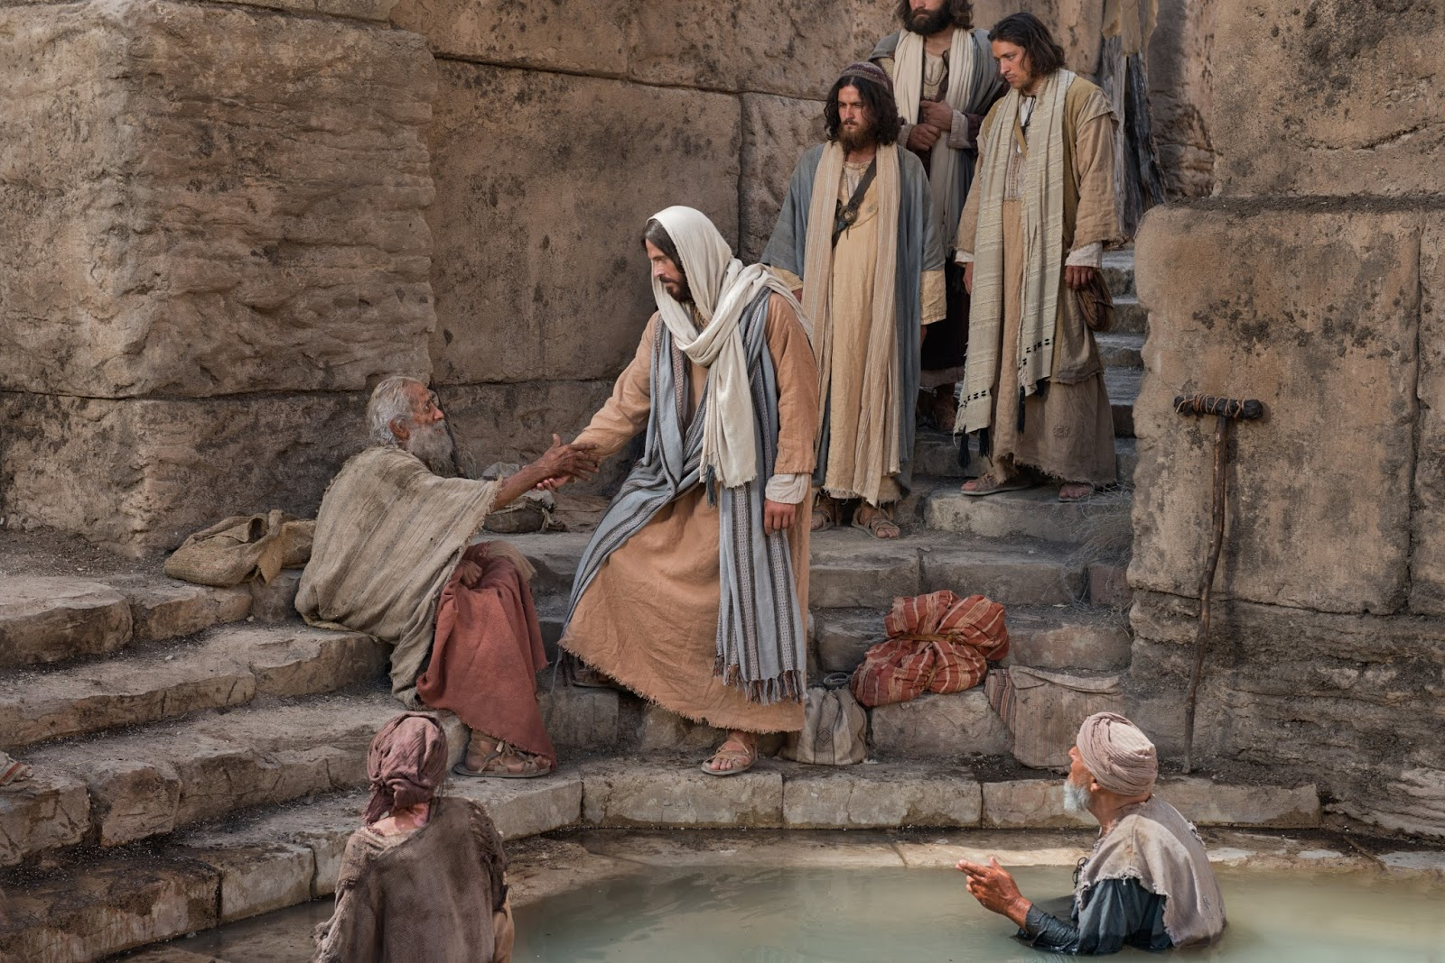

Slide 28
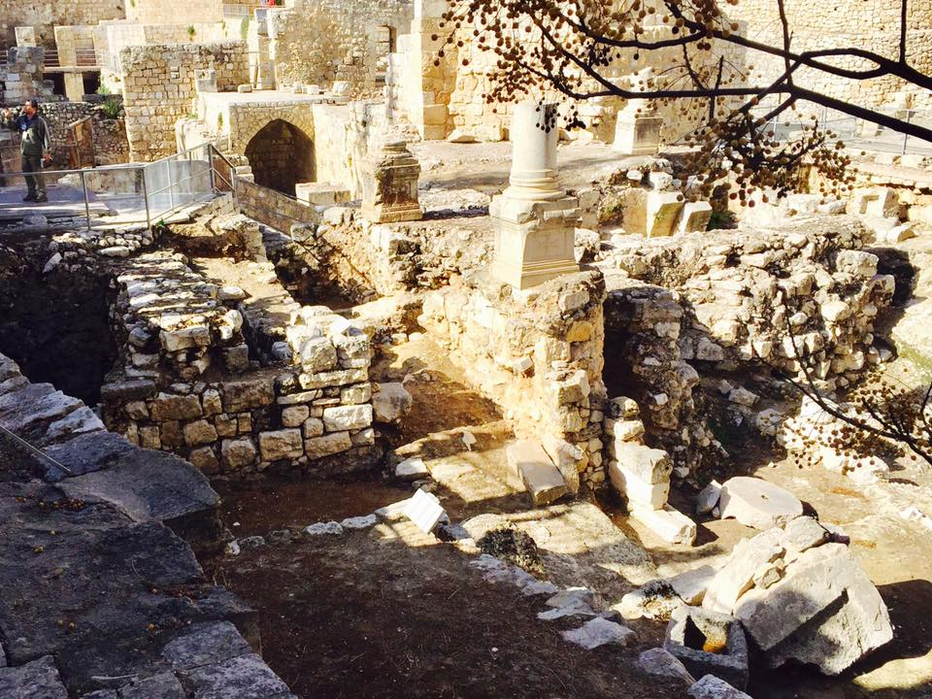

Slide 29
Inside the city, near the Sheep Gate, was the pool of Bethesda, with five covered porches. Crowds of sick people—blind, lame, or paralyzed—lay on the porches.
One of the men lying there had been sick
for thirty-eight years.
John 5: 2-5 New Living Translation

Slide 30
When Jesus saw him and knew
he had been ill for a long time,
he asked him, “Would you like to get well?”
John 5: 6 New Living Translation

Slide 31
“I can’t, sir,” the sick man said,
“for I have no one to put me into the pool
when the water bubbles up.
Someone else always gets there ahead of me.”
John 5: 8-9 New Living Translation

Slide 32
Jesus told him, “Stand up, pick up your mat, and walk!”
Instantly, the man was healed!
He rolled up his sleeping mat and began walking!
John 5: 7 New Living Translation

Slide 33
What Happens When You accept it

Slide 34
What Happens When You accept it
GOD’S MERCY makes the impossible possible

Slide 36
3
ACCEPT GOD’s MERCY BECAUSE
we will face death

Slide 37
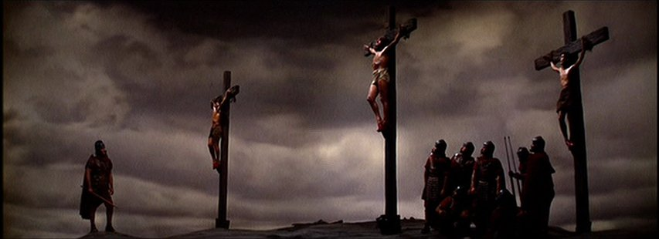

Slide 38
One of the criminals hanging beside him scoffed,
“So you’re the Messiah, are you? Prove it by saving yourself—and us, too, while you’re at it!”
But the other criminal protested,
“Don’t you fear God even when you have been sentenced to die?
Luke 23: 39-41 New Living Translation

Slide 39
“We deserve to die for our crimes, but this man hasn’t done anything wrong.” Then he said, “Jesus, remember me when you come into your Kingdom.”
And Jesus replied, “I assure you, today you will be with me in paradise.”
Luke 23: 41-43 New Living Translation

Slide 40
What Happens When You accept it

Slide 41
What Happens When You accept it
GOD’S MERCY will save me for eternity

Slide 42
“I am the resurrection and the life! Whoever believes in me,
even though he dies, will live again!” John 11:25
“Anyone who asks for mercy from the Lord
shall have it and shall be saved.” Acts 2:21

Slide 43
A-Accept For all have sinned and come short of the glory of God Romans 3:23
B-Believe
“Believe in the Lord Jesus and you will be saved Acts 16:31 C-Confess If you confess with your mouth Jesus as Lord, and believe in your heart that God raised Him from the dead, you will be saved Romans 10:9

Slide 44
HAPPY
EASTER

