Slide 2
Filled
with the
spirit
the study of the holy spirit

Slide 3
"Don’t be drunk with wine, because that will ruin your life. Instead, be filled with the Holy Spirit.”
EPHESIANS 5:18
new living translation
he’s more than a force

Slide 4
misconceptions
It is an emotional experience

Slide 5
misconceptions
It is an emotional experience
It is only for special christians

Slide 6
misconceptions
It is an emotional experience
It is only for special christians
It is Controversial and therefore better off ignored

Slide 7
THE DISCIPLES
And everyone present was filled with the Holy Spirit and began speaking in other languages, as the Holy Spirit gave them this ability.
ACTS 2:4
new living translation
he’s more than a force

Slide 8
THE SAMARITANS
¹⁴ When the apostles in Jerusalem heard that the people of Samaria had accepted God’s message, they sent Peter and John there. ¹⁵ As soon as they arrived, they prayed for these new believers to receive the Holy Spirit.
ACTS 8:14-17
new living translation
he’s more than a force

Slide 9
THE SAMARITANS
¹⁶ The Holy Spirit had not yet come upon any of them, for they had only been baptized in the name of the Lord Jesus. ¹⁷ Then Peter and John laid their hands upon these believers, and they received the Holy Spirit.
ACTS 8:14-17
new living translation
he’s more than a force

Slide 10
THE GENTILES
Even as Peter was saying these things, the Holy Spirit fell upon all who were listening to the message. The Jewish believers who came with Peter were amazed that the gift of the Holy Spirit had been poured out on the Gentiles, too. For they heard them speaking in other tongues and praising God
ACTS 10:44-46
new living translation
he’s more than a force

Slide 11
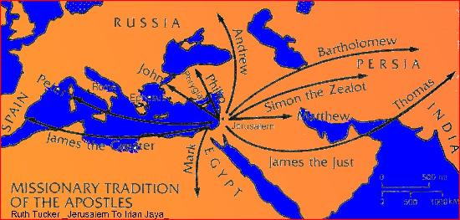

Slide 12
Desire
1
To be under the control of the holy spirit

Slide 15
Blessed are those who hunger and thirst for righteousness,
for they will be filled.
MATTHEW 5:6
new living translation
he’s more than a force

Slide 16
But the Holy Spirit produces this kind of fruit in our lives: love, joy, peace, patience, kindness, goodness, faithfulness, gentleness, and self-control
GALATIANS 5:22
new living translation
he’s more than a force

Slide 17
And do not grieve the Holy Spirit of God, with whom you were sealed for the day of redemption.
EPHESIANS 4:30
new living translation
he’s more than a force

Slide 18
So I say, let the Holy Spirit guide your lives. Then you won’t be doing what your sinful nature craves.
GALATIANS 5:16
new living translation
he’s more than a force

Slide 19
I urge you, brothers, in view of God's mercy, to offer your bodies as living sacrifices, holy and pleasing to God
ROMANS 12:1
new living translation
he’s more than a force

Slide 20
BE available
2
TO THE HOLY SPIRIT

Slide 21
Don’t be drunk with wine, because that will ruin your life. Instead, be filled with the Holy Spirit.
EPHESIANS 5:18
new living translation
he’s more than a force

Slide 22
Don’t be drunk with wine, because that will ruin your life. Instead, be filled with the Holy Spirit.
EPHESIANS 5:18
new living translation
he’s more than a force

Slide 23
fillability

Slide 24
It’s about influence and control It’s a command
It’s continual It’s something the Holy Spirit does

Slide 25
Continually choose
3
To live under his influence

Slide 27
We continually ask God to fill you with the knowledge of his will through all the wisdom and understanding that the Spirit gives, so that you may live a life worthy of the Lord and please him in every way…
COLOSSIANS 1:9-10
new living translation
he’s more than a force

Slide 28
…bearing fruit in every good work, growing in the knowledge of God, being strengthened with all power according to his glorious might so that you may have great endurance and patience, and giving joyful thanks to the Father, who has qualified you to share in the inheritance of his holy people in the kingdom of light.
COLOSSIANS 1:10-12
new living translation
he’s more than a force

Slide 29
WE NEED TWo THiNGS…
EMPTINESS AND OPENNESS

