Slide 1
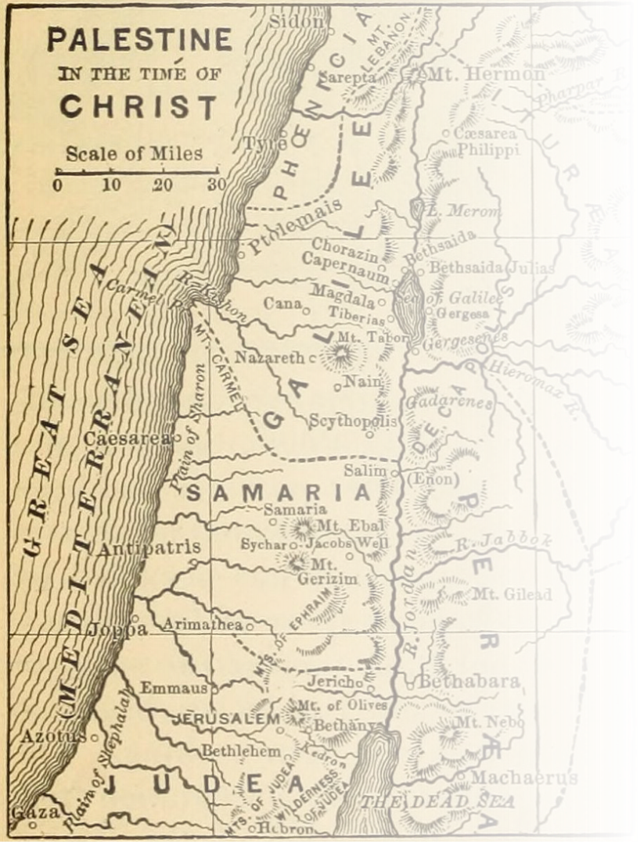
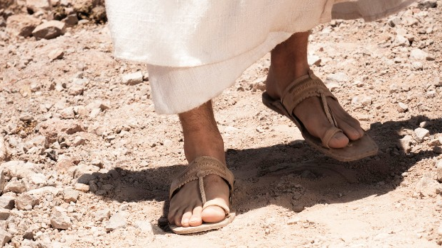
Where Jesus Walked
40 days in the footsteps of Christ

Slide 2
Validation
Where Jesus Walked

Slide 4
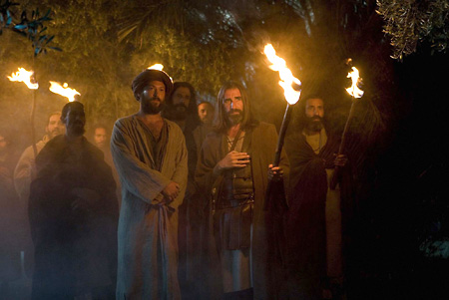
Arrest

Slide 5
Judas, the betrayer, knew this place, because Jesus had often gone there with his disciples. The leading priests and Pharisees had given Judas a contingent of Roman soldiers and Temple guards to accompany him. Now with blazing torches, lanterns, and weapons, they arrived at the olive grove.
John 18:2-3 New Living Translation

Slide 6
Judas, the betrayer, knew this place, because Jesus had often gone there with his disciples. The leading priests and Pharisees had given Judas a contingent of Roman soldiers and Temple guards to accompany him. Now with blazing torches, lanterns, and weapons, they arrived at the olive grove.
John 18:2-3 New Living Translation

Slide 7
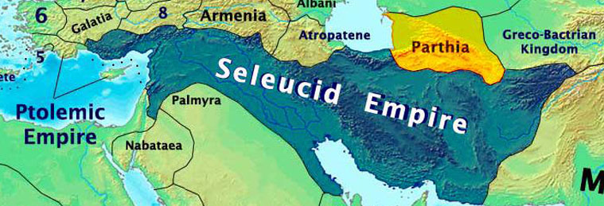
Judas Maccabeus
-He led a revolt against the Seleucid Empire (167–160 BCE)

Slide 8
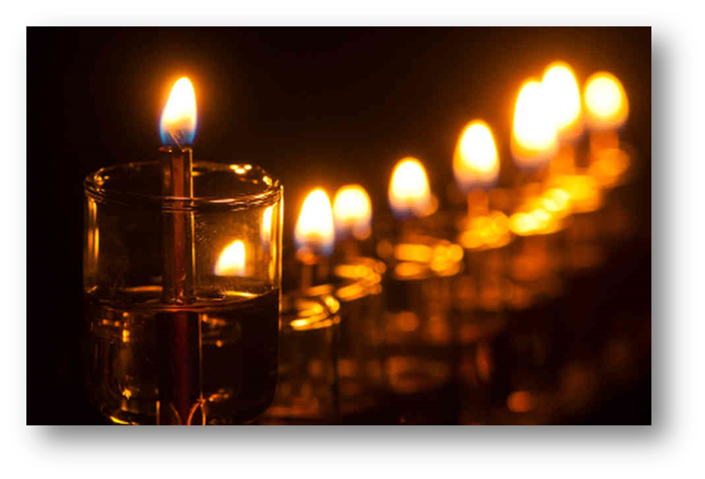
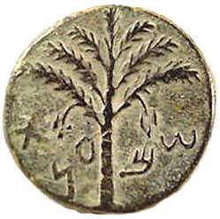
Judas Maccabeus

Slide 9
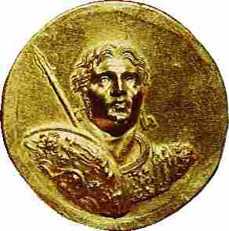
Judas of Galilee
A Jewish leader who led an armed resistance to the census imposed for roman tax purposes around 6 AD

Slide 10
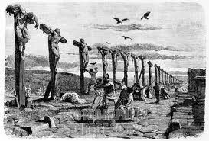
Judas of Galilee
After him, at the time of the census, there was Judas of Galilee. He got people to follow him, but he was killed, too, and all his followers were scattered.
Acts 5:37 New Living Translation

Slide 11
Judas, the betrayer, knew this place, because Jesus had often gone there with his disciples. The leading priests and Pharisees had given Judas a contingent of Roman soldiers and Temple guards to accompany him. Now with blazing torches, lanterns, and weapons, they arrived at the olive grove.
John 18:2-3 New Living Translation

Slide 12
Judas, the betrayer, knew this place, because Jesus had often gone there with his disciples. The leading priests and Pharisees had given Judas a contingent of Roman soldiers and Temple guards to accompany him. Now with blazing torches, lanterns, and weapons, they arrived at the olive grove.
John 18:2-3 New Living Translation

Slide 13
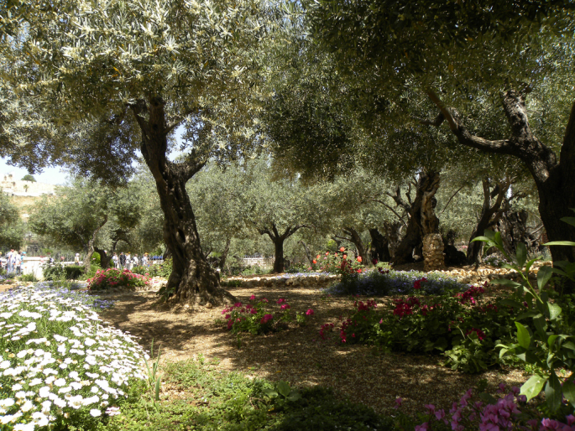
Every day Jesus went to the Temple to teach, and each evening he returned to spend the night on the Mount of Olives.
Luke 21:37 New Living Translation

Slide 14
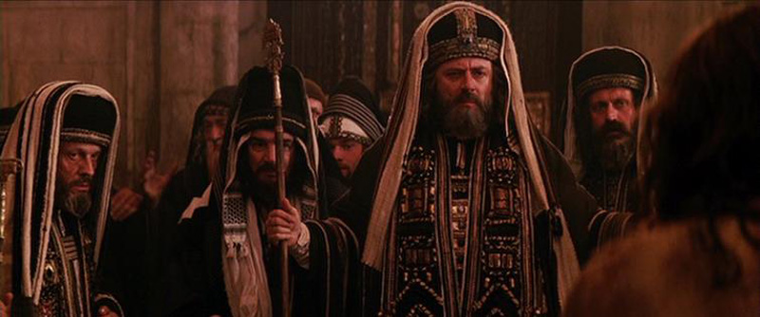
Trials

Slide 15
The Trials
Three Jewish religious trials
1. Annas, Decision: proceed
2. Caiaphas, Decision: proceed death sentence
3. Sanhedrin, Decision: Death.

Slide 16
1. No Formal Charge 2. Secret Night Meeting 3. Judges Brought Charges 4. No Witnesses for Jesus 5. No Trial Allowed Before Passover 6. Not Effort Time Allowed 7. Personal Testimony Cannot Incriminate
Illegal!

Slide 17
Trials
Three Roman Civic trials
1. Pilate, Decision: Not guilty.
2. Herod, Decision: Not guilty.
3. Pilate again, Decision: Not guilty

Slide 18
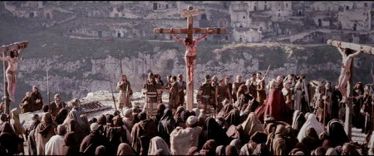
Death

Slide 19
Why die?
#6) To reconcile us to God #5) To show God’s love for sinners
#4) To show Jesus’ own love for us
#3) To take away our condemnation
#2) To bring us to God
#1) To give eternal life to all who believe on Him
-john piper

Slide 21
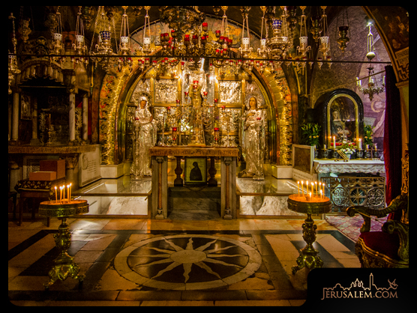
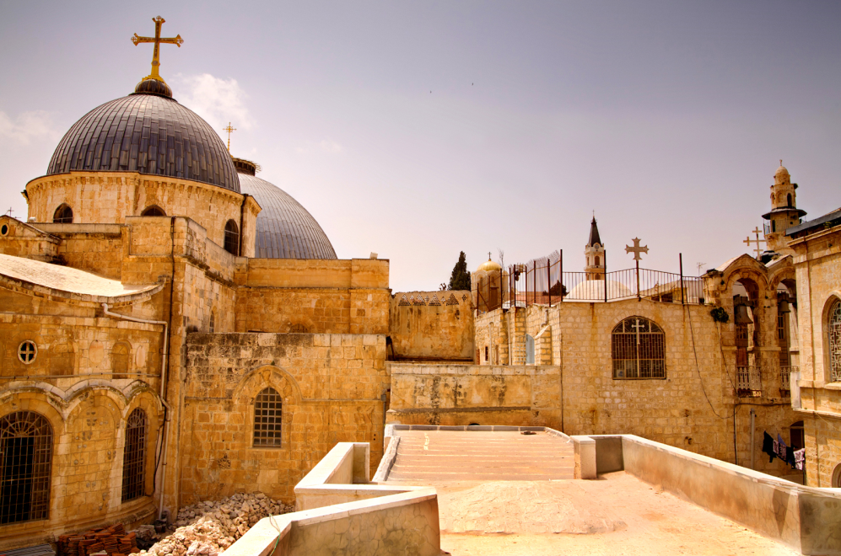

Slide 22
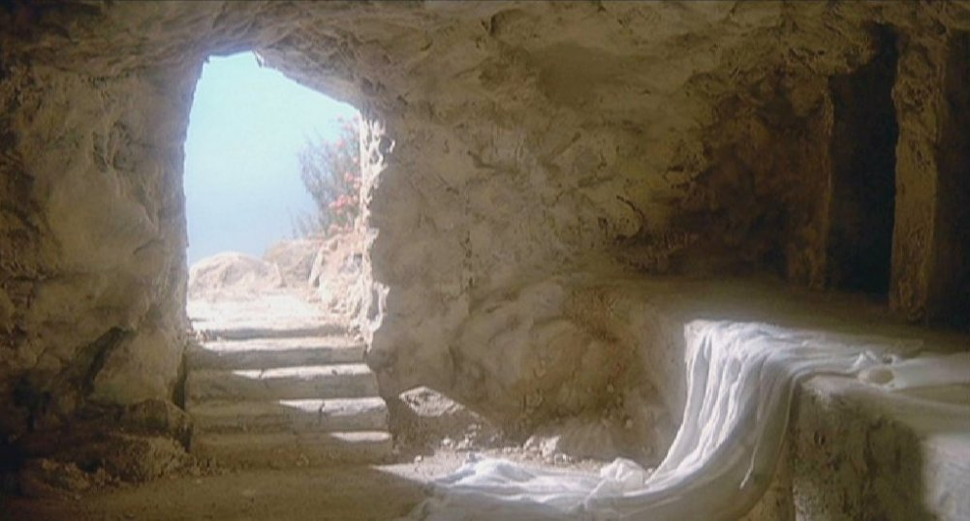
resurrection

Slide 23
Why believe?
· A Public Execution Assured His Death · A High Official Secured The Gravesite · In Spite Of Guards, The Grave Was Found Empty · Many People Claimed To Have Seen Him Alive · His Apostles Were Dramatically Changed · Witnesses Were Willing To Die For Their Claims · Jewish Believers Changed Their Day Of Worship · Although It Was Unexpected, It Was Clearly Predicted

Slide 24
Jesus’ life and resurrection changes me when I…

Slide 25
1. Believe it really happened
I passed on to you what was most important and what had also been passed on to me. Christ died for our sins, just as the Scriptures said. He was buried, and he was raised from the dead on the third day, just as the Scriptures said.
1 Corinthians 15:3-4 New Living Translation

Slide 26
2. Believe it happening now
But you will receive power when the Holy Spirit comes upon you. And you will be my witnesses, telling people about me everywhere—in Jerusalem, throughout Judea, in Samaria, and to the ends of the earth.
Acts 1:8 New Living Translation

Slide 27
3. Believe it will happen
“Men of Galilee,” they said, “why are you standing here staring into heaven? Jesus has been taken from you into heaven, but someday he will return from heaven in the same way you saw him go!”
Acts 1:11 New Living Translation

Slide 28
Where Jesus Walked
40 days in the footsteps of Christ

