Slide 2
Depends on
who you depend on

Slide 3
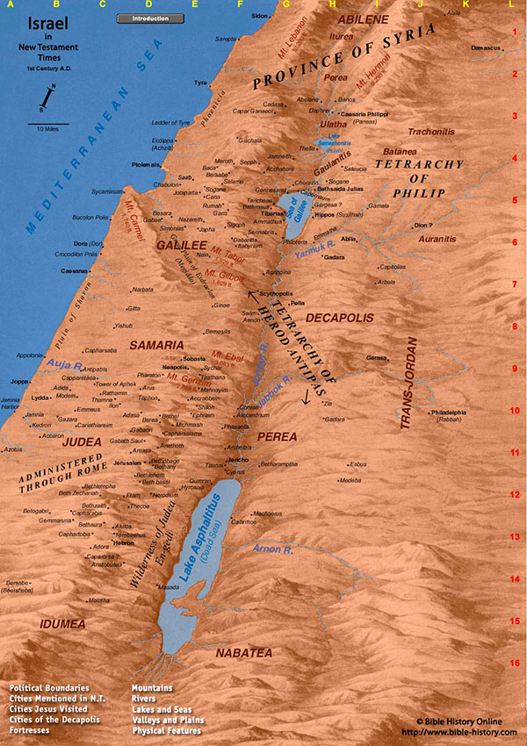

Slide 4
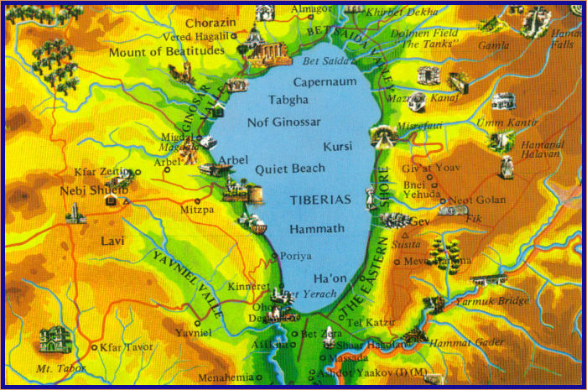

Slide 5
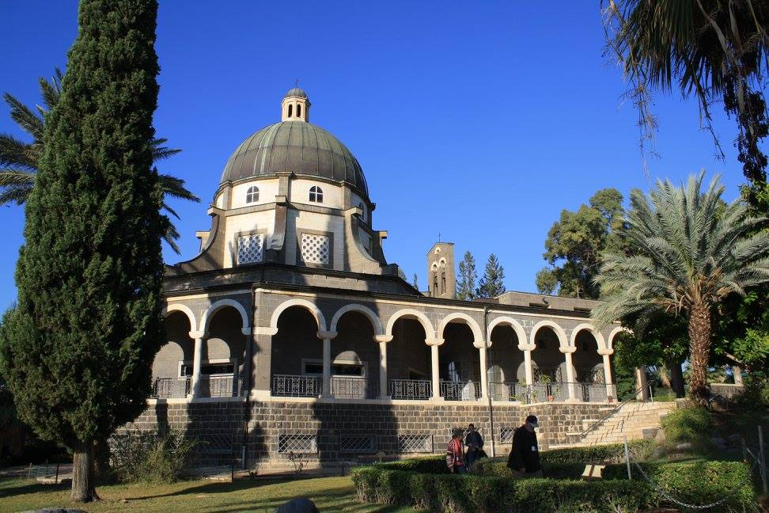

Slide 6
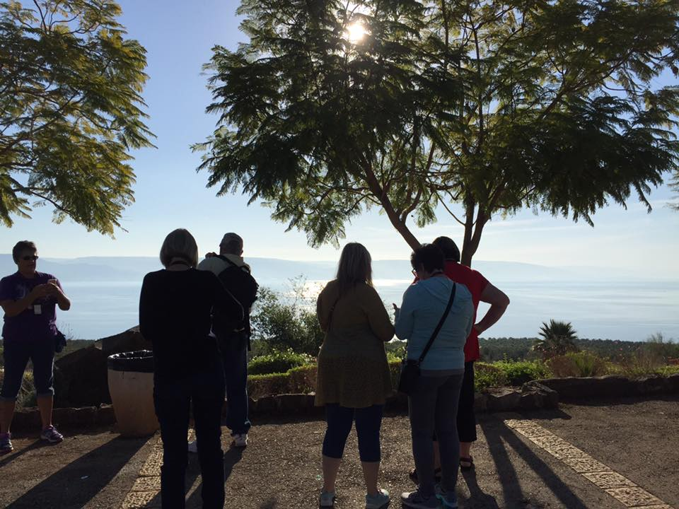

Slide 7
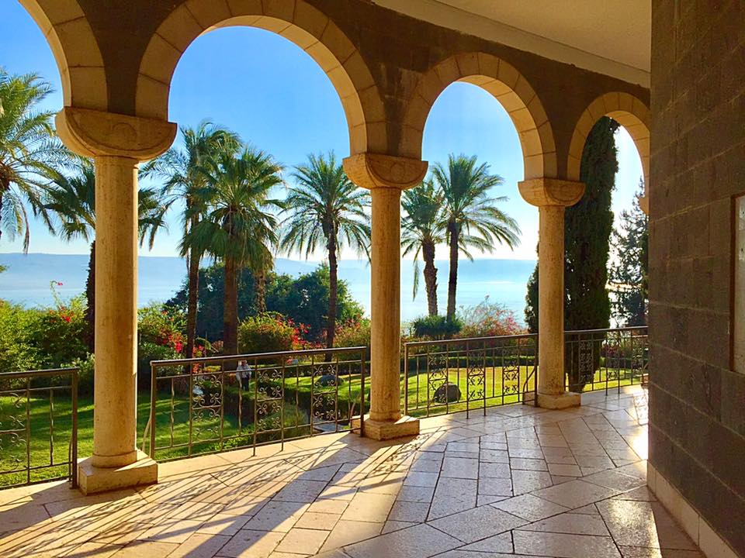

Slide 8
MATTHEW 5:3-10 NLT
“God blesses those who are poor and realize their need for him, for the Kingdom of Heaven is theirs.
God blesses those who mourn, for they will be comforted.
God blesses those who are humble, for they will inherit the whole earth.
God blesses those who hunger and thirst for justice, for they will be satisfied.

Slide 9
MATTHEW 5:3-10 NLT
God blesses those who are merciful, for they will be shown mercy.
God blesses those whose hearts are pure, for they will see God.
God blesses those who work for peace, for they will be called the children of God.
God blesses those who are persecuted for doing right, for the Kingdom of Heaven is theirs

Slide 10
1
Depend on
God’s wisdom

Slide 11
PROVERBS 14:12 ESV There is a way that seems right to a man, but its end is the way to death.

Slide 12
JAMES 1:5 ESV If any of you lacks wisdom, let him ask God, who gives generously to all without reproach, and it will be given him.

Slide 13
PROVERBS 3:5-6 NLT Trust in the Lord with all your heart; do not depend on your own understanding. Seek his will in all you do, and he will show you which path to take.

Slide 14
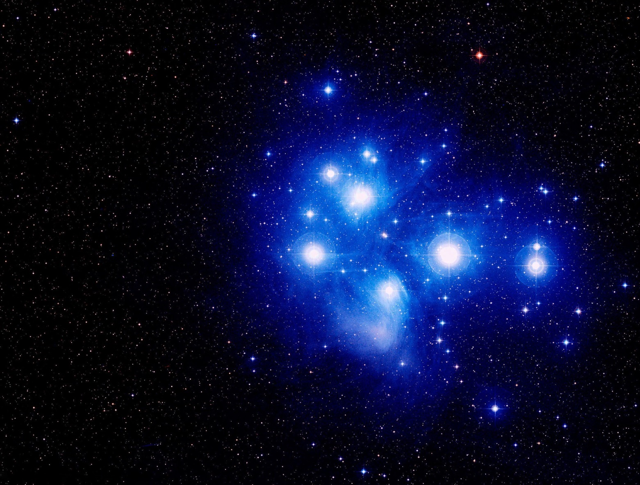
“Can you direct the movement of the stars—
binding the cluster of the Pleiades or loosening the cords of Orion? Can you direct the constellations through the seasons or guide the Bear with her cubs across the heavens?
Do you know the laws of the universe? Can you use them to regulate the earth? Job 38:31-33

Slide 15
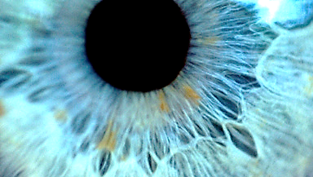

Slide 16
READ AND PRAY
READ THIS WEEK:
Ps. 62 / Phil 4 / Is. 40 / 2 Cor. 12:1-10
PRAY A.C.T.S. adoration/confession/thanks/supplication

Slide 18
2
Depend on
God’s strength

Slide 19
PSALMS 71:16 KJV I walk in the strength of the Lord.

Slide 20
ISAIAH 40:31 NLT But those who trust in the Lord will find new strength. They will soar high on wings like eagles. They will run and not grow weary. They will walk and not faint.

Slide 21
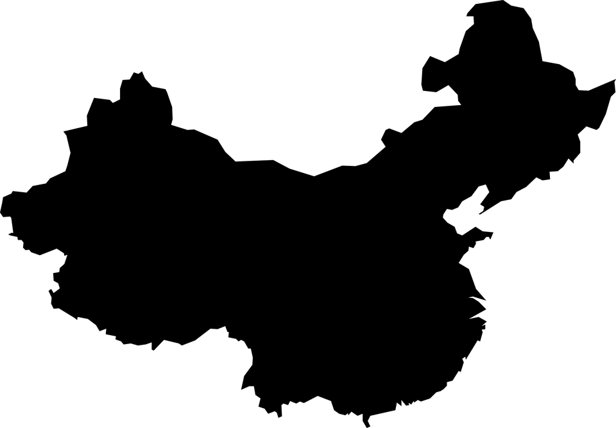
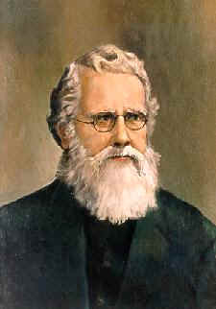
“I am so weak I can no longer work. I am so weak I can no longer study. I am so weak I can no longer read my Bible. I cannot even pray. I can only lie still in the arms of God like a little child in trust.” -Hudson Taylor Missionary to China from 1854-1905

Slide 23
3
Depend on
God’s timing

Slide 24
PSALM 31:14-15 NIV I trust in you, O Lord. You are my God. My times are in your hands.

Slide 25
GALATIANS 4:4 NLT But when the right time came, God sent his Son, born of a woman, subject to the law.

Slide 26
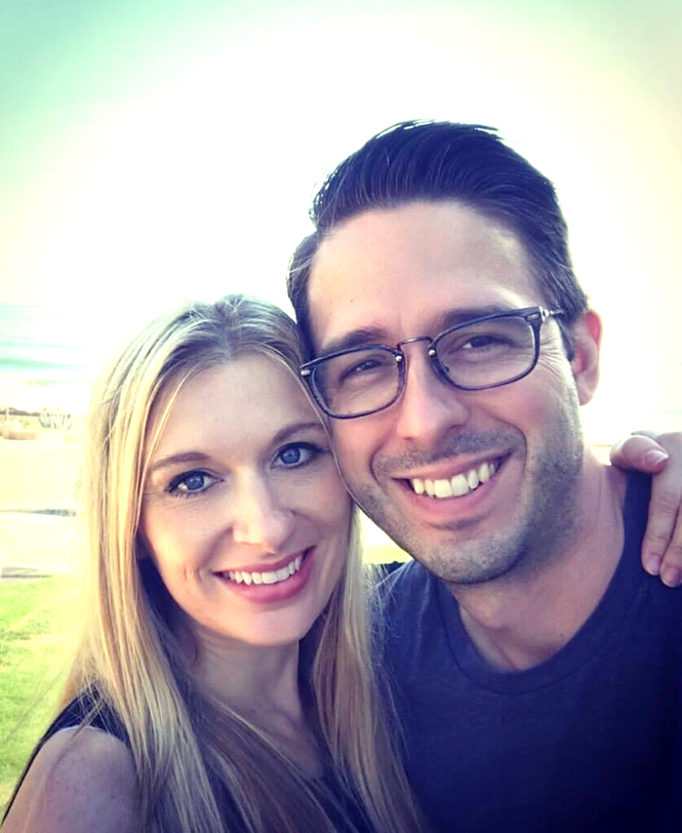

Slide 27
Delay is not a denial

Slide 29
4
Depend on
God’s defense

Slide 30
1 PETER 2:23 NLT When they hurled their insults at him, he did not retaliate; when he suffered, he made no threats. Instead, he entrusted himself to him who judges justly.

Slide 31
ROMANS 12:19 NLT Dear friends, never take revenge. Leave that to the righteous anger of God. For the Scriptures say, “I will take revenge; I will pay them back,”
says the Lord.

Slide 33
5
Depend on
God’s wealth

Slide 34
ROMANS 12:19 NLT And this same God who takes care of me will supply all your needs from his glorious riches, which have been given to us in Christ Jesus.

Slide 36
Declaration of Dependence
get baptized

