Slide 4
Living in the goodness of God
How God Comforts His Sheep

Slide 5
Psalm 23

Slide 6
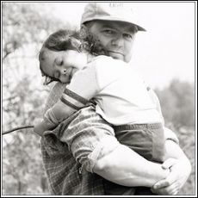
COMFORT
A state of physical ease and freedom from pain or constraint.
Things that contribute to physical ease and well-being.

Slide 7
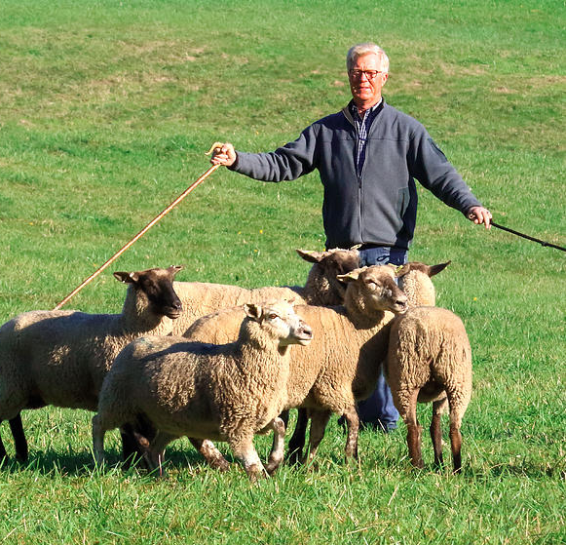
Psalm 23

Slide 9
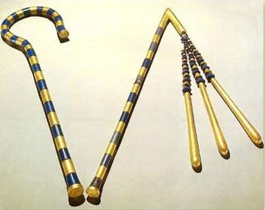
HOW IS A ROD COMFORTING?
Your rod and your staff protect and comfort me.
Psalm 23:4

Slide 10
A ROD represents Power and Authority
Your rod and your staff protect and comfort me.
Psalm 23:4

Slide 12
GOD’S IN CHARGE
"The earth is the LORD’s, and everything in it, the world, and all who live in it; for he founded it on the seas and established it on the waters"
Psalm 24:1-2

Slide 13
GOD PROTECTS US
“God is faithful. He will not allow the temptation to be more than you can stand. When you are tempted, he will show you a way out so that you can endure.” 1 CORINTHIANS 10:13

Slide 14
“reach out and take away everything he has, and he will surely curse you to your face!”
“All right, you may test him,” the Lord said to Satan. “Do whatever you want with everything he possesses, but don’t harm him physically.”
So Satan left the Lord’s presence.
Job 1:11-12

Slide 15
And they consoled him and comforted him because of all the trials the Lord had brought against him.
Job 42:11

Slide 16
“Satan is God’s strange servant to do the will of God.”
-John Piper

Slide 17
GOD DISCIPLINES US
God’s discipline is always good for us, so that we might share in his holiness. No discipline is enjoyable while it is happening—it’s painful! But afterward there will be a peaceful harvest of right living for those who are trained in this way.
Hebrews 12:10-11

Slide 19
HOW IS A STAFF COMFORTING?
Your rod and your staff protect and comfort me.
Psalm 23:4

Slide 20
A STAFF represents Care and Compassion
Your rod and your staff protect and comfort me.
Psalm 23:4

Slide 21
GOD RESCUES US
“You have allowed me to suffer much hardship,
but you will restore me to life again
and lift me up from the depths of the earth.
You will restore me to even greater honor
and comfort me once again.”
psalm 71:20-21

Slide 22
GOD GUIDES US
“After he has gathered his own flock, he walks ahead of them, and they follow him because they know his voice..”
John 10:4

Slide 23
GOD KEEPS US
“ I give them eternal life, and they will never perish. No one can snatch them away from me, for my Father has given them to me, and he is more powerful than anyone else. No one can snatch them from the Father’s hand.”
John 10:28-29

Slide 25
Take comfort to realize that God takes time to invest in your life.

Slide 26
Psalm 23

