Slide 4
Making Wise Decisions
IN CHALLENGING TIMES

Slide 5
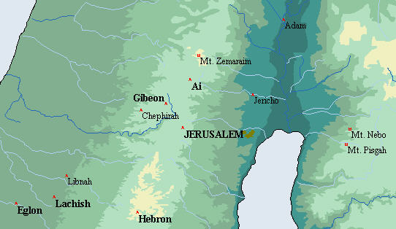

Slide 7
1
KNOW
YOUR ENEMY

Slide 8
These kings combined their armies to fight as one against Joshua and the Israelites. But when the people of Gibeon heard what Joshua had done to Jericho and Ai, they resorted to deception to save themselves.
Joshua 9:2-4
New Living Translation

Slide 10
Stay alert! Watch out for your great enemy, the devil. He prowls around like a roaring lion, looking for someone to devour.
1 Peter 5:8
New living translation

Slide 11
Even Satan disguises himself as an angel of light.
2 Corinthians 11:14
New Living Translation

Slide 13
Sometimes Satan’s ambassador’s can lie more convincingly that Christians can tell the truth.
-Warren W. Wiersbe

Slide 14
ASK GOD
2
FOR WISDOM

Slide 15
So the Israelites examined their food, but they did not consult the Lord.
Joshua 9:14
New Living Translation

Slide 16
If any of you lacks wisdom, you should ask God, who gives generously to all without finding fault, and it will be given to you.
James 1:5 New International version

Slide 18
- Accept God’s Word as the final authority.
"Your Word is a lamp to my feet and a light for my path." PSALM 119 : 105
"We also thank God continually because, when you received the Word of God which you heard from us, you accepted it, not as the word of men, but actually as it is, the Word of God, which is at work in you who believe." 1 THESSALONIANS 2 : 13

Slide 19
UNRELIABLE SOURCES OF AUTHORITY • Culture (always changing) "Don't follow the crowd in doing wrong." EXODUS 23:2 • Traditions (like a strait jacket) "You have replaced the commands of God with the traditions of men." MARK 7:8 • Feelings (unreliable) "There is a way that seems right to man, but the ends thereof are the ways of death." PROVERBS 16:25

Slide 20
Accept God’s Word as the final authority.

Slide 21
Accept God’s Word as the final authority.
Pray Do not worry. Learn to pray about everything. Give thanks to God as you ask Him for what you need. Phil 4:6

Slide 22
Accept God’s Word as the final authority.
Pray Do not worry. Learn to pray about everything. Give thanks to God as you ask Him for what you need. Phil 4:6
Seek wise counsel "A wise man will hear and increase in learning, And a man of understanding will acquire wise counsel." PROVERBS 1:5

Slide 23
Accept God’s Word as the final authority.
Pray Do not worry. Learn to pray about everything. Give thanks to God as you ask Him for what you need. Phil 4:6
Seek wise counsel "A wise man will hear and increase in learning, And a man of understanding will acquire wise counsel." PROVERBS 1:5
Look at Circumstances "When I went to Troas to preach the Gospel of Christ and found that the Lord had opened a door for me...“ 2 CORINTHIANS 2:12

Slide 25
WHEN YOU MAKE A COMMITMENT
3
Keep it

Slide 26
The people of Israel grumbled against their leaders because of the treaty. But the leaders replied, “Since we have sworn an oath in the presence of the Lord, the God of Israel, we cannot touch them. This is what we must do. We must let them live, for divine anger would come upon us if we broke our oath.”
JOSHUA 9:18-20 New Living Translation

Slide 28
4
Admit your mistake
AND MAKE THE BEST OF IT

Slide 29
But that day he made the Gibeonites the woodcutters and water carriers for the community of Israel and for the altar of the Lord—wherever the Lord would choose to build it.
JOSHUA 9:27 New Living Translation

Slide 30
The descendants of the following Temple servants returned from exile:
Ezra 2:43 New Living Translation
Nethinim which means “given ones”

