Slide 2
FUGAZI
GOD

Slide 3
EXODUS 20:4-5
You must not make for yourself an idol of any kind or an image of anything in the heavens or on the earth or in the sea. You must not bow down to them or worship them, for I, the Lord your God, am a jealous God who will not tolerate your affection for any other gods.

Slide 5
WHAT’S AN IDOL?
BUDDHA

Slide 6
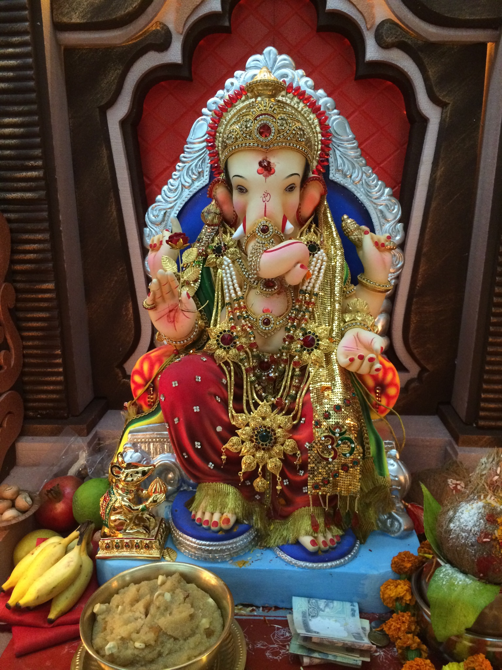
WHAT’S AN IDOL?
BUDDHA
GANESH

Slide 7
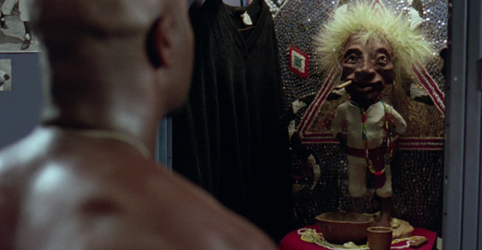
WHAT’S AN IDOL?
BUDDHA
GANESH
JOBU

Slide 8
WHAT’S AN IDOL?

Slide 9
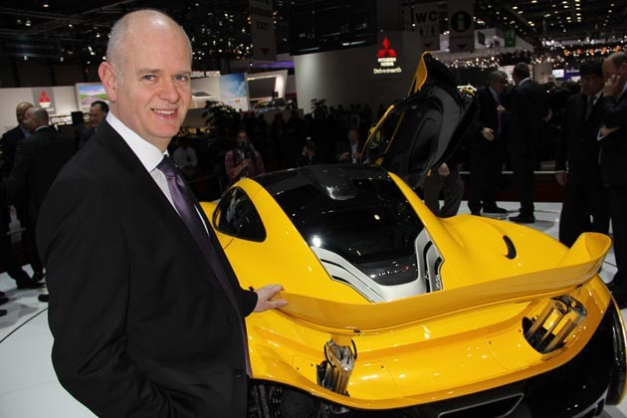
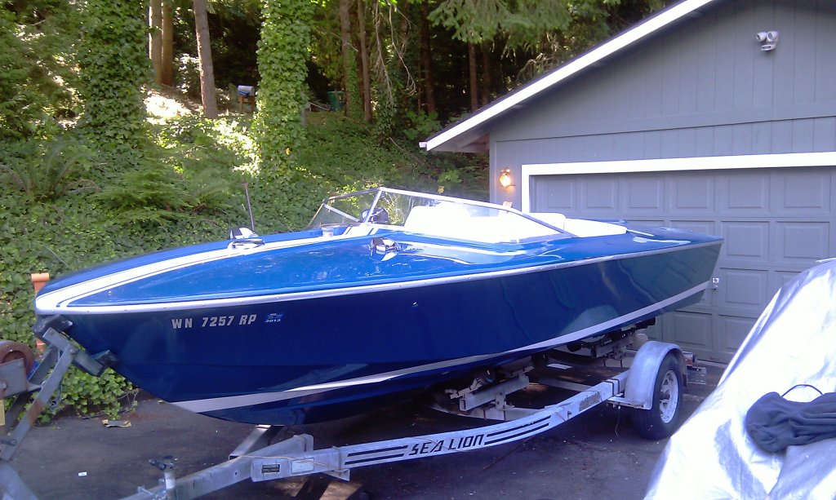
WHAT’S AN IDOL?

Slide 10
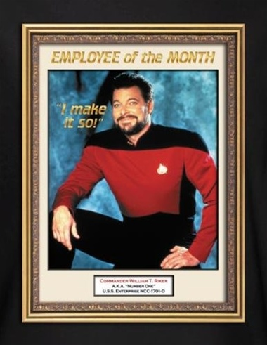
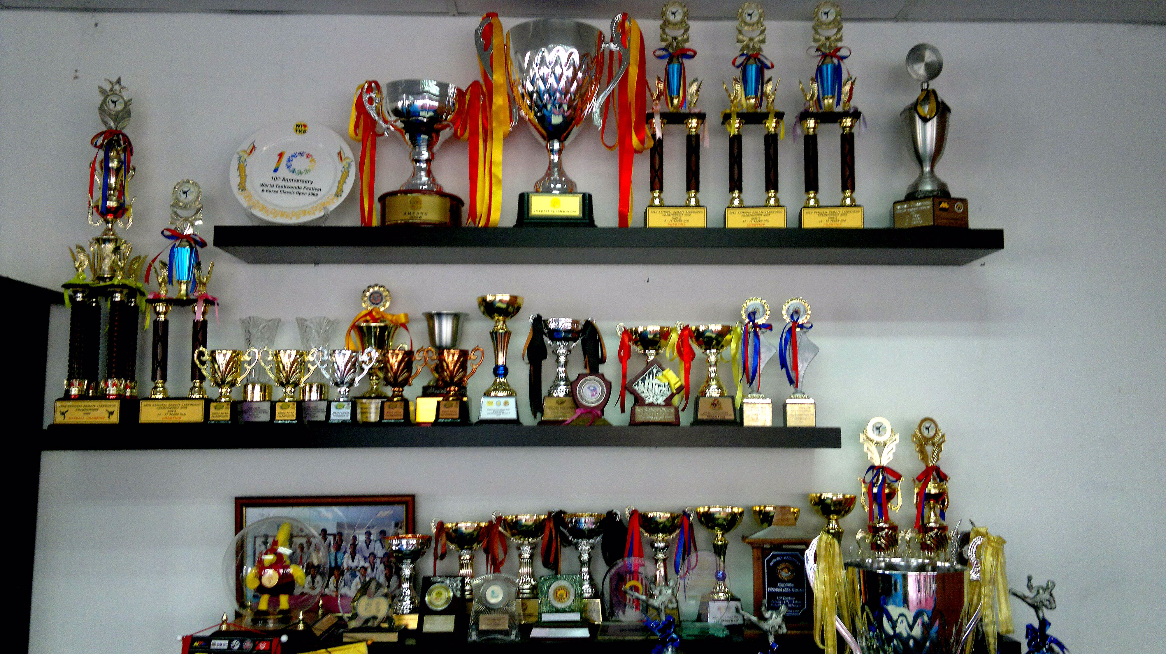
WHAT’S AN IDOL?

Slide 11
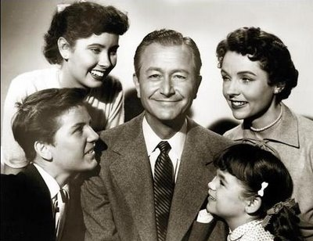
WHAT’S AN IDOL?

Slide 12
DONNIE BRASCO

Slide 13
1
DON’T IDOLIZE
ANYTHING

Slide 14
LUKE 10
You must love the Lord your God with all your heart, all your soul, all your strength, and all your mind.

Slide 15
IDOLS WILL ALWAYS
DISAPPOINT YOU

Slide 16
JEREMIAH 10:14
The whole human race is foolish and has no knowledge! The craftsmen are disgraced by the idols they make, for their carefully shaped works are a fraud. These idols have no breath or power.

Slide 19
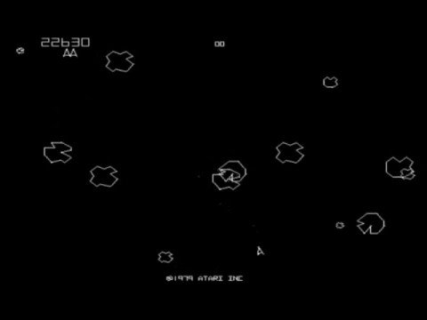

Slide 21
No man’s sky

Slide 22
IDOLS WILL
DOMINATE YOU

Slide 23
1 CORINTHIANS 12:2
(before you knew Christ) you were controlled by dead idols, who always led you astray.

Slide 25
1 CORINTHIANS 6:12
You say, “I am allowed to do anything”—but not everything is good for you. And even though “I am allowed to do anything,” I must not become a slave to anything.

Slide 28
IDOLS WILL
DEFORM AND DESTROY YOU

Slide 29
PSALM 115:8
And those who make idols are just like them,
as are all who trust in them.

Slide 30
2
WORSHIP
ONLY GOD

Slide 31
EXODUS 20:5
You must not bow down to them or worship them, for I, the Lord your God, am a jealous God who will not tolerate your affection for any other gods.

Slide 33
ROMANS 1:25
they worshiped and served the things God created instead of the Creator himself, who is worthy of eternal praise!

Slide 35
We want to limit god’s location

Slide 36
We want to limit god’s location
We want to reduce god’s power and size

Slide 37
Genesis 1:27
So God created human beings in his own image. In the image of God he created them; male and female he created them.

Slide 38
“Much of our difficulty as seeking Christians stems from our unwillingness to take God as He is and adjust our lives accordingly. We insist upon trying to modify Him and to bring Him nearer to our own image…We can get a right start only by accepting God as He is and learning to love Him for what He is. As we go on to know Him better we shall find it a source of unspeakable joy that God is just what He is. Some of the most rapturous moments we know will be those we spend in reverent admiration of the Godhead. In those holy moments the very thought of change in Him will be too painful to endure.”
-AW Tozer

Slide 39
We want to limit god’s location
We want to reduce god’s power and size

Slide 40
We want to limit god’s location
We want to reduce god’s power and size
We want to control God

Slide 42
Psalm 34:8
Taste and see that the Lord is good.

