Slide 1
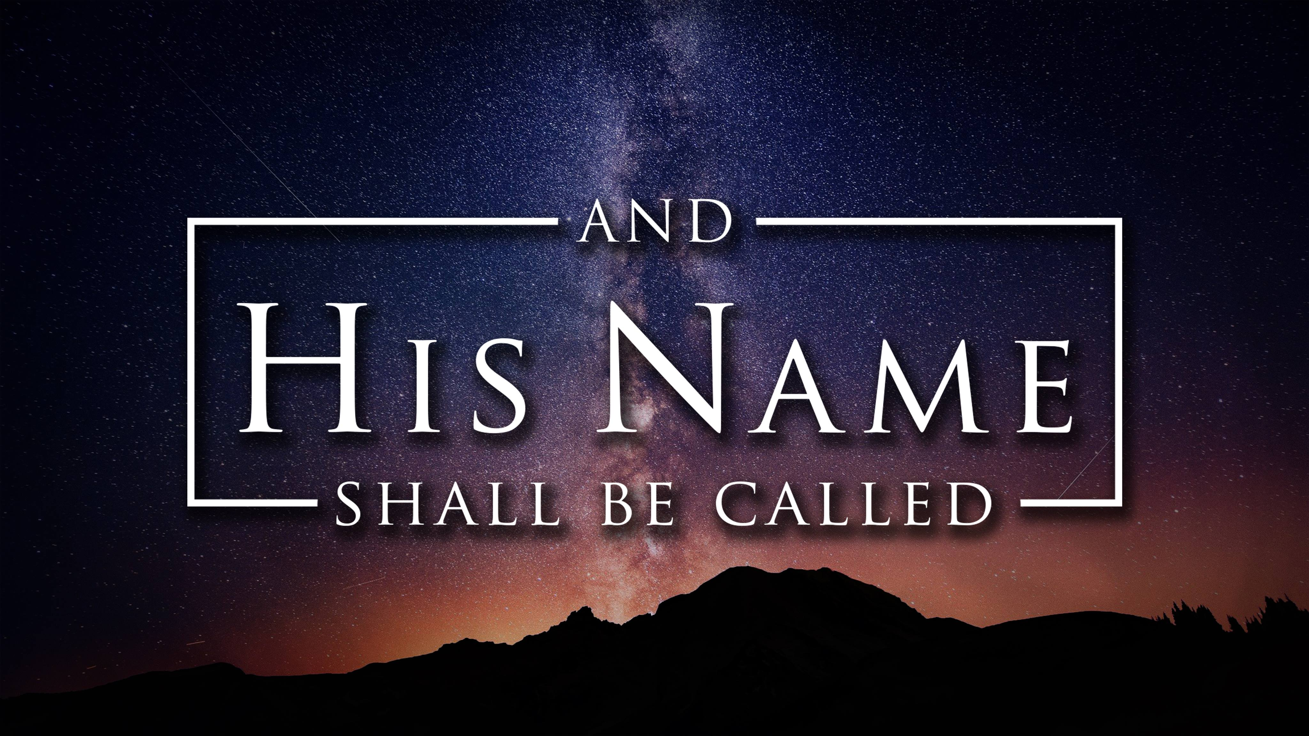

Slide 2
The Messiah

Slide 3
The next day John saw Jesus coming toward him and said, “Look! The Lamb of God who takes away the sin of the world! He is the one I was talking about when I said, ‘A man is coming after me who is far greater than I am, for he existed long before me.’ I did not recognize him as the Messiah, but I have been baptizing with water so that he might be revealed to Israel.”
John 1:29-31

Slide 4
Then John testified, “I saw the Holy Spirit descending like a dove from heaven and resting upon him. I didn’t know he was the one, but when God sent me to baptize with water, he told me, ‘The one on whom you see the Spirit descend and rest is the one who will baptize with the Holy Spirit.’ I saw this happen to Jesus, so I testify that he is the Chosen One of God.”
John 1:32-34

Slide 5
The Messiah – Anointed One

Slide 6
The Messiah – Anointed Ones
Prophets, Priests, Kings

Slide 8
Jesus is the Messiah – The Anointed One
“You are a priest forever in the order of Melchizedek.”
Psalm 110:4

Slide 10
1
Follow the Messiah Because
We Need Protection
“When John’s two disciples heard this, they followed Jesus.”
John 1:37

Slide 12
2
Listen to the Messiah
To See Clearly
Jesus looked around and saw them following. “What do you want?” he asked them. They replied, “Rabbi” (which means “Teacher”), “where are you staying?” “Come and see,” he said.
John 1:38

Slide 13
Nicodemus: physical birth / spiritual birth (John 3:3–8)
Woman at the well: physical water / spiritual water (John 4:7–14)
Crowds: physical bread / living bread (John 6:30–51)
Blind man: physical sight / spiritual sight. (John 9:39)

Slide 15
3
Trust the Messiah Because
He Knows You Completely
“How do you know about me?” Nathanael asked.
John 1:48

Slide 16
And I will give to each one a white stone, and on the stone will be engraved a new name that no one understands except the one who receives it.
Revelation 2:17

Slide 18
4
Tell About the Messiah
Everywhere
Andrew went to find his brother, Simon, and told him,
“We have found the Messiah”
John 1:41

Slide 20
Jesus is…
Wonderful Counselor, Mighty God, Everlasting Father, Prince of Peace,
Immanuel, Son of God, Son of Man, Holy One, Savior, Messiah, Teacher, Lamb of God, Lord of Lords, and King of Kings!

