Slide 2
TALKING ABOUT JESUS ON
MARS HILL

Slide 3
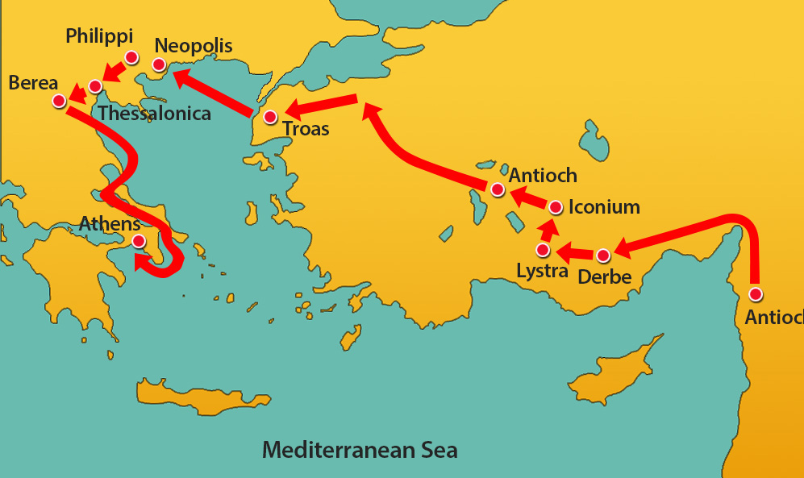

Slide 4
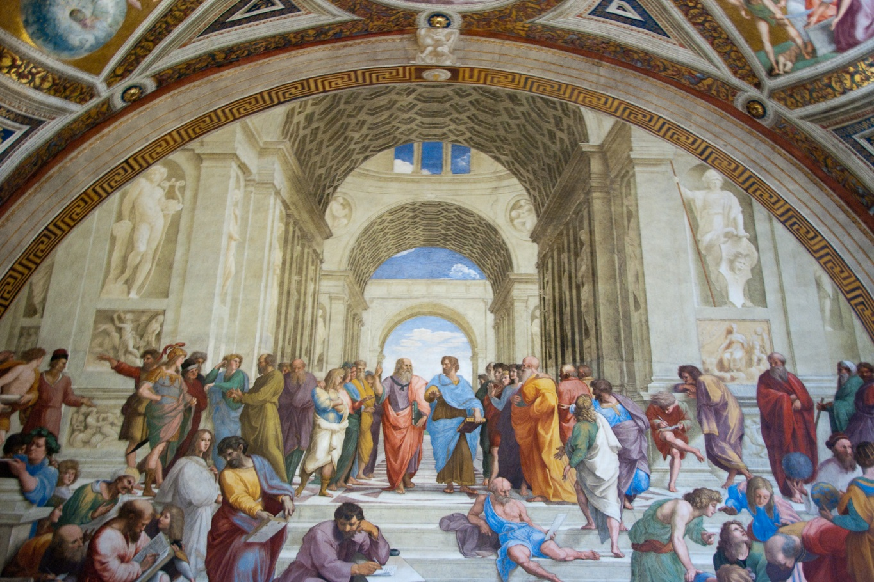
Epicurean and Stoic philosophers

Slide 5
http://www.tlc.org/acts/
0:00 – 2:48

Slide 7
1
START
WHERE THEY ARE

Slide 8
“Men of Athens, I notice that you are very religious in every way, for as I was walking along
I saw your many shrines.”
Acts 17:22-23 new living translation

Slide 10
2
DEFINE GOD

Slide 11
“…one of your altars had this inscription on it: ‘To an Unknown God.’ This God, whom you worship without knowing, is the one I’m telling you about.”
Acts 17:22-23 new living translation

Slide 12
Zeus: sky god, along with Hades and Poseidon, Zeus shared the rule of the world
Euthenia: goddess of prosperity
Athena: the goddess of wisdom; politics.
Hades: god of the underworld
Nike: the goddess of victory
Aphrodite: goddess of sexuality, beauty, fertility.
Cloacina: the goddess of the sewer system.

Slide 14
God is the Maker
²⁴ He is the God who made the world and everything in it.
God is the Ruler ²⁴ Since he is Lord of heaven and earth, he doesn’t live in man-made temples
God is the Giver
²⁵ He himself gives life and breath to everything,
Acts 17:24-25 new living translation

Slide 16
3
EXPLAIN
THAT GOD REWARDS SEEKERS

Slide 17
“His purpose was for the nations to seek after God and perhaps feel their way toward him and find him—though he is not far from any one of us. For in him we live and move and exist. As some of your own poets have said,
‘We are his offspring.’
Acts 17:27-28 new living translation

Slide 18
“Keep on asking, and you will receive what you ask for. Keep on seeking, and you will find. Keep on knocking, and the door will be opened to you. For everyone who asks, receives. Everyone who seeks, finds. And to everyone who knocks, the door will be opened.
Matthew 6:7-8 new living translation

Slide 19
In Ourselves
In Nature

Slide 20
You will never find a man, woman, boy, or girl who does not have a passion for life, who does not want to live, who is not in revolt against death and boredom and frustration and all the other negative qualities of life. They all want to seize hold of life. And you will never find a man, woman, boy or girl who does not want to succeed, who does not want to reach out and try something new and accomplish new objectives, to conquer new territory. That is because man is made in the image of God. Further, you will never find a human being who does not have some power to create, to invent, some ability to produce or fashion or make or shape.
-Ray Stedman

Slide 21
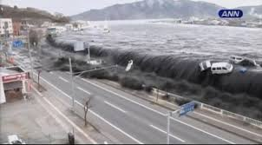

Slide 23
4
PROCLAIM
GOD IS THE ULTIMATE JUDGE

Slide 24
““God overlooked people’s ignorance about these things in earlier times, but now he commands everyone everywhere to repent of their sins and turn to him. For he has set a day for judging the world with justice by the man he has appointed, and he proved to everyone who this is by raising him from the dead.”
Acts 17:30-31 new living translation

Slide 25
““God overlooked people’s ignorance about these things in earlier times, but now he commands everyone everywhere to repent of their sins and turn to him. For he has set a day for judging the world with justice by the man he has appointed, and he proved to everyone who this is by raising him from the dead.”
Acts 17:30-31 new living translation

Slide 27
5
YOU CAN’T CONTROL THE
RESPONSE

Slide 28
When they heard Paul speak about the resurrection of the dead, some laughed in contempt, but others said, “We want to hear more about this later.” That ended Paul’s discussion with them, but some joined him and became believers.
Acts 17:32-34 new living translation

Slide 30
The gospel is fundamentally an announcement, not an explanation.

